Slide 1
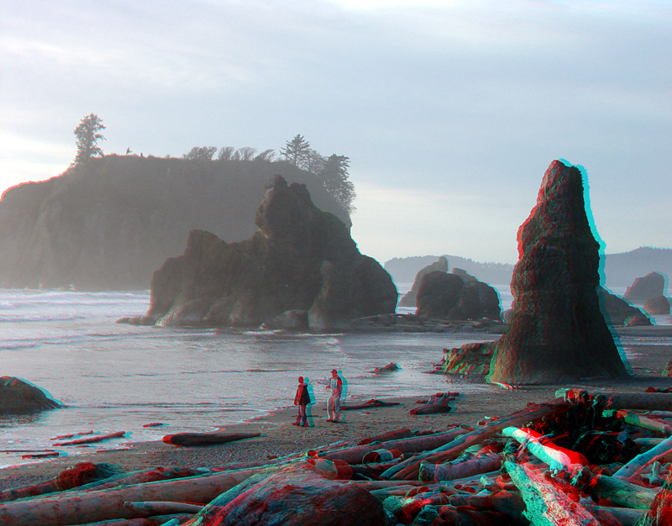
Anaglyph 3D
Anaglyph 3D is the stereoscopic 3D effect achieved by means of encoding each eye's image using filters of different (usually chromatically opposite) colors, typically red and cyan. Anaglyph 3D images contain two differently filtered colored images, one for each eye. When viewed through the "color-coded" "anaglyph glasses", each of the two images reaches the eye it's intended for, revealing an integrated stereoscopic image. The visual cortex of the brain fuses this into the perception of a three-dimensional scene or composition.

Slide 2
An image demonstrating binocular rivalry. If you view the image with red-cyan 3D glasses, the text will alternate between Red and Blue.

Slide 4
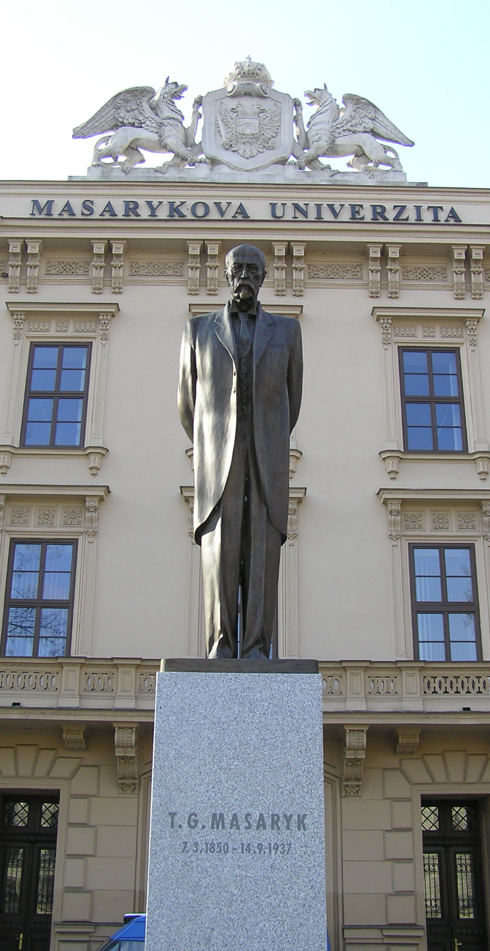
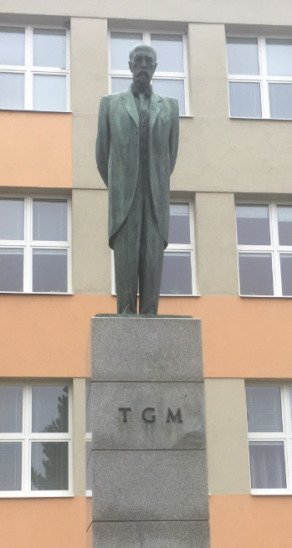

Slide 5
www.zoner.eu
ZONER a.s. is a European company based in Brno, with branches in Slovakia, Hungary, Japan and the USA, which is engaged in software development and distribution, and is also a leading provider of Internet services related to Internet presentations and e-commerce. The company is divided into four departments (photographic software, Internet services, online security and publishing), each of which has its own director and the whole company is headed by a single chairman of the board of directors. There are over 100 employees in ZONER a.s.

Slide 6
Zoner Photo Studio is software used by millions of photographers all over the world. The latest X version will help you download pictures onto your computer, organise, edit and share them, and even make photo books, calendars and other photo-items.
The software division was founded in 1993 with the main purpose of bringing a high quality graphic program in Czech language onto the Czech market. Due to the program’s high quality and popularity on the Czech market, localisations in a number of languages were requested and Zoner Photo Studio has fans all over the world, especially in the USA, Canada, Great Britain, Germany, Japan, Russia and Spain. Zoner Photo Studio has also crossed the magic line of ten million installations.

Slide 7
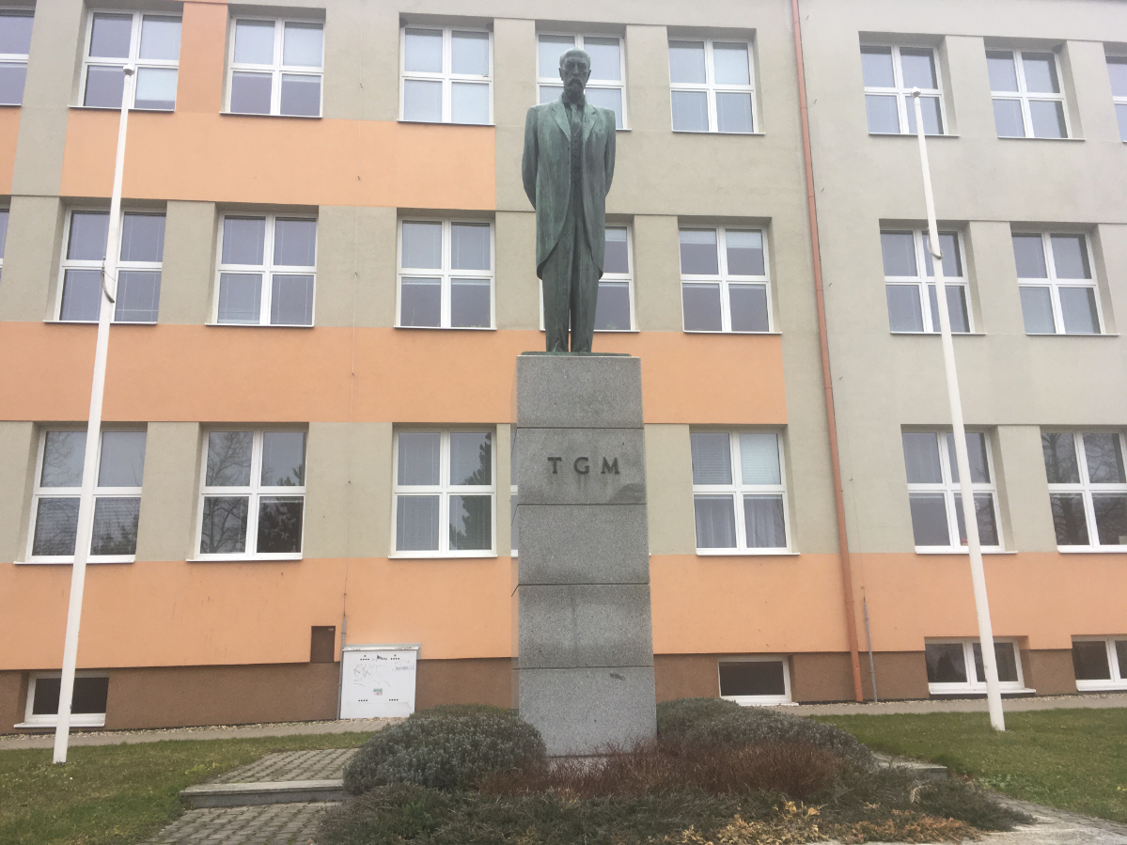
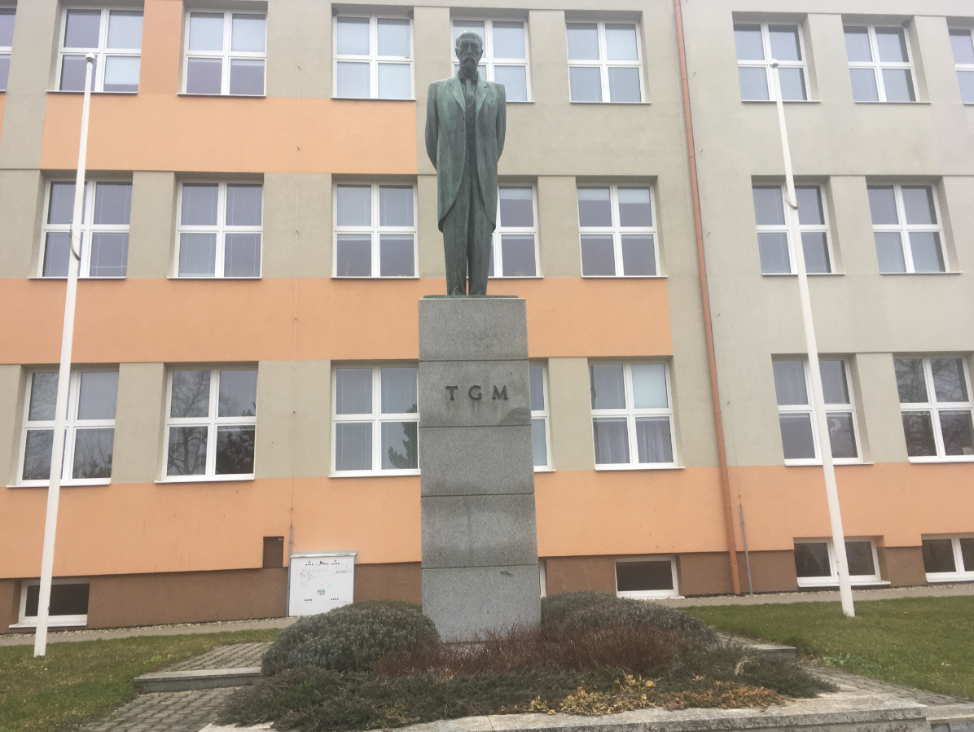

Slide 8
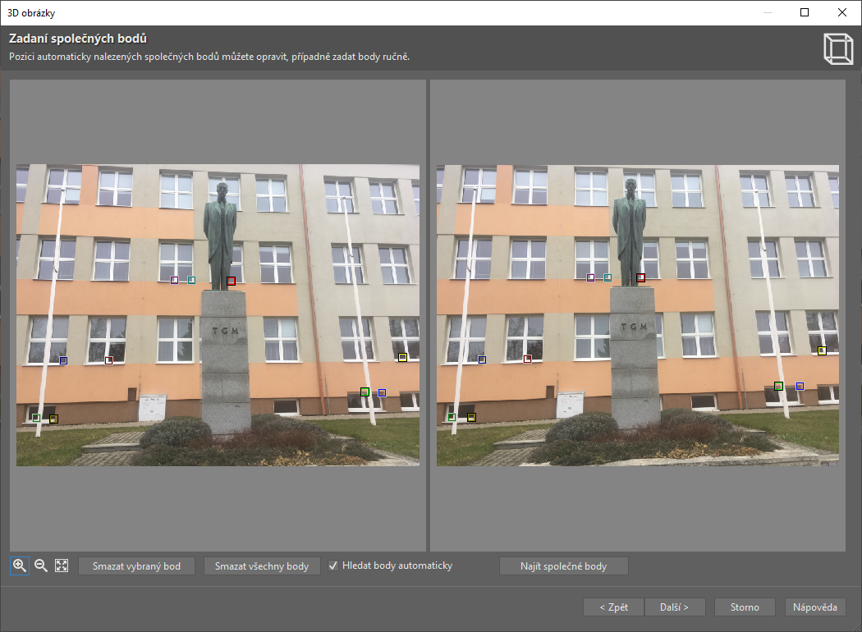

Slide 9
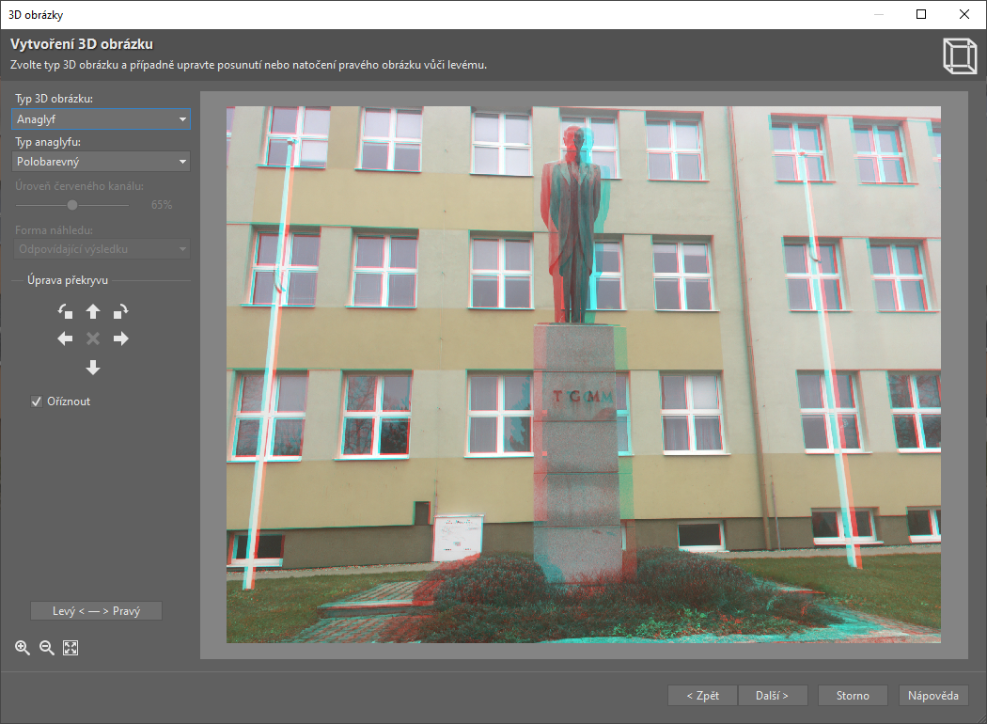

Slide 10
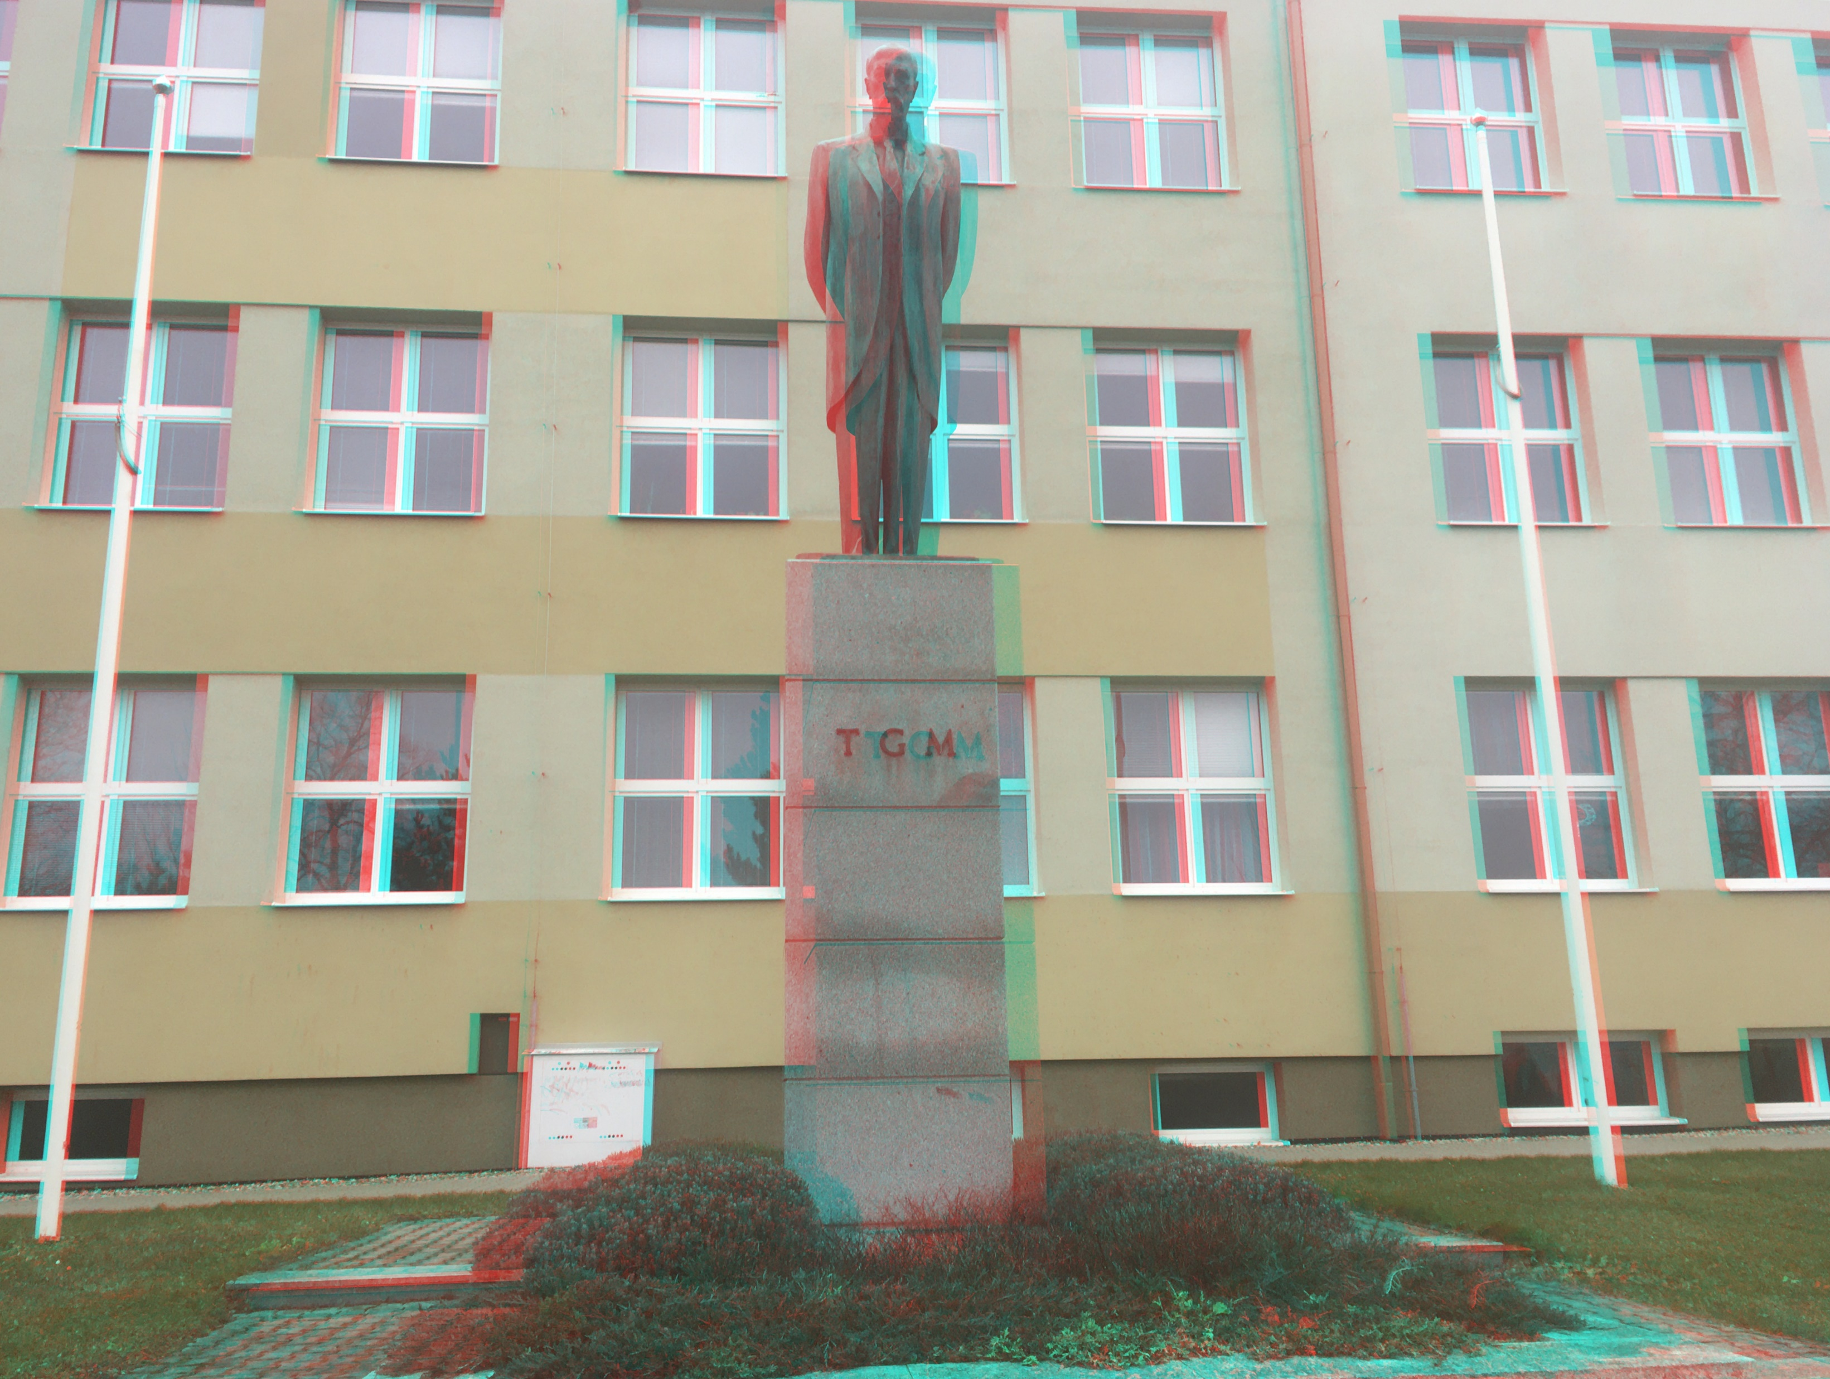

Slide 11
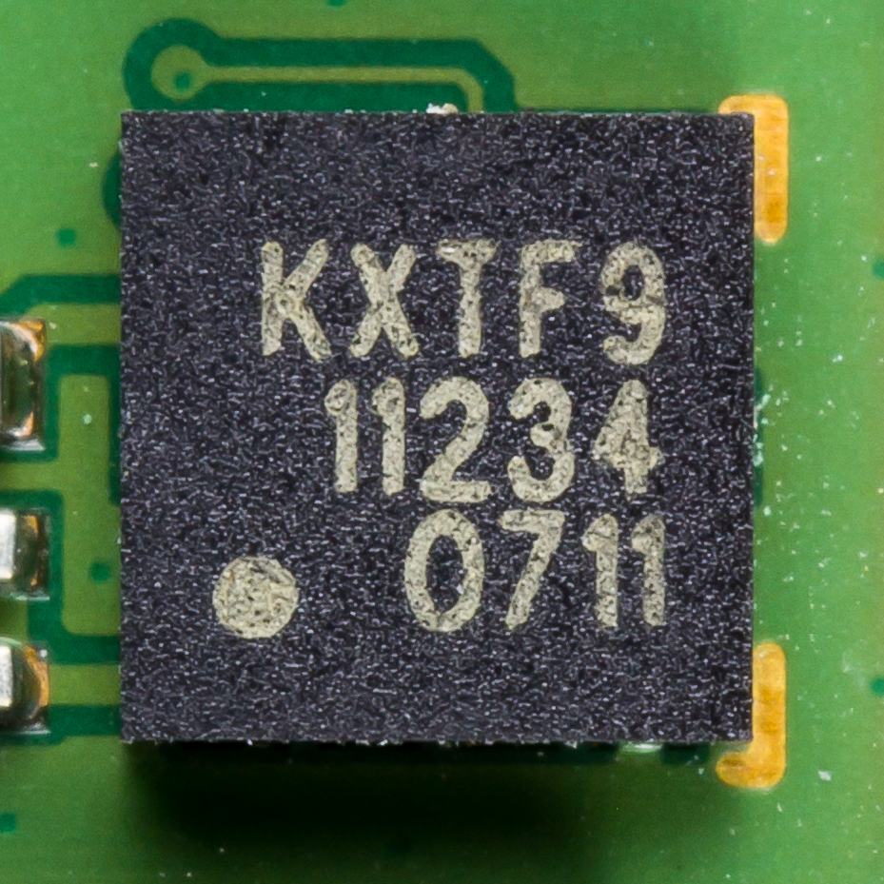
Accelerometer
An accelerometer is a tool that measures proper acceleration.
Proper acceleration is the acceleration (the rate of change of velocity) of a body in its own instantaneous rest frame
a_{g} = 9,823 m·s⁻²

Slide 12
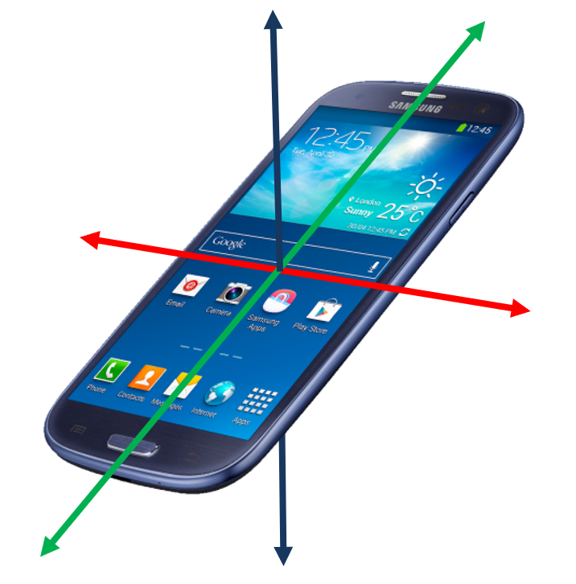
https://www.youtube.com/watch?v=KZVgKu6v808

Slide 13
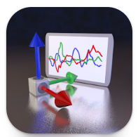
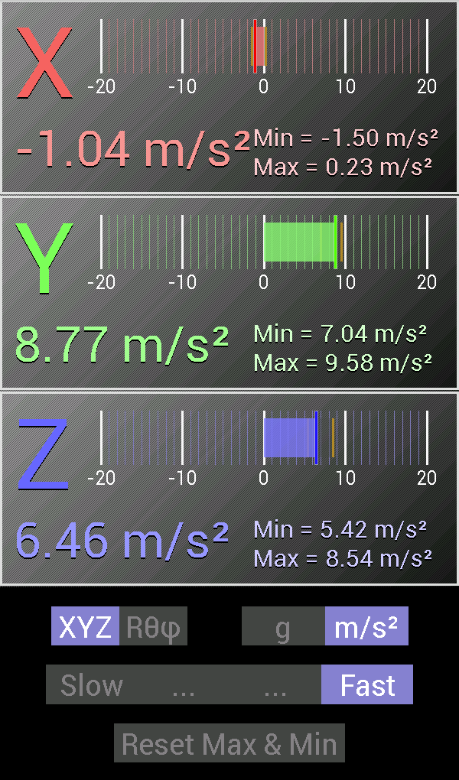
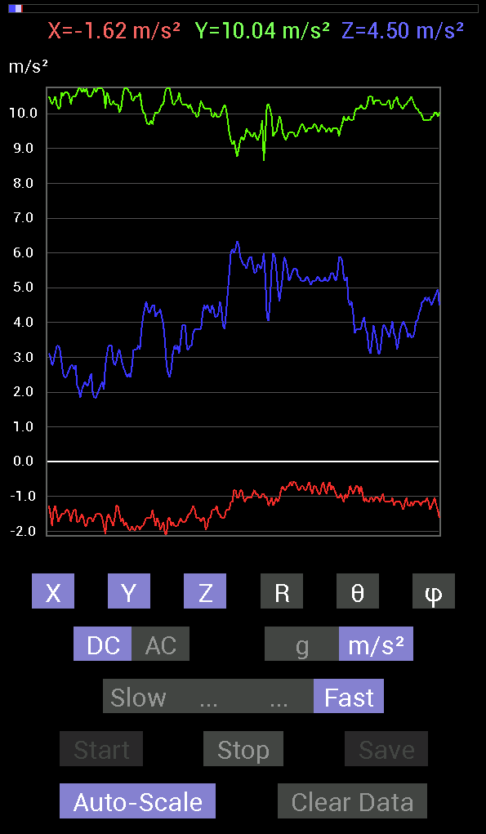
Accelerometer

Slide 14
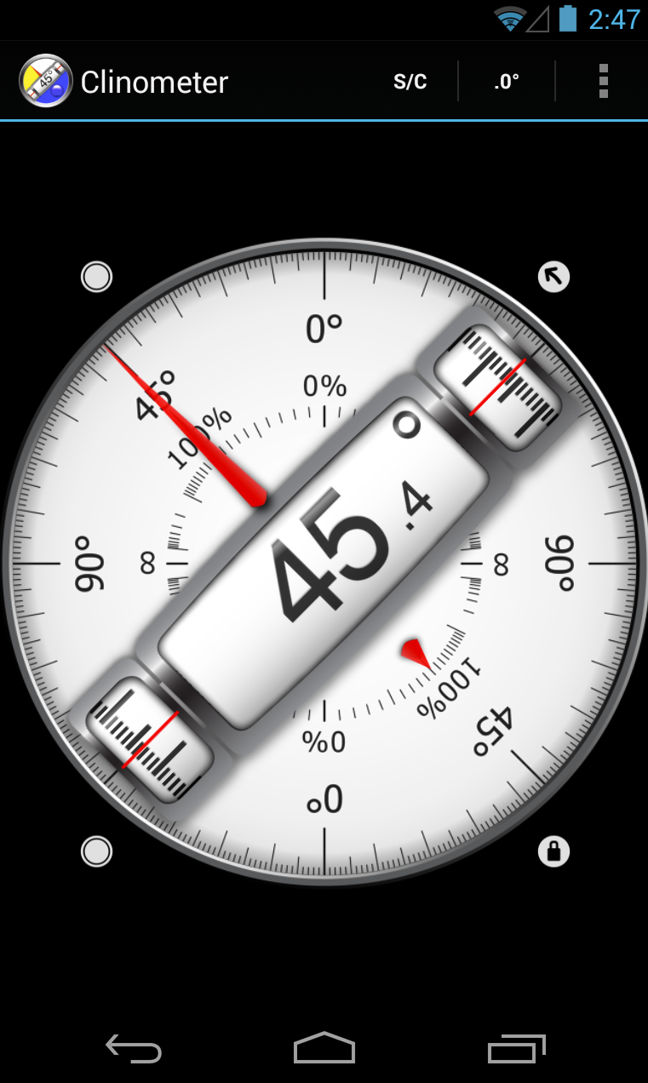
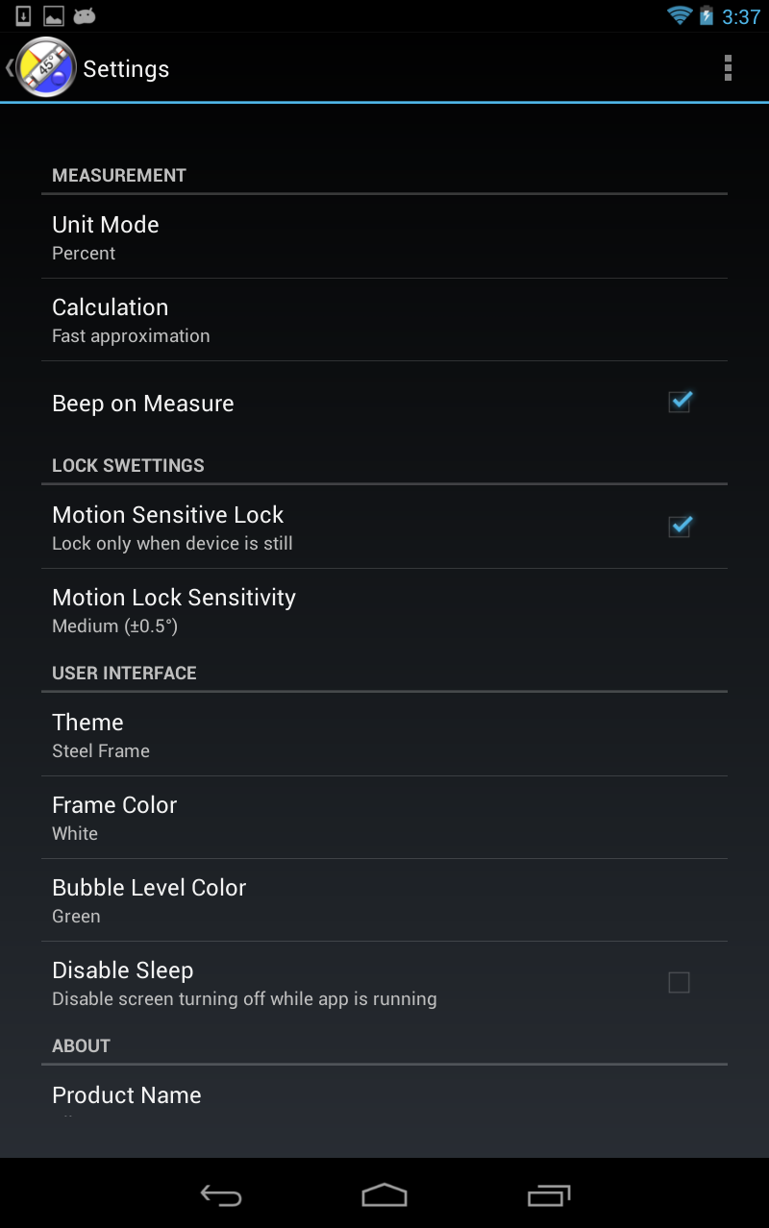
Clinometer + bubble level

Slide 15
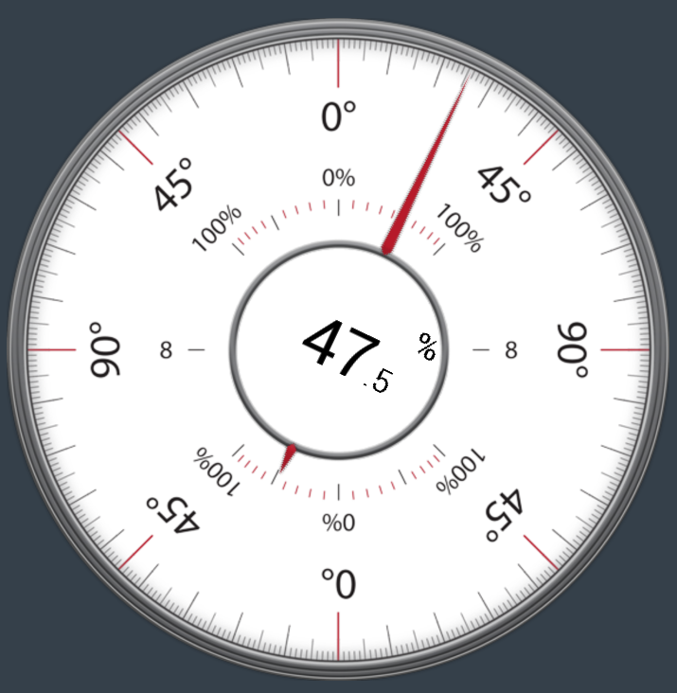
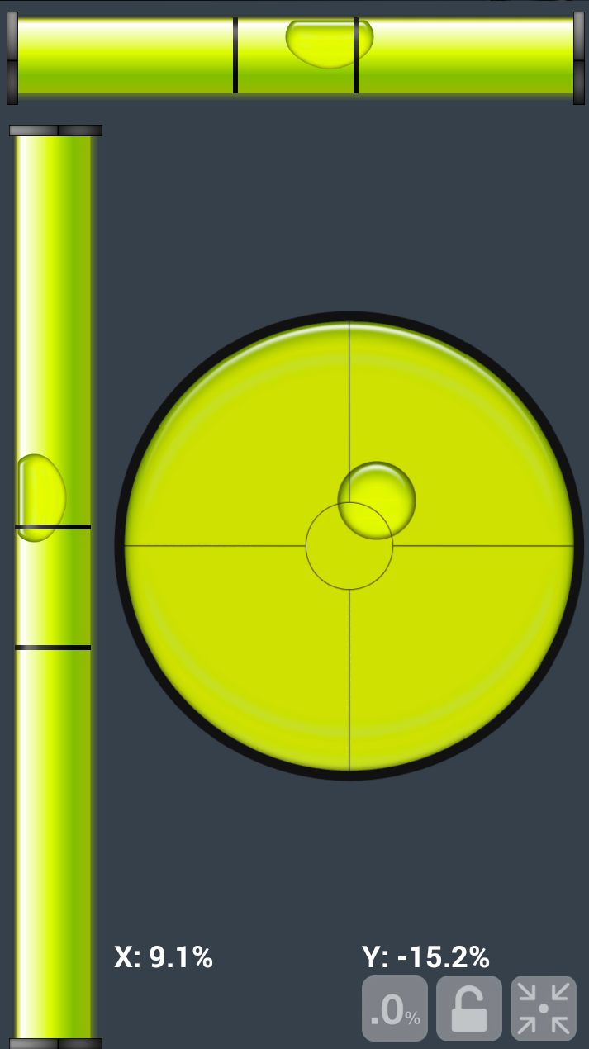
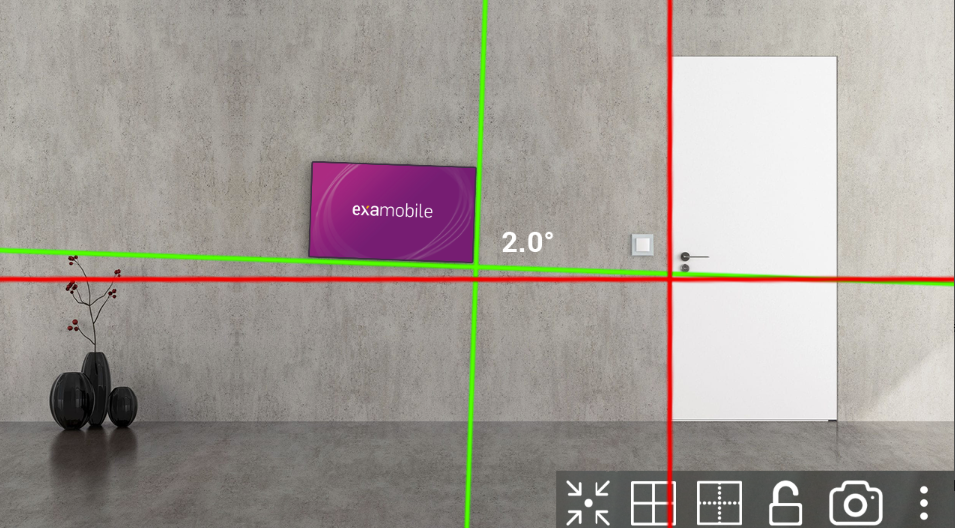
Laser Level

Slide 16
Heart Monitor

Slide 17
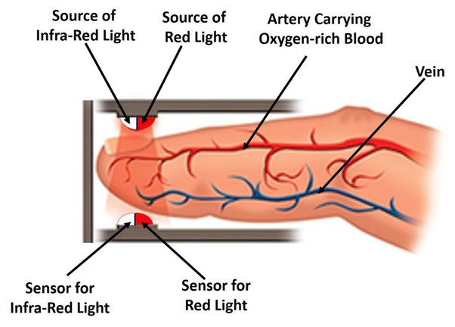
Pulse oximetry
a noninvasive method for monitoring a person's oxygen saturation
https://www.youtube.com/watch?v=N3MCvREORVA

Slide 18
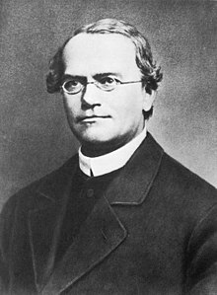
Gregor Johann Mendel
20 July 1822 – 6 January 1884
Gregor Johann Mendel is one of the most significant men in all of history, not only that of Brno. In 1866, he published the famous paper ‘Experiments on Plant Hybridisation’, which laid the groundwork for modern genetics. This renowned scientist spent a major part of his life in Brno.

Slide 19
Gregor Johann Mendel
He was born on 20 July 1822, in the Moravian-Silesian town of Hynčice, not far from what is now Nový Jičín. After finishing his studies at the grammar school in Opava, he continued at the University of Olomouc (which is now Palacký University Olomouc). He later joined the seminary, and in 1843 joined the Augustinian Abbey of St Thomas in Staré Brno (Old Brno) where he was given the name Gregor.

Slide 20
Gregor Johann Mendel
When he was 28 years old and working as a substitute secondary school teacher in Znojmo, he applied to the University of Vienna to take biology and physics tests to become a certified teacher but failed them. Between 1851 and 1853, he studied mathematics, physics, chemistry, botany, zoology, and palaeontology at the University of Vienna. Returning to Brno, from 1856 he studied the cross-breeding of peas. Based on his experiments, he formulated three rules, later known as Mendel’s laws of inheritance. In 1867, he became the abbot of the Abbey of St Thomas and was soon appointed to additional positions, which meant that he had to put aside his research. He spent the last ten years of his life in an exhausting dispute with the Austrian government over taxes on abbey properties.

Slide 21
Gregor Johann Mendel
Although Mendel was among the most significant citizens of Brno during his life, his contribution to biology was fully appreciated only after his death.
https://www.youtube.com/watch?v=mUr_ezQv1sY

Slide 22
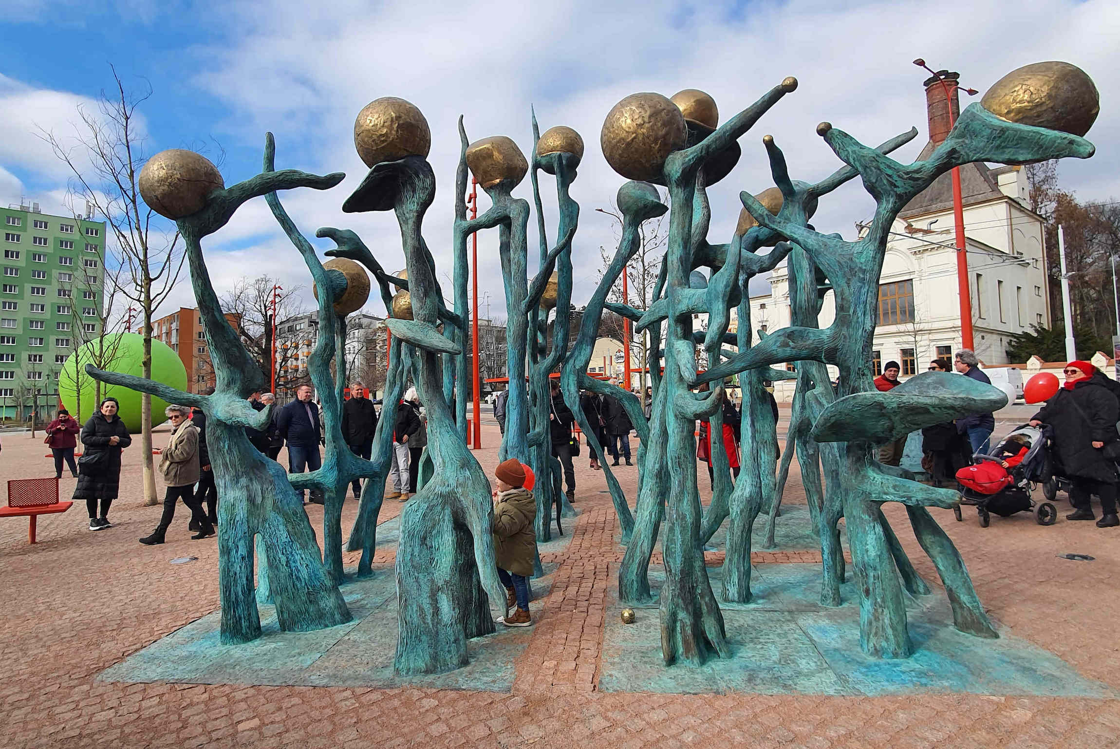
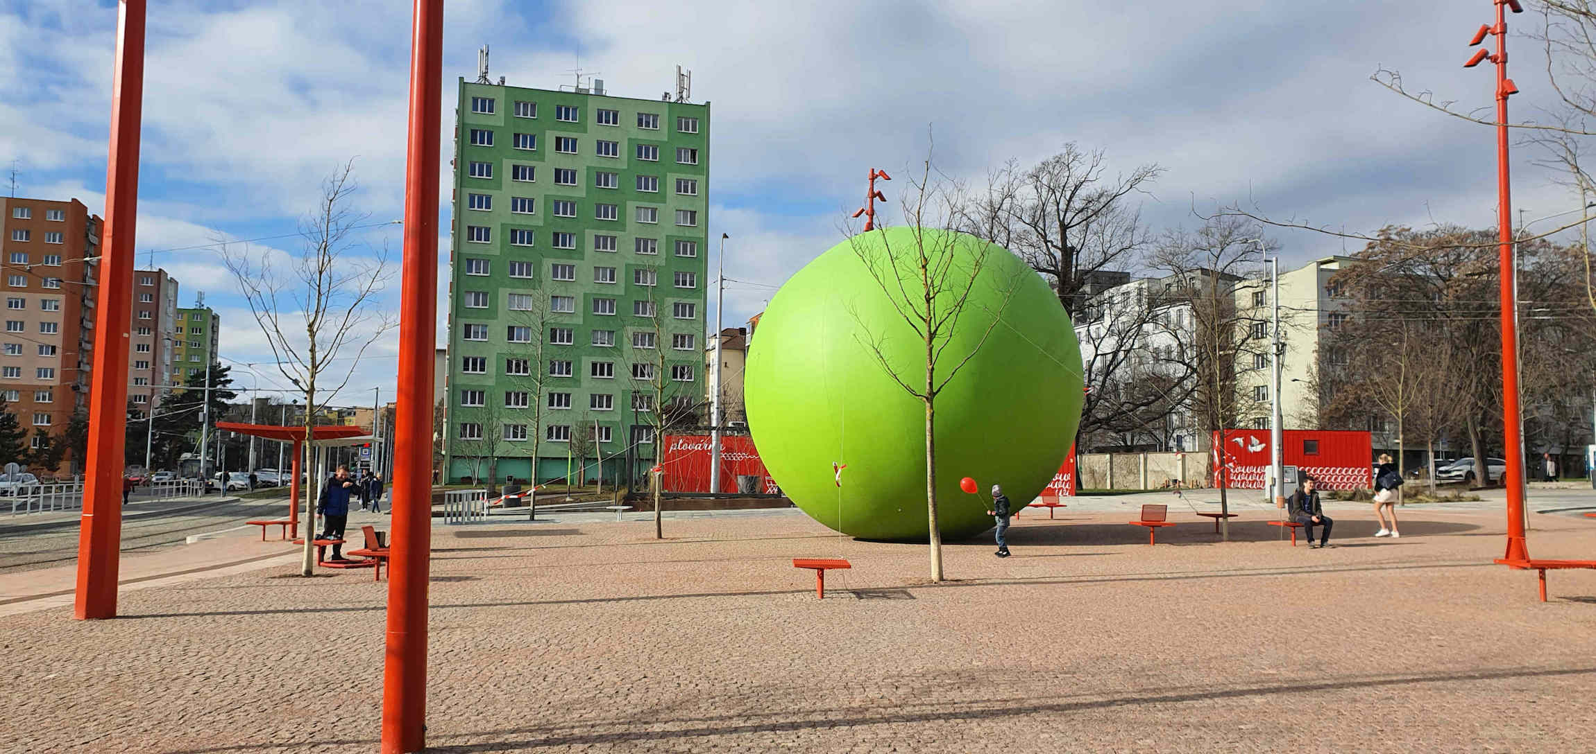
Mendel Square

Slide 23
Mendel Square
This historical square is located in the area of Old Brno
Until the end of the 1950s, Mendel Square was a large public space with a park in front of the monastery and basilica, bordered on the south by a line of old houses that no longer exist. A few dozen metres from it were, for example, a municipal spa and the Old Brno town hall. During WW2, however, the square was damaged in an air raid. In the 1960s, the square was rebuilt based on a design by architect František Kočí that disrupted this part of the city and destroyed its historical value and peaceful atmosphere.

Slide 24
Mendel Square
The square is now dominated by the Abbey of St Thomas, which is closely associated with the activities of both Gregor Johann Mendel and Leoš Janáček. Visitors can hardly miss the monumental Gothic Bazilika Nanebevzetí Panny Marie (Basilica of the Assumption of Our Lady), whose collection of objects includes the Black Madonna painting worshipped as the protector of the city of Brno.

Slide 25
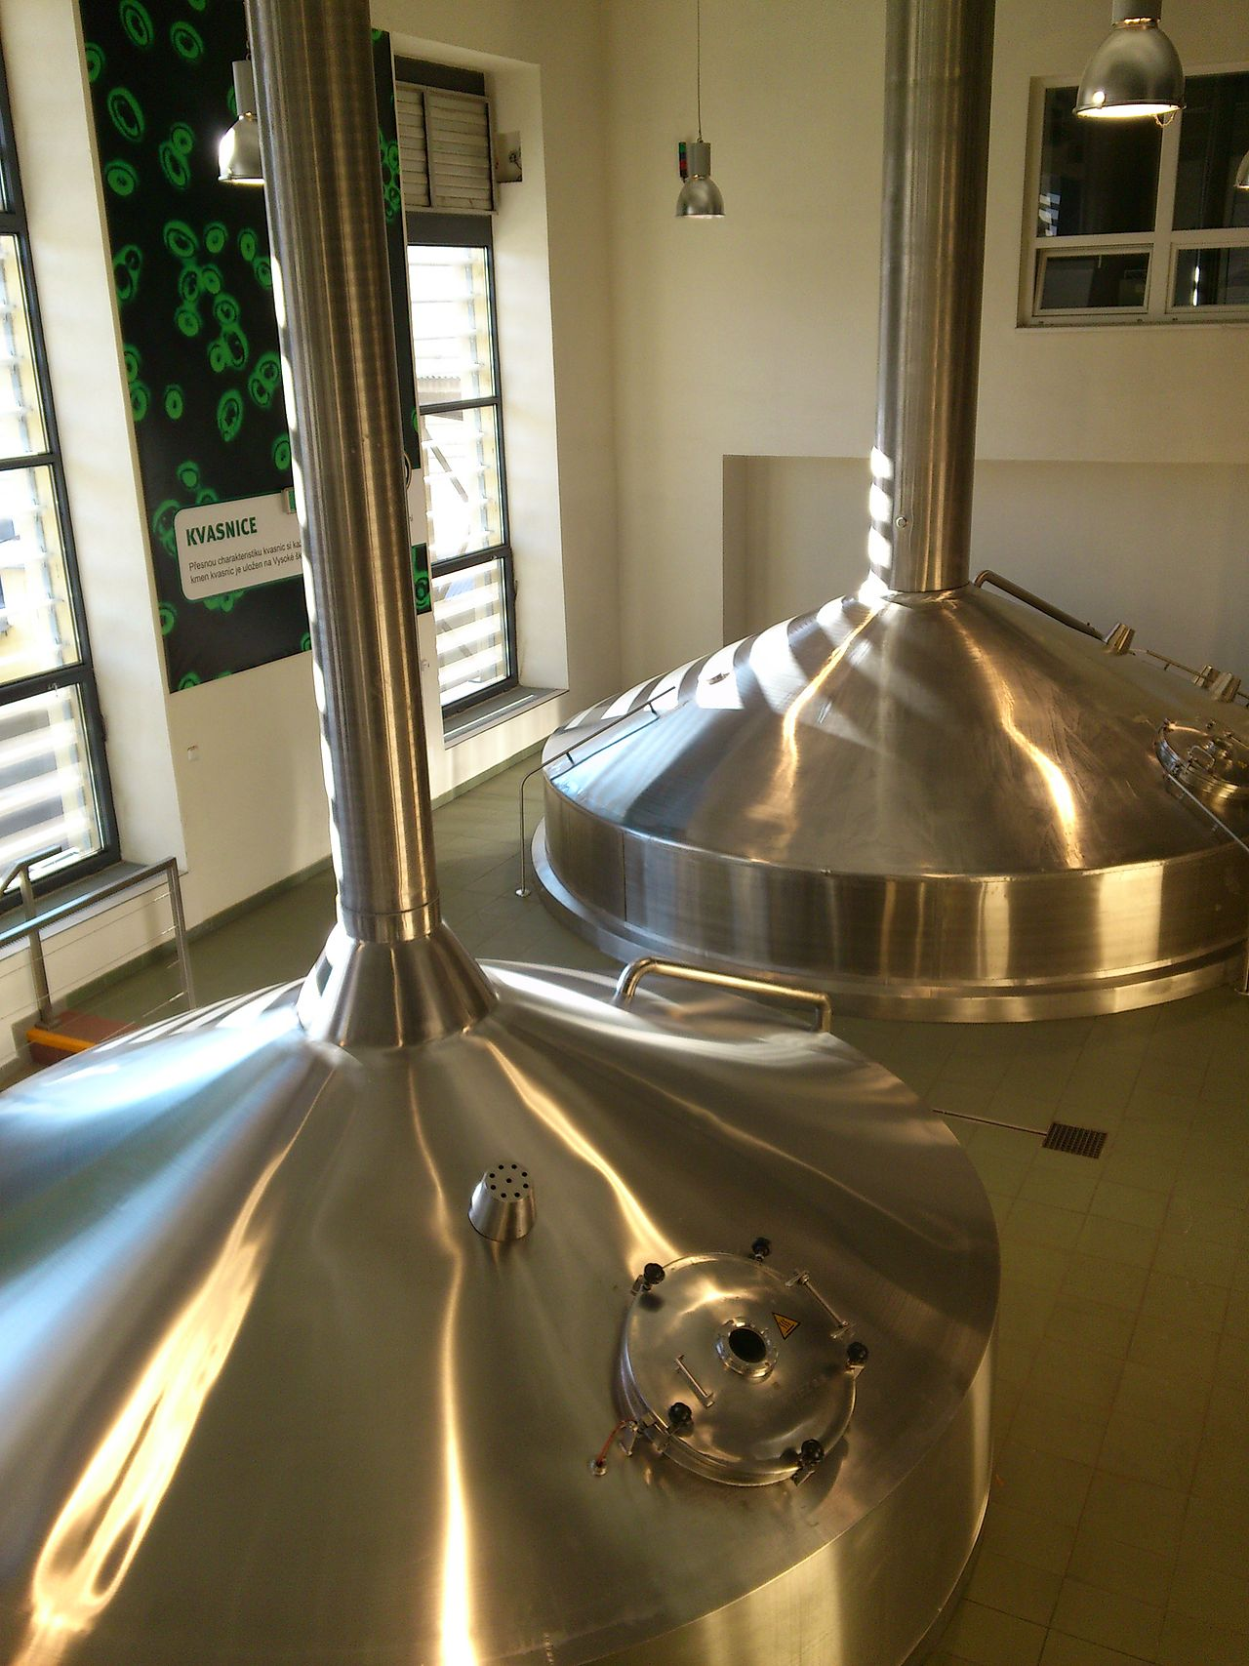
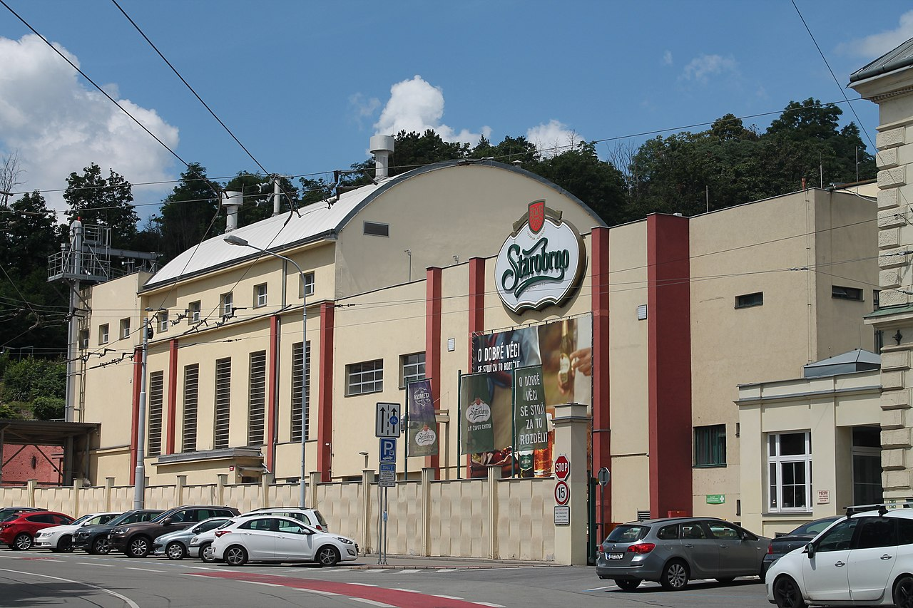
Mendel Square
For 140 years, the Starobrno brewery has been located close to the square. Although it has modern facilities, it keeps traditional production procedures alive and complements them with innovations and modern technologies. Its premises and production methods are open to tours by the public.

Slide 26
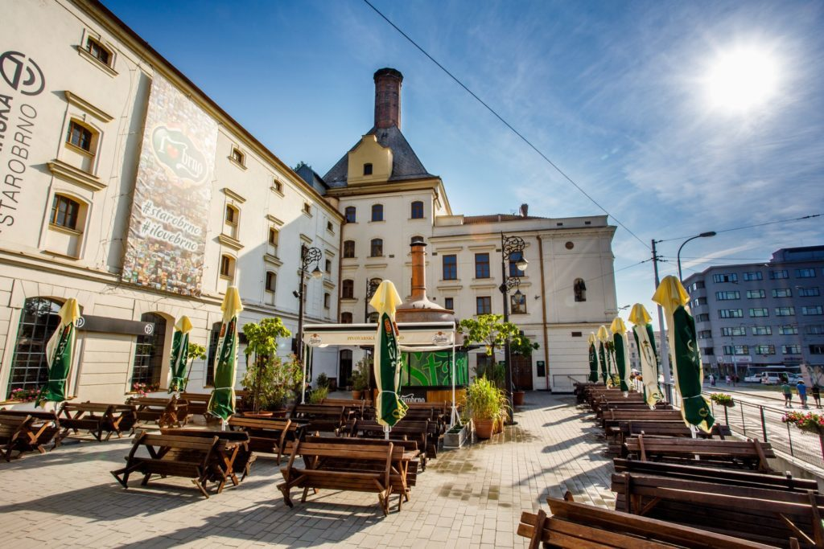
Starobrno Brewery

Slide 27
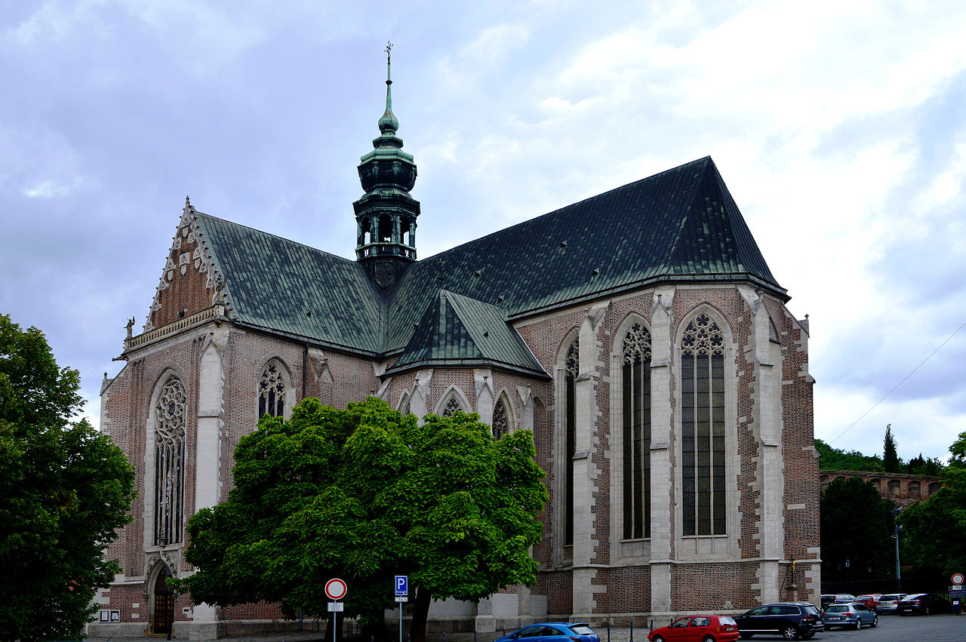
Basilica of the Assumption of Our Lady

Slide 28
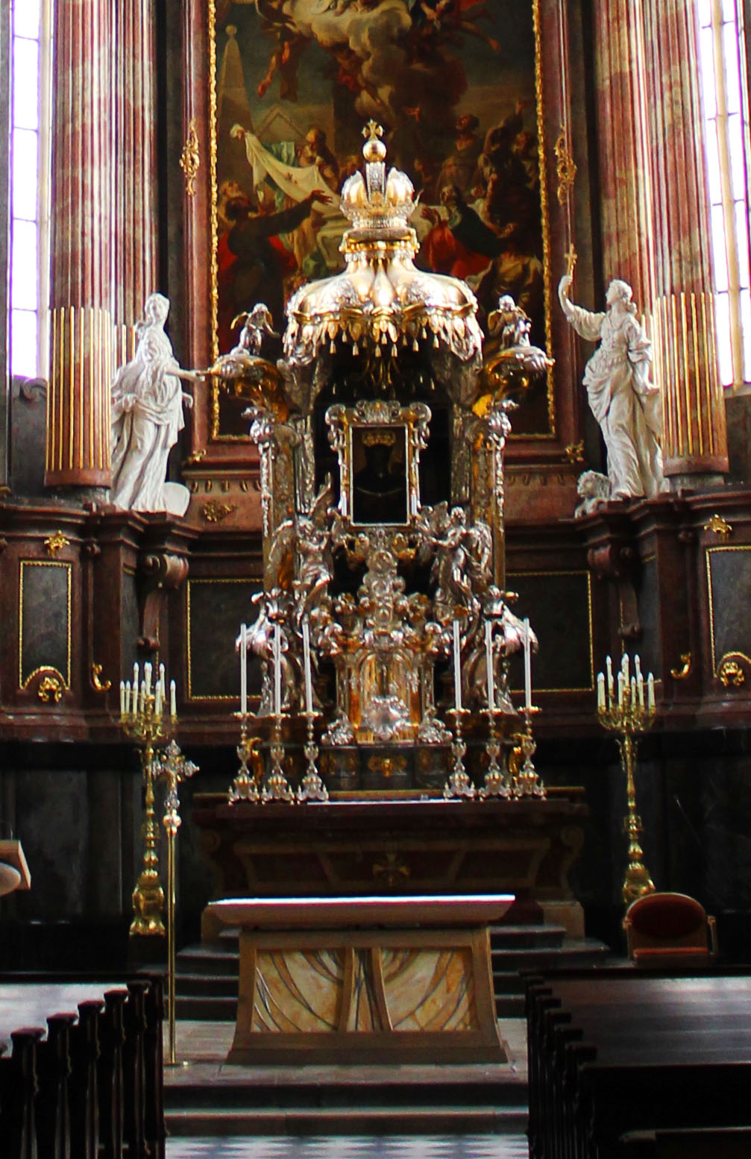
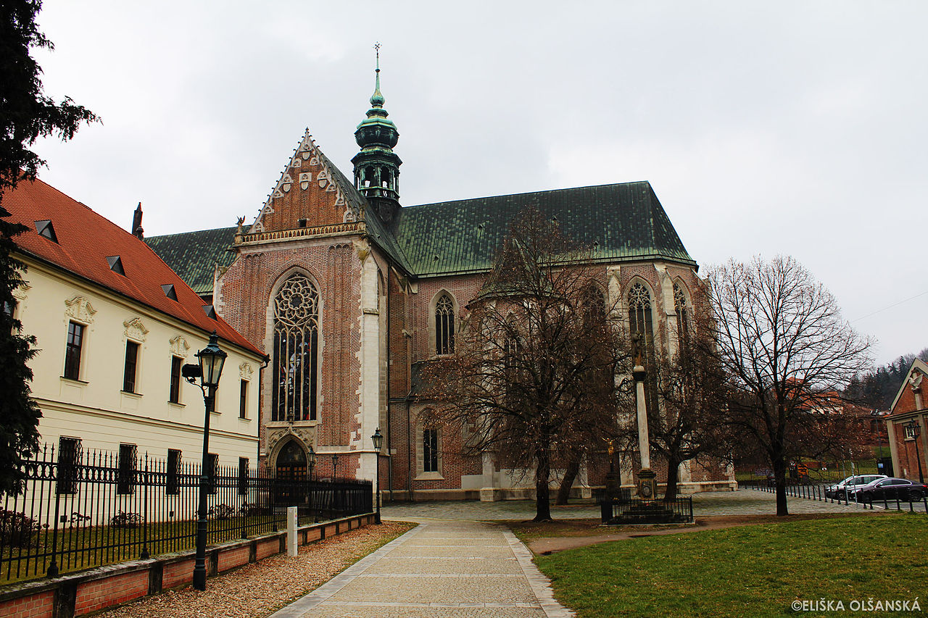
Basilica of the Assumption of Our Lady
Often described as a jewel of Gothic architecture in Moravia

Slide 29
Basilica of the Assumption of Our Lady
The construction of this church, dedicated to the Assumption of Our Lady, began in Staré Brno (Old Brno) in 1323. It was initiated by Queen Elisabeth Richeza, the widow of Czech King Václav II (Wenceslaus II of Bohemia). At the same time, she founded a women’s Cistercian cloister right next to the church called Aula Sanctae Mariae. When she died, she was buried in the basilica and her tomb was marked with an ‘E’ and a royal crown.

Slide 30
Basilica of the Assumption of Our Lady
The interior of the church underwent structural changes in the Baroque style in the 18th century while other buildings were being constructed in the abbey. Under orders from Emperor Joseph II, Augustinian friars moved from their original monastery to Mendlovo náměstí (Mendel Square) in 1783, bringing with them their famous silver altar dominated by a unique painting of the Black Madonna, which had been donated to the Church of St Thomas by Emperor Charles IV in 1356. A feast of the Protector of the City of Brno and the Pearl of Moravia, as the Black Madonna is nicknamed, is held every year in mid-August.

Slide 31
Basilica of the Assumption of Our Lady
The educational activities of the Augustinian Order made the abbey in Old Brno a centre of spiritual, scientific, and cultural life in the city. Two of the prominent men related to this place are Gregor Johann Mendel, who discovered the laws of genetic inheritance, and musical composer Leoš Janáček.

Slide 32
Basilica of the Assumption of Our Lady

