Slide 1

Prvky kovových konstrukcí
BOA002
Ing. Martin Vild, Ph.D.
04/2023

Slide 2



Prezentuje
Ing. Martin Vild, Ph.D.
IDEA StatiCa – Product Owner
VUT FAST – Odborný asistent
Výzkum:
Přípoje ocelových konstrukcí
Metoda konečných prvků
Scopus Author ID: 56188615700
Člen komisí:
CEN/TC 250/SC 3/WG 8 "Evolution of EN 1993-1-8 - Joints and connections“
ECCS TC10 “Structural Connections”
Web:
https://www.fce.vutbr.cz/KDK/vild.m/
email: martin.vild@vutbr.cz
Kancelář: C203
Konzultace:
Středa 12–13:40
Čtvrtek 14–16

Slide 3
Obsah
Klopení
Klopení – ESDEP course
Klopení – experiment
Klopení – AISC (USA)

Slide 4
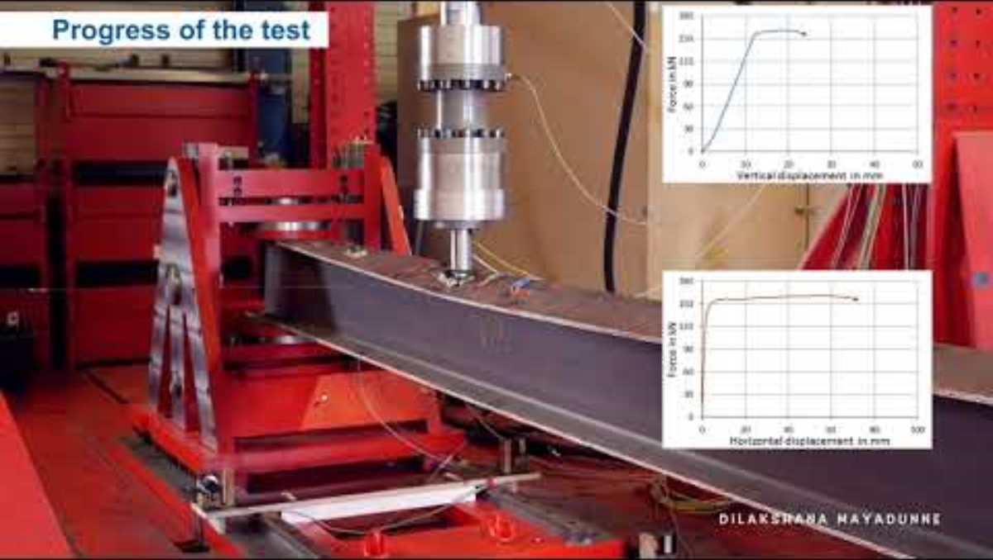

Slide 5
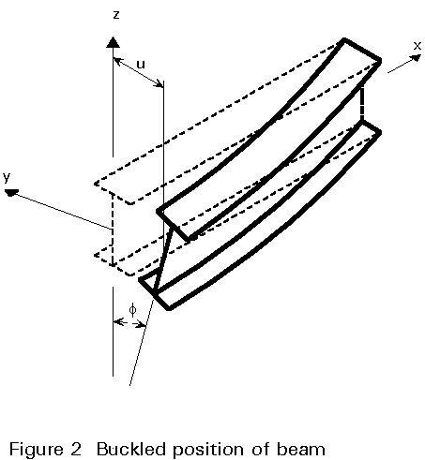
Klopení – postup
Metoda konečných prvků (GMNIA)
  Shell nebo Solid
  1-D prvky se 7 stupni volnosti (LTBeam)
EN 1993-1-1
  Klopení – obecné případy (6.3.2.2)
  Klopení – I-profily (6.3.2.3)
  Obecná metoda (6.3.4)

Slide 6
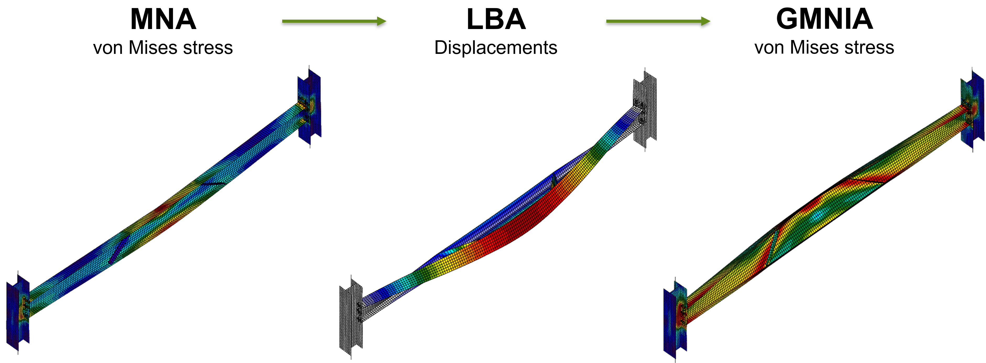
Klopení – MKP – Shellové prvky

Slide 7
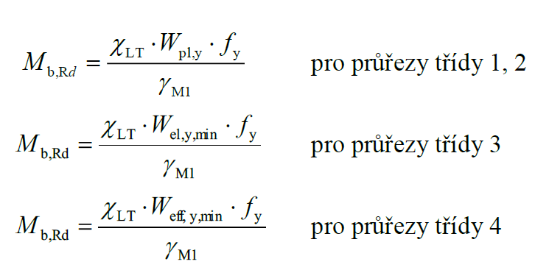
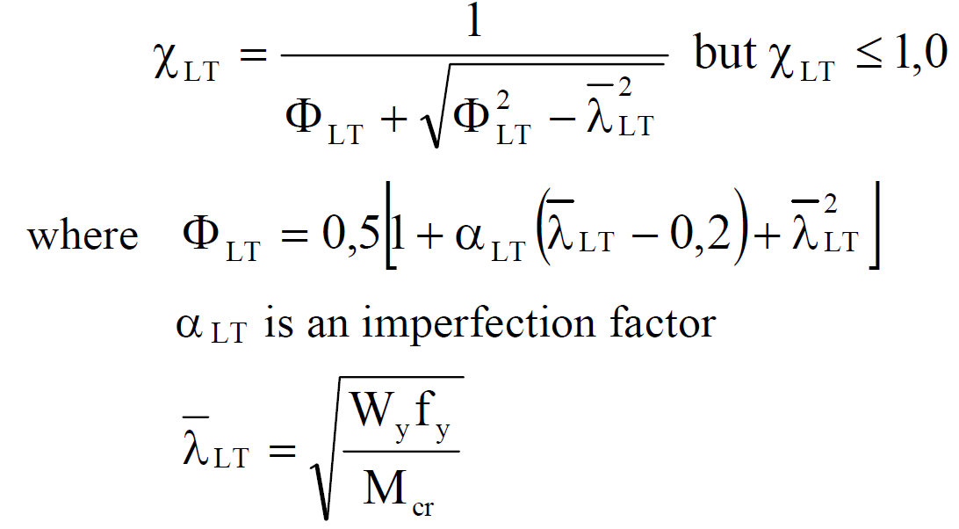
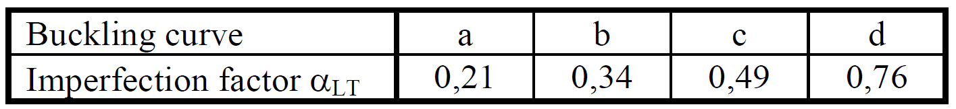
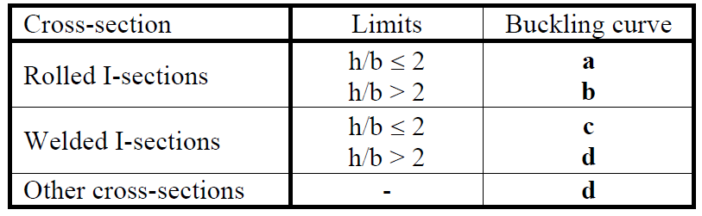
Klopení – obecné případy

Slide 8
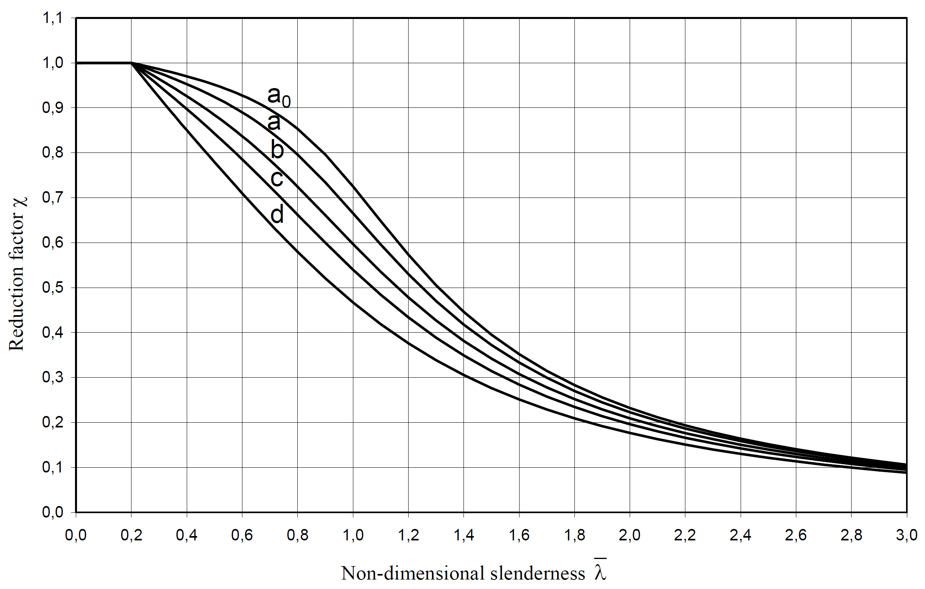
Křivky klopení

Slide 9
Pružný kritický moment
Klopení – EN 1993-1-1, čl. 6.3.2
Pružný kritický moment je v Národní příloze – ČSN EN 1993-1-1, NB3 – viz následující slajdy
Podrobněji také v EN 1999 (Navrhování hliníkových konstrukcí), příloha I

Slide 10
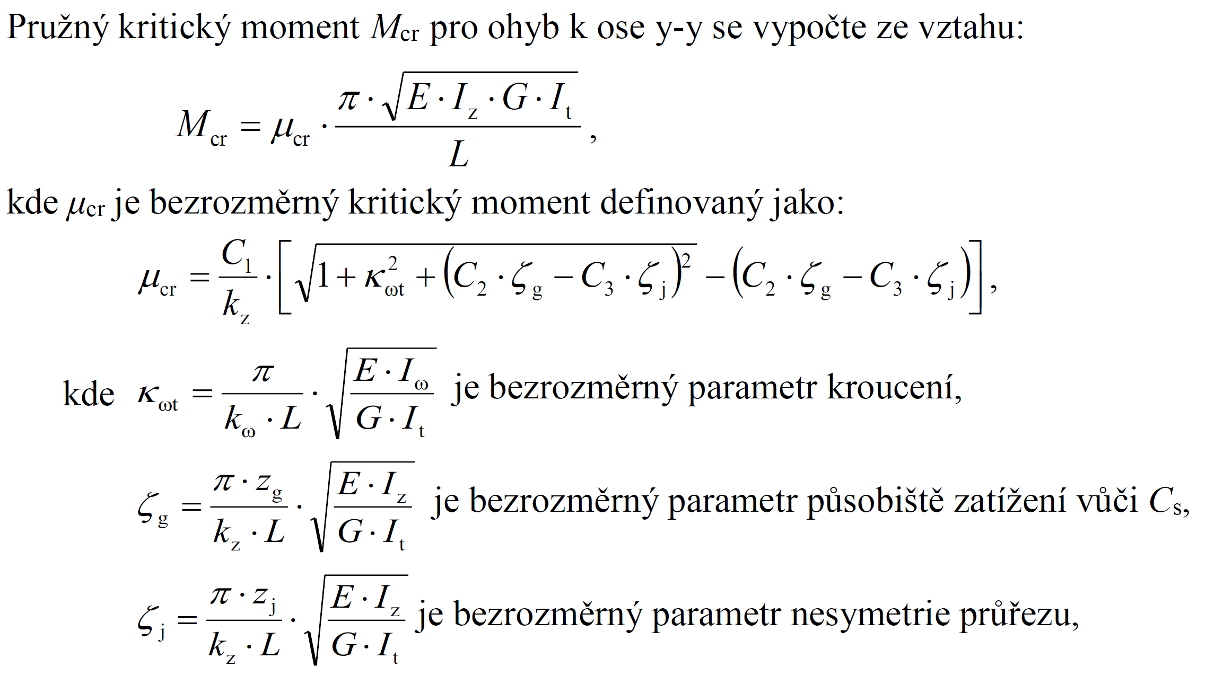
Pružný kritický moment

Slide 11
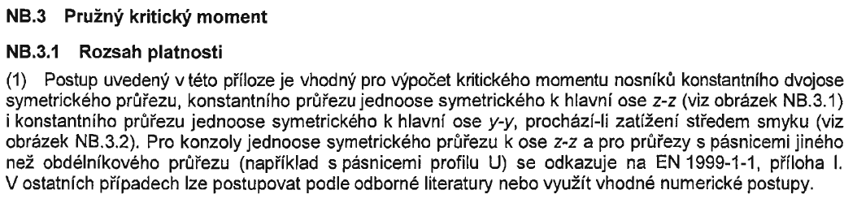
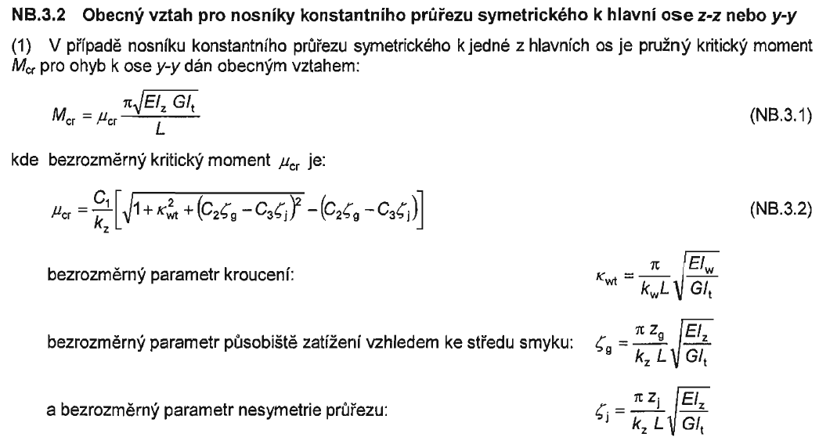

Pro symetrický průřez $ζ_{j}=0$

Slide 12
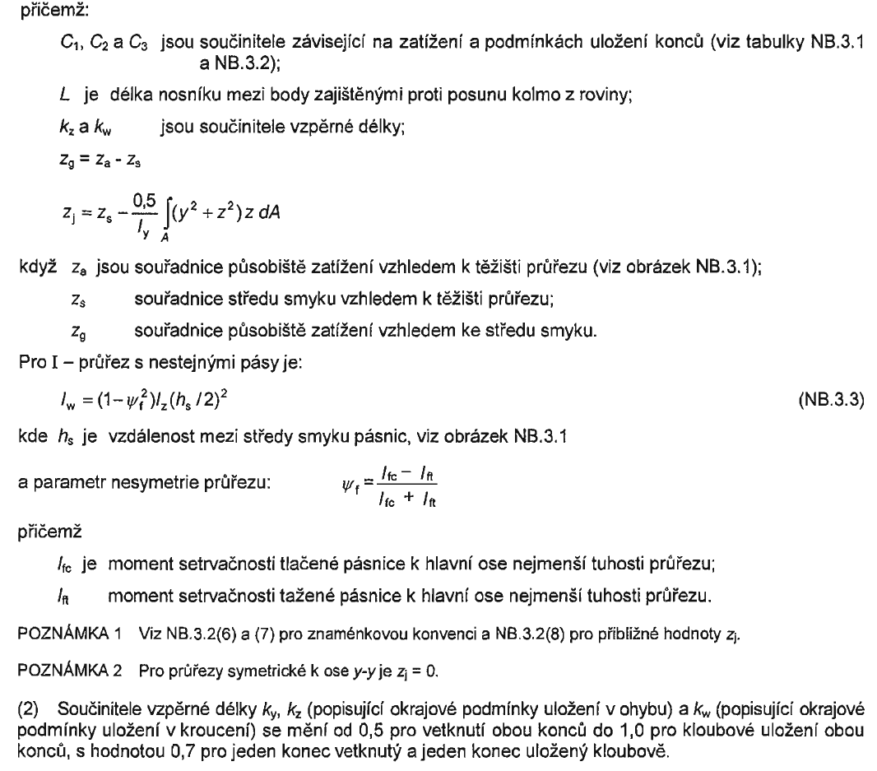

Slide 13
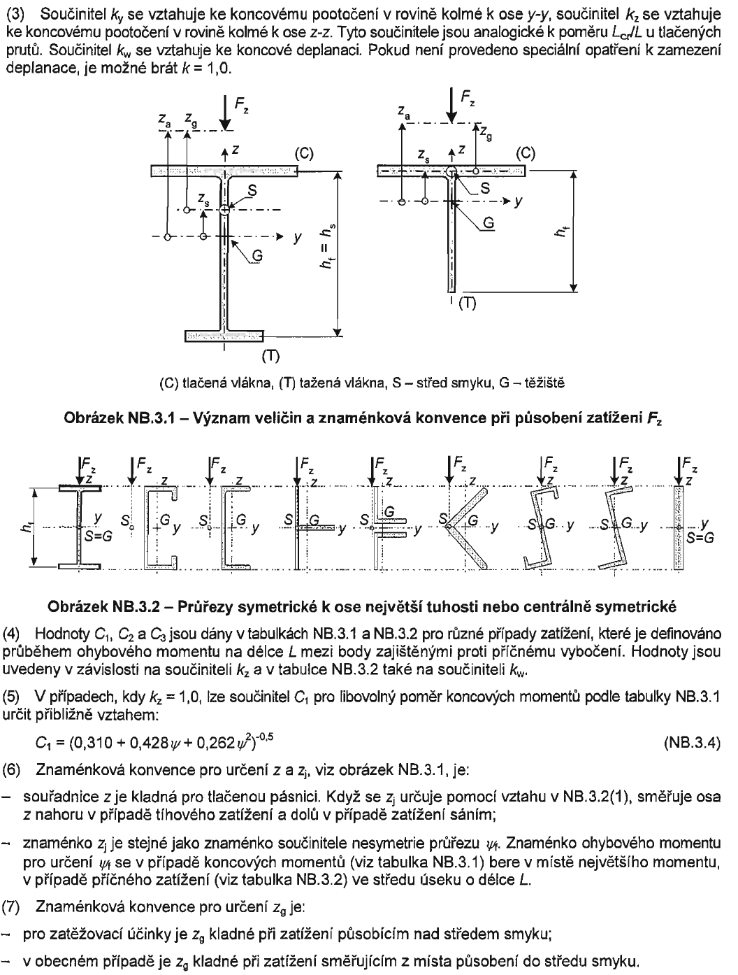

Slide 14
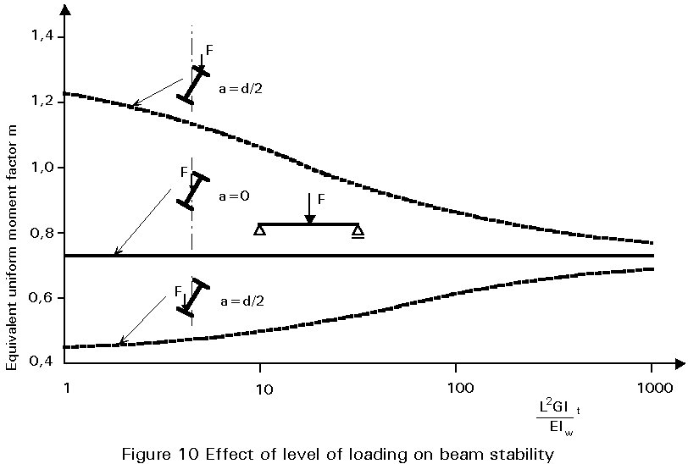
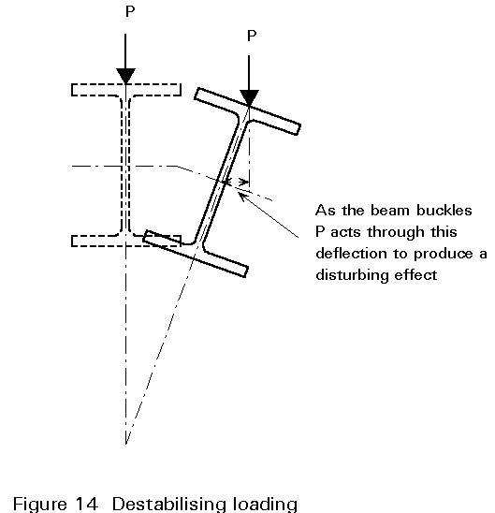
Pozice zatížení

Slide 15
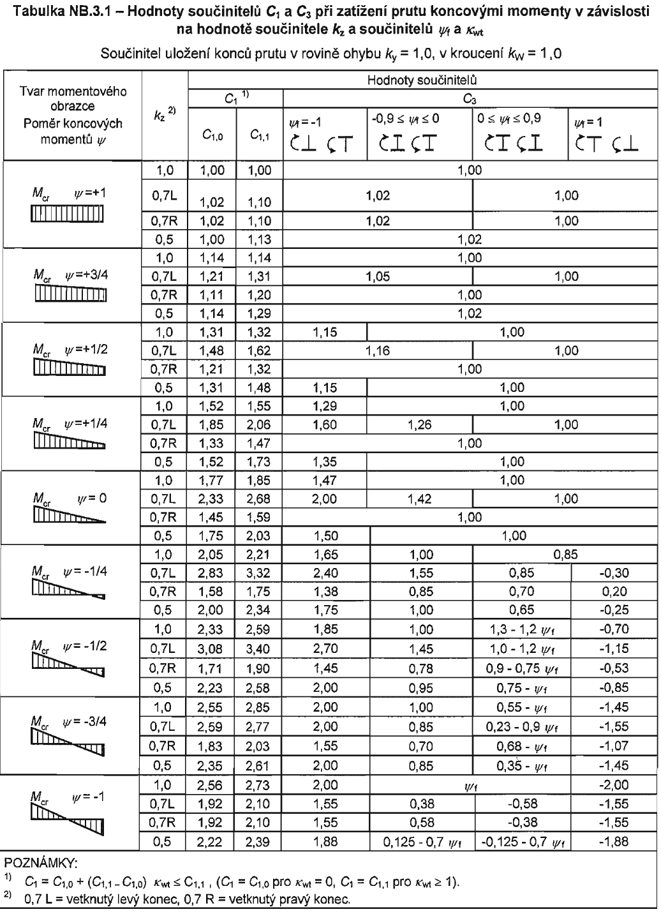
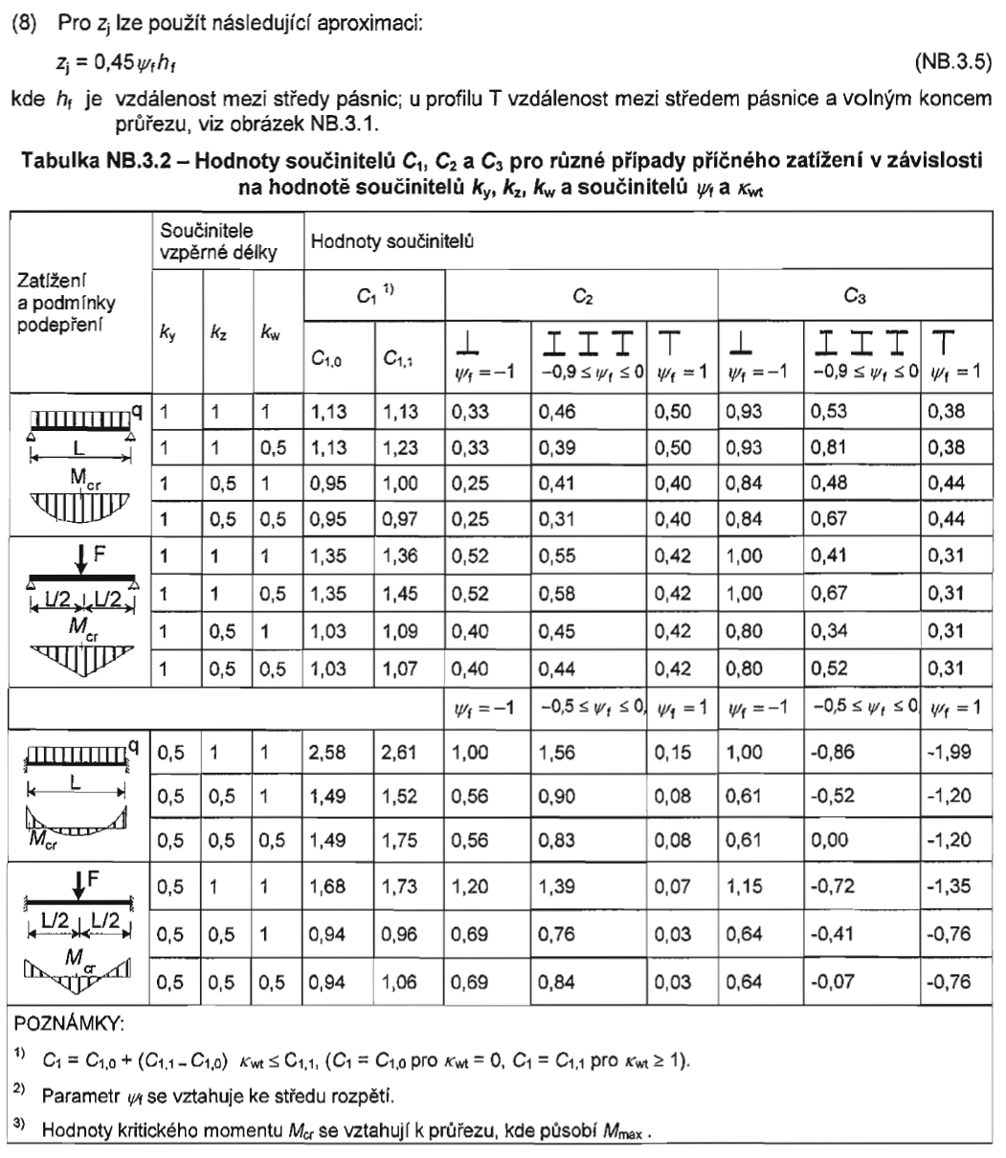

Slide 16
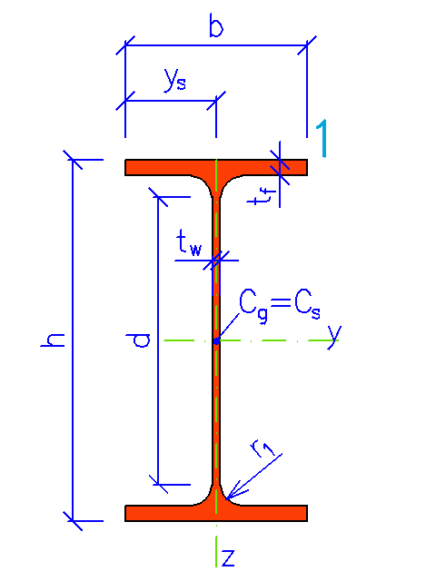
Příklad
IPE 200, S 235
h = 200 mm
b = 100 mm
t_{f} = 8,5 mm
t_{w} = 5,6 mm
r₁ = 12 mm
I_{z} = 1.42E+6 mm⁴
I_{t} = 6.98E+4 mm⁴
W_{y,pl} = 2.20E+5 mm³
I_{w} = 1.30E+10 mm⁶
+
q = 4 kN/m
L = 6 m

Slide 17
Řešené příklady
Posuďte nosník na ohyb s vlivem klopení
Prosté uložení, není bráněno deplanaci
Nosník je zatížen spojitým rovnoměrným zatížením q [kN/m] působícím shora dolů na horní nebo spodní hraně
+
q
-

Slide 18
Řešené příklady
profil | ocel | L [mm] | q [kN/m] | k_{y} | k_{z} | k_{w} | C₁ | C₂ | C₃ | z_{a} [mm] | I_{y} [mm⁴] | I_{t} [mm⁴] | I_{w} [mm⁴] | W_{pl,y} [mm³] | κ_{wt} | ζ_{g} | ζ_{j} | μ_{cr} | M_{cr} [kNm] | f_{y} [MPa] | λ'_{LT,pl} | Φ_{LT,pl} | χ_{LT,pl} | M_{b,pl,Rd} [kNm] | M_{Ed} [kNm]
IPE 140 | S235 | 4000 | 2.45 | 1 | 1 | 1 | 1.13 | 0.46 | 0.53 | -70 | 449000 | 24100 | 1980000000 | 88400 | 0.362 | -0.382 | 0 | 1.417 | 15.097 | 235 | 1.173 | 1.290 | 0.547 | 11.369 | 4.900
IPE 160 | S275 | 4050 | 5.3 | 1 | 1 | 1 | 1.13 | 0.46 | 0.53 | 80 | 683000 | 35800 | 3960000000 | 124000 | 0.415 | 0.436 | 0 | 1.018 | 16.098 | 275 | 1.455 | 1.691 | 0.392 | 13.363 | 10.867
IPE 180 | S355 | 4100 | 4.65 | 1 | 1 | 1 | 1.13 | 0.46 | 0.53 | -90 | 1010000 | 47800 | 7430000000 | 166000 | 0.486 | -0.510 | 0 | 1.550 | 34.026 | 355 | 1.316 | 1.483 | 0.461 | 27.193 | 9.771
IPE 200 | S235 | 4150 | 8.9 | 1 | 1 | 1 | 1.13 | 0.46 | 0.53 | 100 | 1420000 | 69800 | 13000000000 | 220000 | 0.526 | 0.550 | 0 | 1.023 | 31.786 | 235 | 1.275 | 1.426 | 0.484 | 25.043 | 19.160
IPE 220 | S275 | 4200 | 8.95 | 1 | 1 | 1 | 1.13 | 0.46 | 0.53 | -110 | 2050000 | 91700 | 22700000000 | 285000 | 0.599 | -0.626 | 0 | 1.683 | 71.170 | 275 | 1.049 | 1.140 | 0.631 | 49.458 | 19.735
IPE 140 | S355 | 4250 | 3.6 | 1 | 1 | 1 | 1.13 | 0.46 | 0.53 | 70 | 449000 | 24100 | 1980000000 | 88400 | 0.341 | 0.360 | 0 | 1.022 | 10.245 | 355 | 1.750 | 2.194 | 0.284 | 8.920 | 8.128
IPE 160 | S235 | 4300 | 3.45 | 1 | 1 | 1 | 1.13 | 0.46 | 0.53 | -80 | 683000 | 35800 | 3960000000 | 124000 | 0.391 | -0.411 | 0 | 1.446 | 21.542 | 235 | 1.163 | 1.277 | 0.554 | 16.136 | 7.974
IPE 180 | S275 | 4350 | 6.2 | 1 | 1 | 1 | 1.13 | 0.46 | 0.53 | 90 | 1010000 | 47800 | 7430000000 | 166000 | 0.458 | 0.481 | 0 | 1.018 | 21.067 | 275 | 1.472 | 1.717 | 0.384 | 17.552 | 14.665
IPE 200 | S355 | 4400 | 6.65 | 1 | 1 | 1 | 1.13 | 0.46 | 0.53 | -100 | 1420000 | 69800 | 13000000000 | 220000 | 0.496 | -0.519 | 0 | 1.559 | 45.718 | 355 | 1.307 | 1.470 | 0.466 | 36.428 | 16.093
IPE 220 | S235 | 4450 | 10.9 | 1 | 1 | 1 | 1.13 | 0.46 | 0.53 | 110 | 2050000 | 91700 | 22700000000 | 285000 | 0.566 | 0.591 | 0 | 1.027 | 40.990 | 235 | 1.278 | 1.430 | 0.483 | 32.329 | 26.981
IPE 140 | S275 | 4500 | 1.95 | 1 | 1 | 1 | 1.13 | 0.46 | 0.53 | -70 | 449000 | 24100 | 1980000000 | 88400 | 0.322 | -0.340 | 0 | 1.377 | 13.040 | 275 | 1.365 | 1.554 | 0.435 | 10.581 | 4.936
IPE 160 | S355 | 4550 | 4.8 | 1 | 1 | 1 | 1.13 | 0.46 | 0.53 | 80 | 683000 | 35800 | 3960000000 | 124000 | 0.370 | 0.388 | 0 | 1.020 | 14.358 | 355 | 1.751 | 2.196 | 0.284 | 12.503 | 12.422
IPE 180 | S235 | 4600 | 4.15 | 1 | 1 | 1 | 1.13 | 0.46 | 0.53 | -90 | 1010000 | 47800 | 7430000000 | 166000 | 0.434 | -0.455 | 0 | 1.491 | 29.173 | 235 | 1.156 | 1.269 | 0.558 | 21.772 | 10.977
IPE 200 | S275 | 4650 | 8.4 | 1 | 1 | 1 | 1.13 | 0.46 | 0.53 | 100 | 1420000 | 69800 | 13000000000 | 220000 | 0.469 | 0.491 | 0 | 1.019 | 28.270 | 275 | 1.463 | 1.703 | 0.389 | 23.506 | 22.704
IPE 220 | S355 | 4700 | 8.45 | 1 | 1 | 1 | 1.13 | 0.46 | 0.53 | -110 | 2050000 | 91700 | 22700000000 | 285000 | 0.535 | -0.560 | 0 | 1.605 | 60.680 | 355 | 1.291 | 1.448 | 0.475 | 48.085 | 23.333
IPE 140 | S235 | 4750 | 3.1 | 1 | 1 | 1 | 1.13 | 0.46 | 0.53 | 70 | 449000 | 24100 | 1980000000 | 88400 | 0.305 | 0.322 | 0 | 1.026 | 9.206 | 235 | 1.502 | 1.765 | 0.372 | 7.718 | 8.743
IPE 160 | S275 | 4800 | 2.95 | 1 | 1 | 1 | 1.13 | 0.46 | 0.53 | -80 | 683000 | 35800 | 3960000000 | 124000 | 0.350 | -0.368 | 0 | 1.404 | 18.741 | 275 | 1.349 | 1.530 | 0.444 | 15.133 | 8.496
IPE 180 | S355 | 4850 | 5.7 | 1 | 1 | 1 | 1.13 | 0.46 | 0.53 | 90 | 1010000 | 47800 | 7430000000 | 166000 | 0.411 | 0.431 | 0 | 1.018 | 18.895 | 355 | 1.766 | 2.224 | 0.280 | 16.482 | 16.760
IPE 200 | S235 | 4900 | 6.15 | 1 | 1 | 1 | 1.13 | 0.46 | 0.53 | -100 | 1420000 | 69800 | 13000000000 | 220000 | 0.446 | -0.466 | 0 | 1.503 | 39.556 | 235 | 1.143 | 1.253 | 0.567 | 29.304 | 18.458
IPE 220 | S275 | 4950 | 10.4 | 1 | 1 | 1 | 1.13 | 0.46 | 0.53 | 110 | 2050000 | 91700 | 22700000000 | 285000 | 0.508 | 0.531 | 0 | 1.021 | 36.648 | 275 | 1.462 | 1.702 | 0.389 | 30.469 | 31.853
IPE 140 | S355 | 5000 | 1.45 | 1 | 1 | 1 | 1.13 | 0.46 | 0.53 | -70 | 449000 | 24100 | 1980000000 | 88400 | 0.290 | -0.306 | 0 | 1.346 | 11.475 | 355 | 1.654 | 2.020 | 0.314 | 9.868 | 4.531
IPE 160 | S235 | 5050 | 4.3 | 1 | 1 | 1 | 1.13 | 0.46 | 0.53 | 80 | 683000 | 35800 | 3960000000 | 124000 | 0.333 | 0.350 | 0 | 1.023 | 12.978 | 235 | 1.498 | 1.759 | 0.373 | 10.872 | 13.708
IPE 180 | S275 | 5100 | 3.65 | 1 | 1 | 1 | 1.13 | 0.46 | 0.53 | -90 | 1010000 | 47800 | 7430000000 | 166000 | 0.391 | -0.410 | 0 | 1.445 | 25.512 | 275 | 1.338 | 1.514 | 0.450 | 20.530 | 11.867
IPE 200 | S355 | 5150 | 7.9 | 1 | 1 | 1 | 1.13 | 0.46 | 0.53 | 100 | 1420000 | 69800 | 13000000000 | 220000 | 0.424 | 0.443 | 0 | 1.018 | 25.510 | 355 | 1.750 | 2.193 | 0.284 | 22.211 | 26.191
IPE 220 | S235 | 5200 | 7.95 | 1 | 1 | 1 | 1.13 | 0.46 | 0.53 | -110 | 2050000 | 91700 | 22700000000 | 285000 | 0.484 | -0.506 | 0 | 1.546 | 52.804 | 235 | 1.126 | 1.231 | 0.578 | 38.725 | 26.871
IPE 140 | S275 | 5250 | 2.6 | 1 | 1 | 1 | 1.13 | 0.46 | 0.53 | 70 | 449000 | 24100 | 1980000000 | 88400 | 0.276 | 0.291 | 0 | 1.031 | 8.368 | 275 | 1.704 | 2.111 | 0.298 | 7.245 | 8.958
IPE 160 | S355 | 5300 | 2.45 | 1 | 1 | 1 | 1.13 | 0.46 | 0.53 | -80 | 683000 | 35800 | 3960000000 | 124000 | 0.317 | -0.334 | 0 | 1.372 | 16.580 | 355 | 1.629 | 1.978 | 0.323 | 14.208 | 8.603
IPE 180 | S235 | 5350 | 5.2 | 1 | 1 | 1 | 1.13 | 0.46 | 0.53 | 90 | 1010000 | 47800 | 7430000000 | 166000 | 0.373 | 0.391 | 0 | 1.020 | 17.158 | 235 | 1.508 | 1.774 | 0.369 | 14.401 | 18.605
IPE 200 | S275 | 5400 | 5.65 | 1 | 1 | 1 | 1.13 | 0.46 | 0.53 | -100 | 1420000 | 69800 | 13000000000 | 220000 | 0.404 | -0.423 | 0 | 1.458 | 34.831 | 275 | 1.318 | 1.486 | 0.460 | 27.854 | 20.594
IPE 220 | S235 | 5450 | 9.9 | 1 | 1 | 1 | 1.13 | 0.46 | 0.53 | 110 | 2050000 | 91700 | 22700000000 | 285000 | 0.462 | 0.483 | 0 | 1.019 | 33.209 | 235 | 1.420 | 1.637 | 0.408 | 27.339 | 36.757

