Slide 1

Cross-section properties II
BOA001
Ing. Martin Vild, Ph.D.
9/2024

Slide 2
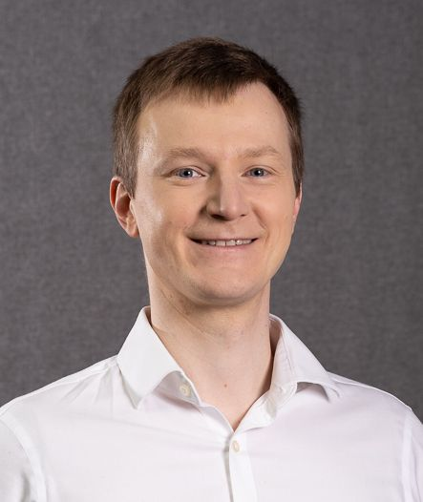


Presenting
Ing. Martin Vild, Ph.D.
IDEA StatiCa – Product Owner
FCE BUT – Assistant professor
Research:
Steel connections
Finite element analysis
Scopus Author ID: 56188615700
Committee member:
CEN/TC 250/SC 3/WG 8 "Evolution of EN 1993-1-8 - Joints and connections“
ECCS TC10 “Structural Connections”
Website:
https://www.fce.vutbr.cz/KDK/vild.m/
email: martin.vild@vutbr.cz
Office: C203
Consultations:
Thursday 10–11

Slide 3
Content
Cross-section properties
  Overview
  Coordinate systems
  Torsion
    Hollow section
    Open section
Buckling
Computational model
Perspective of a structural engineer

Slide 4
Cross-section properties
Cartesian coordinates |  |  | Sectorial coordinates
Area | A | [m²]
Static moment | S_{y}, S_{z} | [m³] | Sectorial first moment | S_{w} | [±mm⁴]
Moment of inertia | I_{y}, I_{z} | [m⁴] | Warping constatnt | I_{w} | [+m⁶]
Deviation moment | D_{yz} | [m⁴] | Sectorial product moment | D_{wy}, D_{wz} | [±mm⁵]
Radius of gyration | i_{y}, i_{z} | [m²]
Polar moment of inertia | I_{p} | [m⁴]

Slide 5
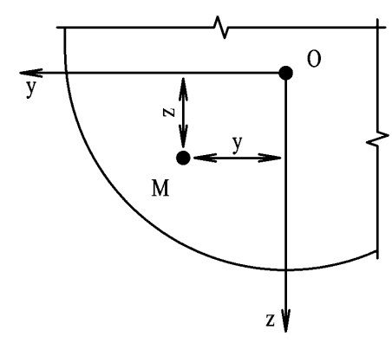

Cartesian coordinates
$y=\overline{zM}$ [±m]
$z=\overline{yM}$ [±m]
PILGR, M. Konstrukce a dopravní stavby. Pracovní verze příkladů do cvičení rozpracovaných podle národních norem ČSN [online]. Brno: 2006, 76 s

Slide 6
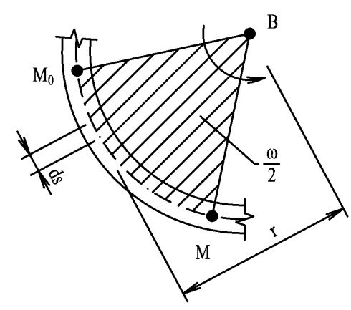

Sectorial coordinates
$w=\int_{M_{0}}^{M}{r ds}$ [±m²]
PILGR, M. Konstrukce a dopravní stavby. Pracovní verze příkladů do cvičení rozpracovaných podle národních norem ČSN [online]. Brno: 2006, 76 s

Slide 7
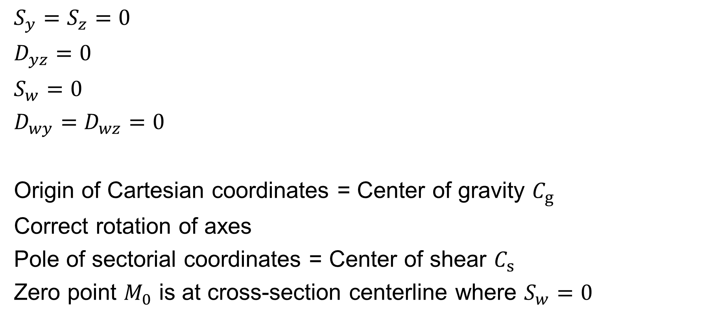
Principal coordinate system
$S_{y}=S_{z}=0$
$D_{yz}=0$
$S_{w}=0$
$D_{wy}=D_{wz}=0$
Origin of Cartesian coordinates = Center of gravity $C_{g}$
Correct rotation of axes
Pole of sectorial coordinates = Center of shear $C_{s}$
Zero point $M_{0}$ is at cross-section centerline where $S_{w}=0$

Slide 8
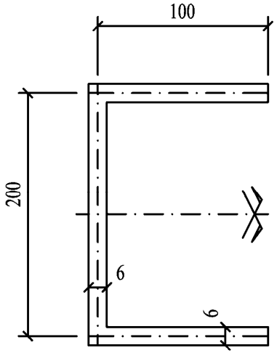
Example
[mm]
Calculate
Area
Location of center of gravity
Draw principal axes
PILGR, M. Konstrukce a dopravní stavby. Pracovní verze příkladů do cvičení rozpracovaných podle národních norem ČSN [online]. Brno: 2006, 76 s

Slide 9
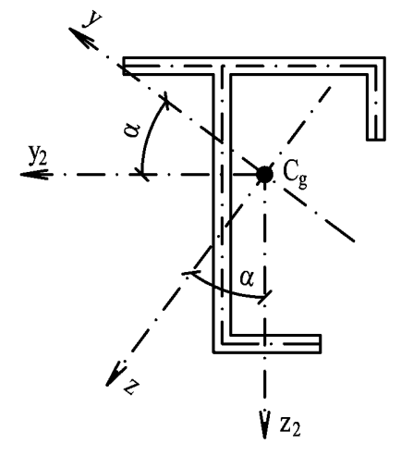

Deviation moment
$D_{yz}=\int_{A}{yz} dA$ [±m⁴]
Use: Angle of principal axes
$α=\frac{1}{2}\operatorname{arctg}{\frac{2D_{y2z2}}{I_{z2}−I_{y2} }}$
PILGR, M. Konstrukce a dopravní stavby. Pracovní verze příkladů do cvičení rozpracovaných podle národních norem ČSN [online]. Brno: 2006, 76 s

Slide 10

Sectorial product moment
$D_{wy}=\int_{A}{wz} dA$ [±m⁵]
$D_{wz}=\int_{A}{wy} dA$ [±m⁵]

Slide 11

Radius of gyration
$i_{y}=\sqrt{\frac{I_{y}}{A}}$ [+m]
$i_{z}=\sqrt{\frac{I_{z}}{A}}$ [+m]
Use: Member slenderness

Slide 12
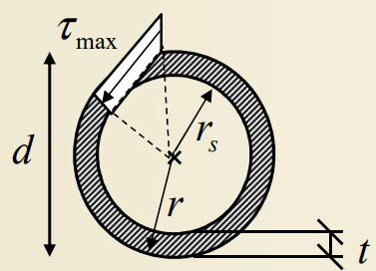
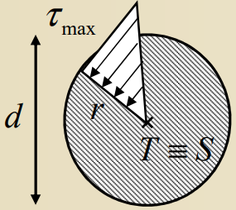

Polar moment of inertia
$I_{p}=$ $\int_{A}{\left(y^{2}+z^{2}\right)dA}=I_{y}+I_{z}$ [m⁴]
For hollow sections: $I_{p}=I_{t}$
http://fast10.vsb.cz/michalcova/Pruznost16_komb/K_02_16_krouceni%20teorie.pdf

Slide 13
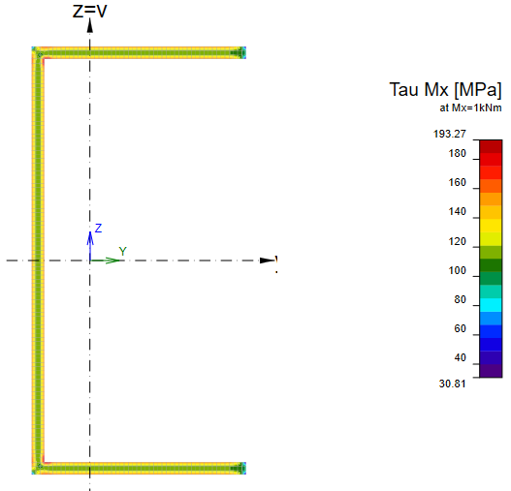
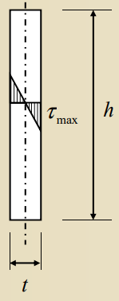
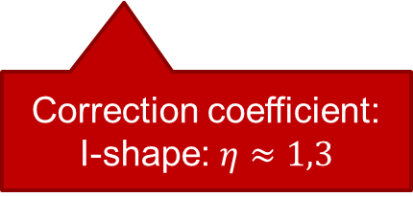

Torsion constant
$$τ_{max}=\frac{T}{I_{t}}⋅e=\frac{T}{W_{t}}$$
$$I_{t}=\frac{η}{3}\sum_{i=1}^{n}{h_{i}⋅t_{i}^{3}}$$
Correction coefficient:
I-shape: $η≈1,3$

Slide 14
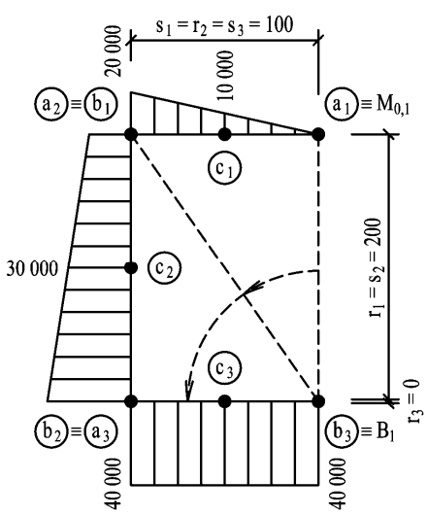
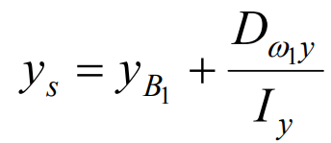
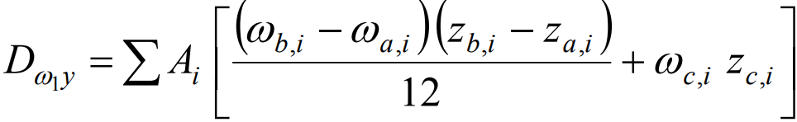
Center of shear

Slide 15
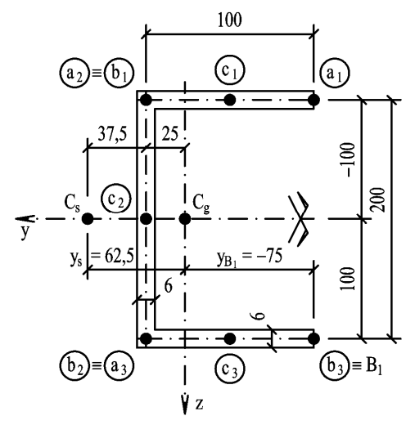
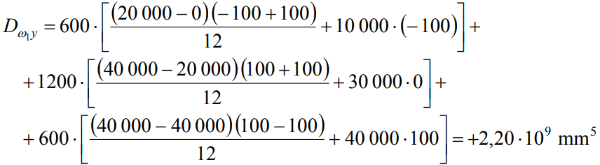

Center of shear

Slide 16
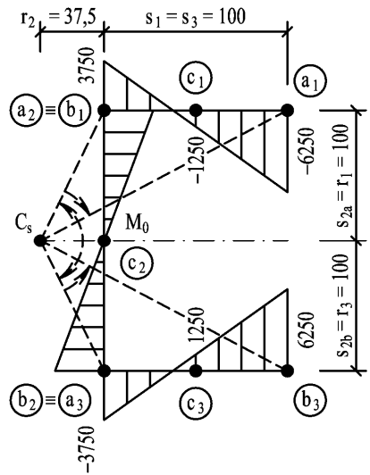

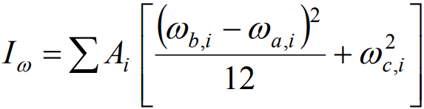
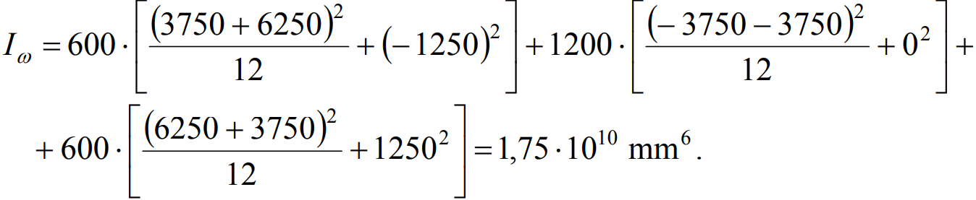
Principal sectorial coordinates
Sectorial first moment
Warping constant

Slide 17
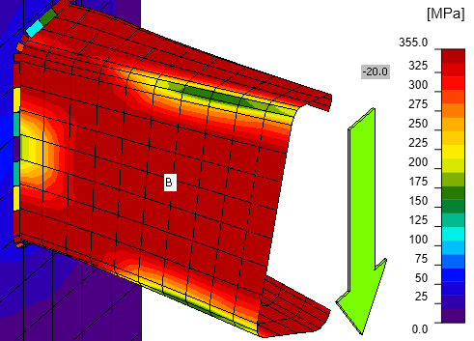
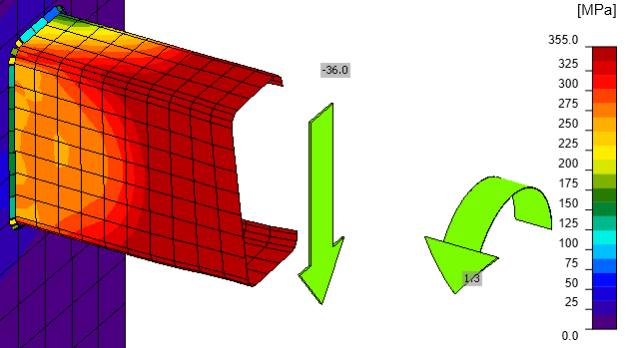

Load – Torsion
Load passes through center of shear → No torsion
Load through center of gravity
Load through center of shear
$$M_{x}=V⋅y_{0}$$

Slide 18
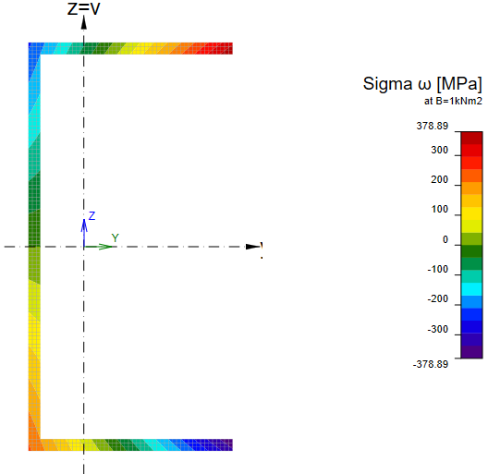
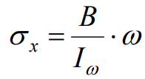
Torsion – warping
Normal stress due to warping
[MPa]

Slide 19
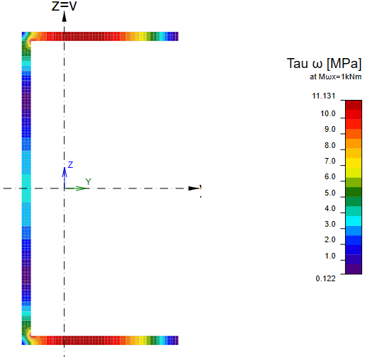
Torsion
St. Venant torsion | Warping

Slide 20
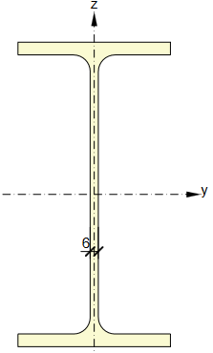
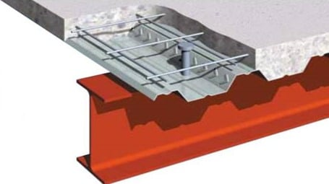




Composite steel-concrete
$$f_{cd}$$
$$−$$
$$+$$
$$f_{yd}$$
https://theconstructor.org/structural-engg/steel-concrete-composite-beams/6912/

Slide 21
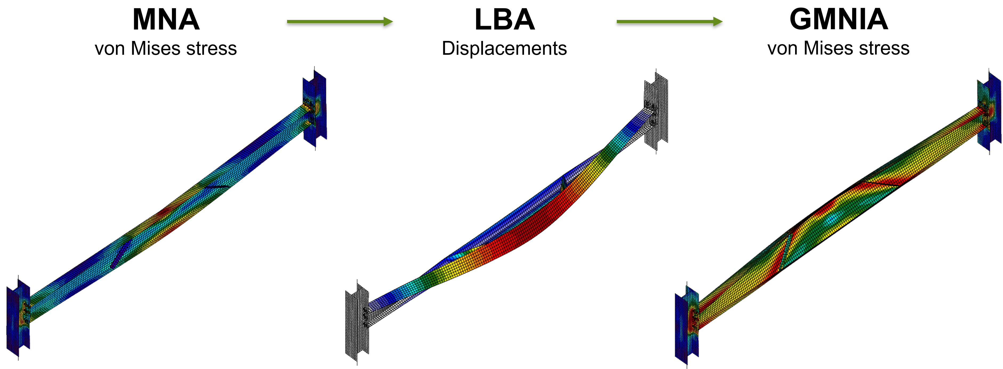
Buckling

Slide 22
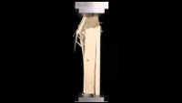

Slide 23
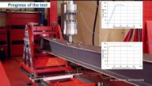

Slide 24
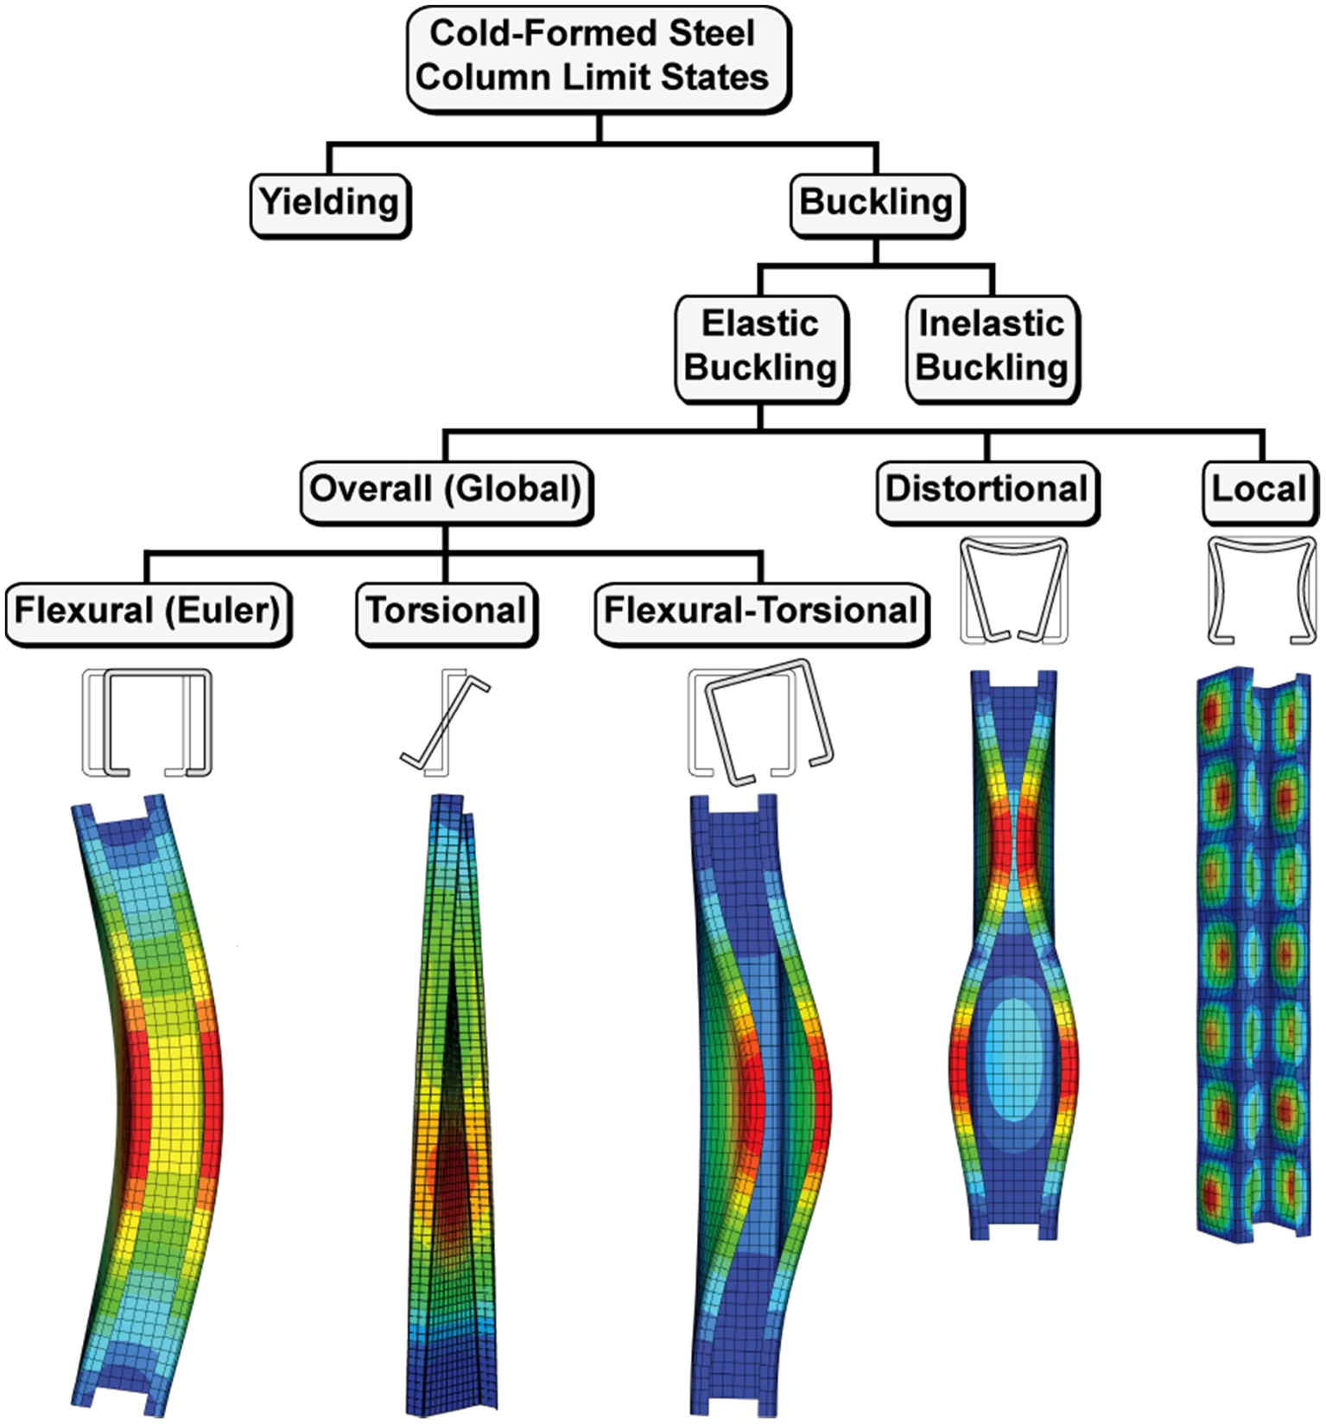

Slide 25
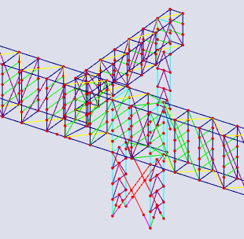
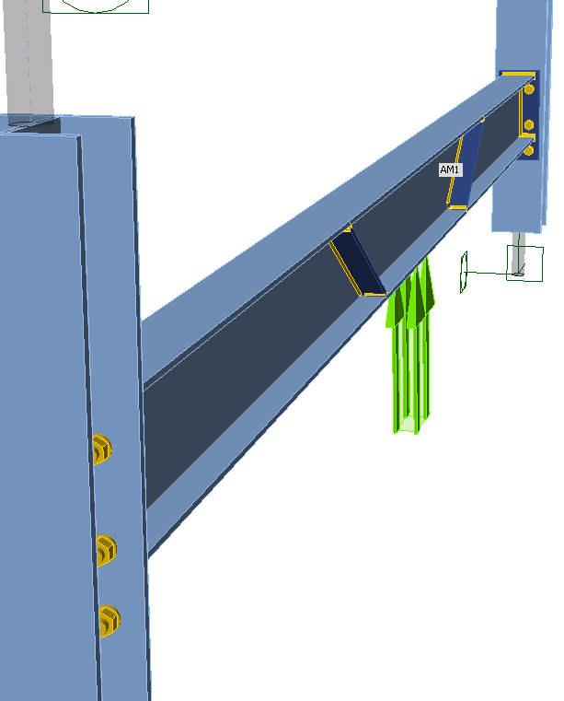
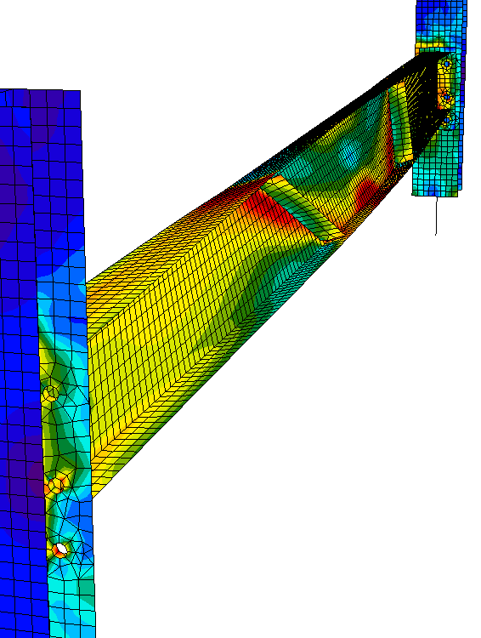
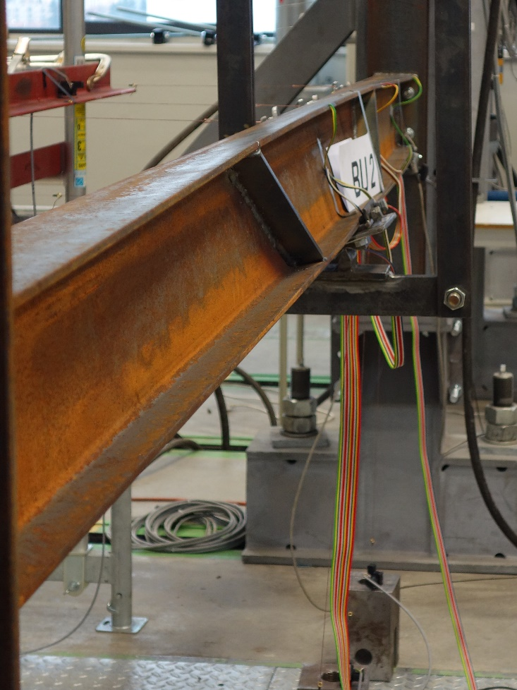
Computational model
Structural engineer must:
Know structural systems
Know design procedures
Know failure modes
Estimate results – cross-sections
Check computational model by simple surrogate models

Slide 26








Perspective of structural engineer
Engineering office
  Not only in Czechia
Authorized engineer
Manufacturer
Software

Slide 27
Useful links
https://www.fce.vutbr.cz/KDK/pilgr.m/Vyuka-bo01/BO01_cvi.pdf
http://fast10.vsb.cz/michalcova/statika11/pr%2010-11-prurezove%20charakterisky%20barevne.pdf
http://fast10.vsb.cz/michalcova/Pruznost16_komb/K_02_16_krouceni%20teorie.pdf
https://www.youtube.com/playlist?list=PLEYqyyrm-hQ3wtF34smyJSAOqUJqnf1ch
https://www.youtube.com/c/BrendanHasty
https://www.youtube.com/@MatPicardal
Form:
https://forms.gle/3qK4LRBzUfAaxWec8

Slide 28
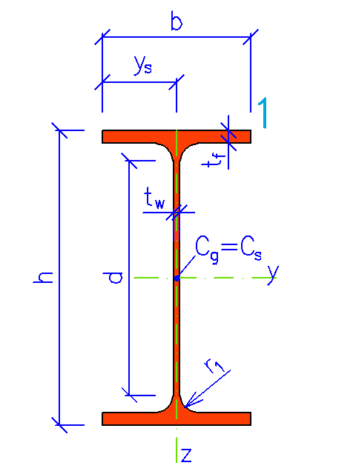
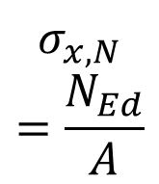
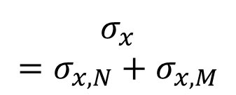

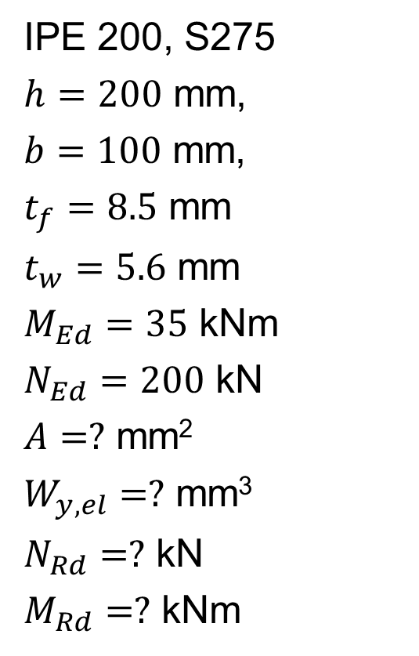




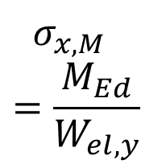

Example
IPE 200, S275
$h=200$ mm,
$b=100$ mm,
$t_{f}=8.5$ mm
$t_{w}=5.6$ mm
$M_{Ed}=35$ kNm
$N_{Ed}=200$ kN
$A=?$ mm²
$W_{y,el}=?$ mm³
$N_{Rd}=?$ kN
$M_{Rd}=?$ kNm
[MPa]
$$−$$
$$+$$
$$+$$
$$=$$
$$+$$
$$+$$
$$σ_{x,N}=\frac{N_{Ed}}{A}$$
$$σ_{x,M} \\ =\frac{M_{Ed}}{W_{el,y}}$$
$$σ_{x}=σ_{x,N}+σ_{x,M}$$

