Slide 1

Snow and Wind Load
BOA001
Ing. Martin Vild, Ph.D.
9/2024

Slide 2



Presenting
Ing. Martin Vild, Ph.D.
IDEA StatiCa – Product Owner
FCE BUT – Assistant professor
Research:
Steel connections
Finite element analysis
Scopus Author ID: 56188615700
Committee member:
CEN/TC 250/SC 3/WG 8 "Evolution of EN 1993-1-8 - Joints and connections“
ECCS TC10 “Structural Connections”
Website:
https://www.fce.vutbr.cz/KDK/vild.m/
email: martin.vild@vutbr.cz
Office: C203
Consultations:
Thursday 10–11

Slide 3
Content
Introduction:
  Design of structures
  Structural system
Loading:
  Statistics and probability
  Imposed
    Snow load
    Wind load
Links:
Design of structures – BEng Hielsher (7:26)
What is Structural Engineering? - Mat Picardal - YT Video - Duration: 5:05
What structural engineers actually do? - Mat Picardal - YT Video - Duration: 9:40
The role of the structural engineer - Article - Approx. duration of reading: 5:00
Loads – Brendan Hasty (10:14)

Slide 4


BOA001 – Requirements
80% attendance rate
Active participation
All assignments completed
Literature:
  EN 1990 Eurocode: Basis of structural design
  EN 1991-1-1 Eurocode 1: Actions on structures - Part 1-1 (general)
  EN 1991-1-3 Eurocode 1: Actions on structures - Part 1-3 (snow)
  EN 1991-1-4 Eurocode 1: Actions on structures - Part 1-4 (wind)

Slide 5


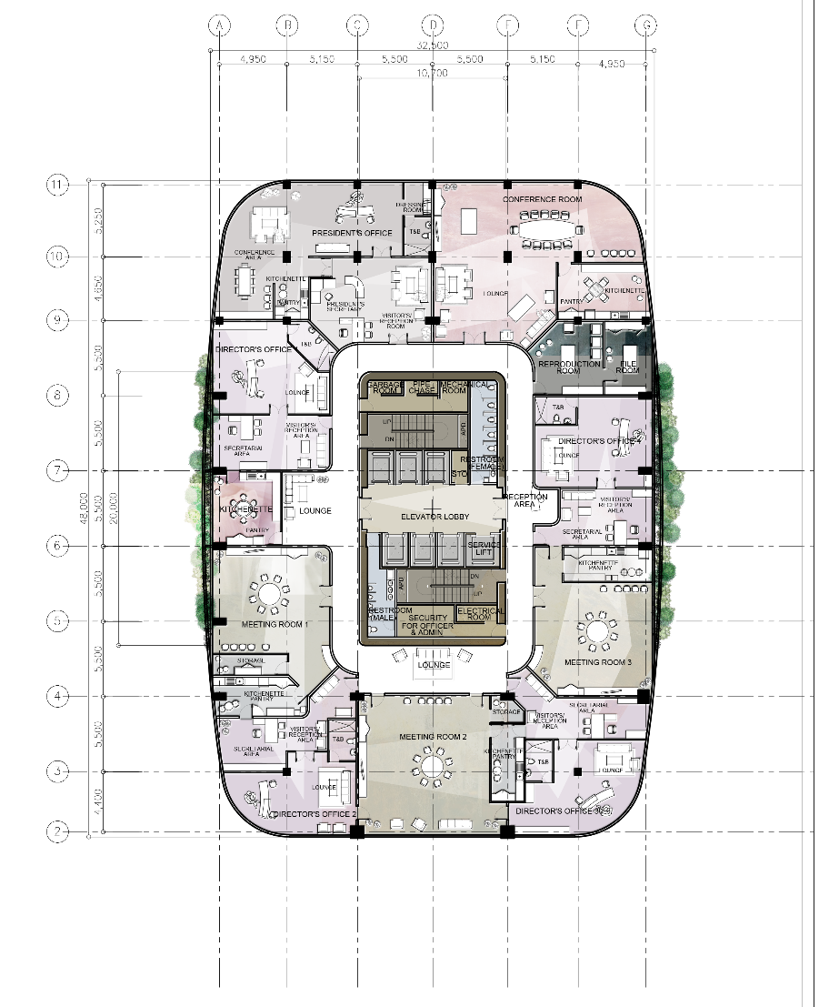
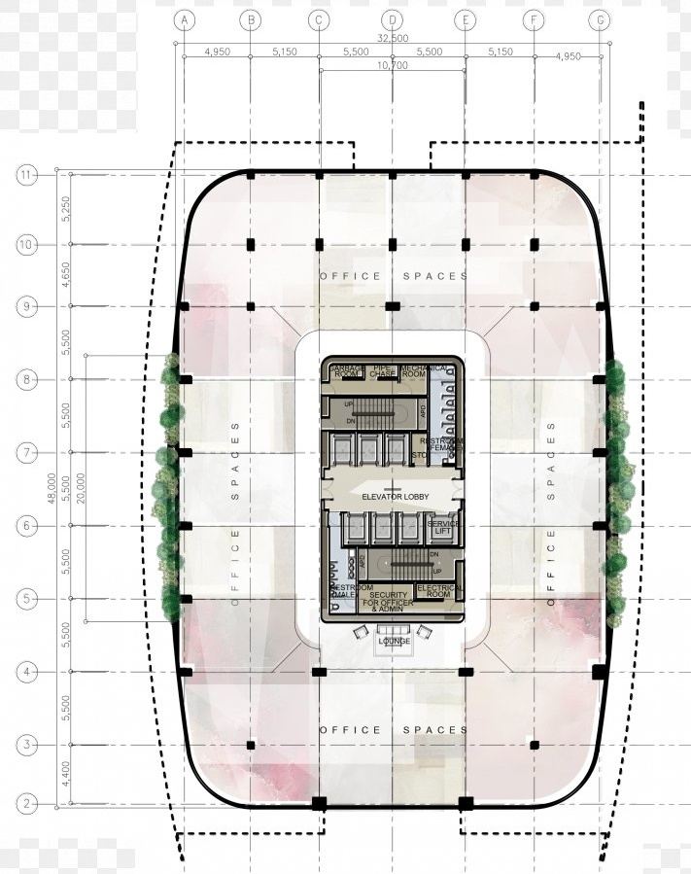
Design of structures
Safety
Purpose
Architecture
https://www.arcaidawards.com/significant-elements-of-modern-architecture/

Slide 6
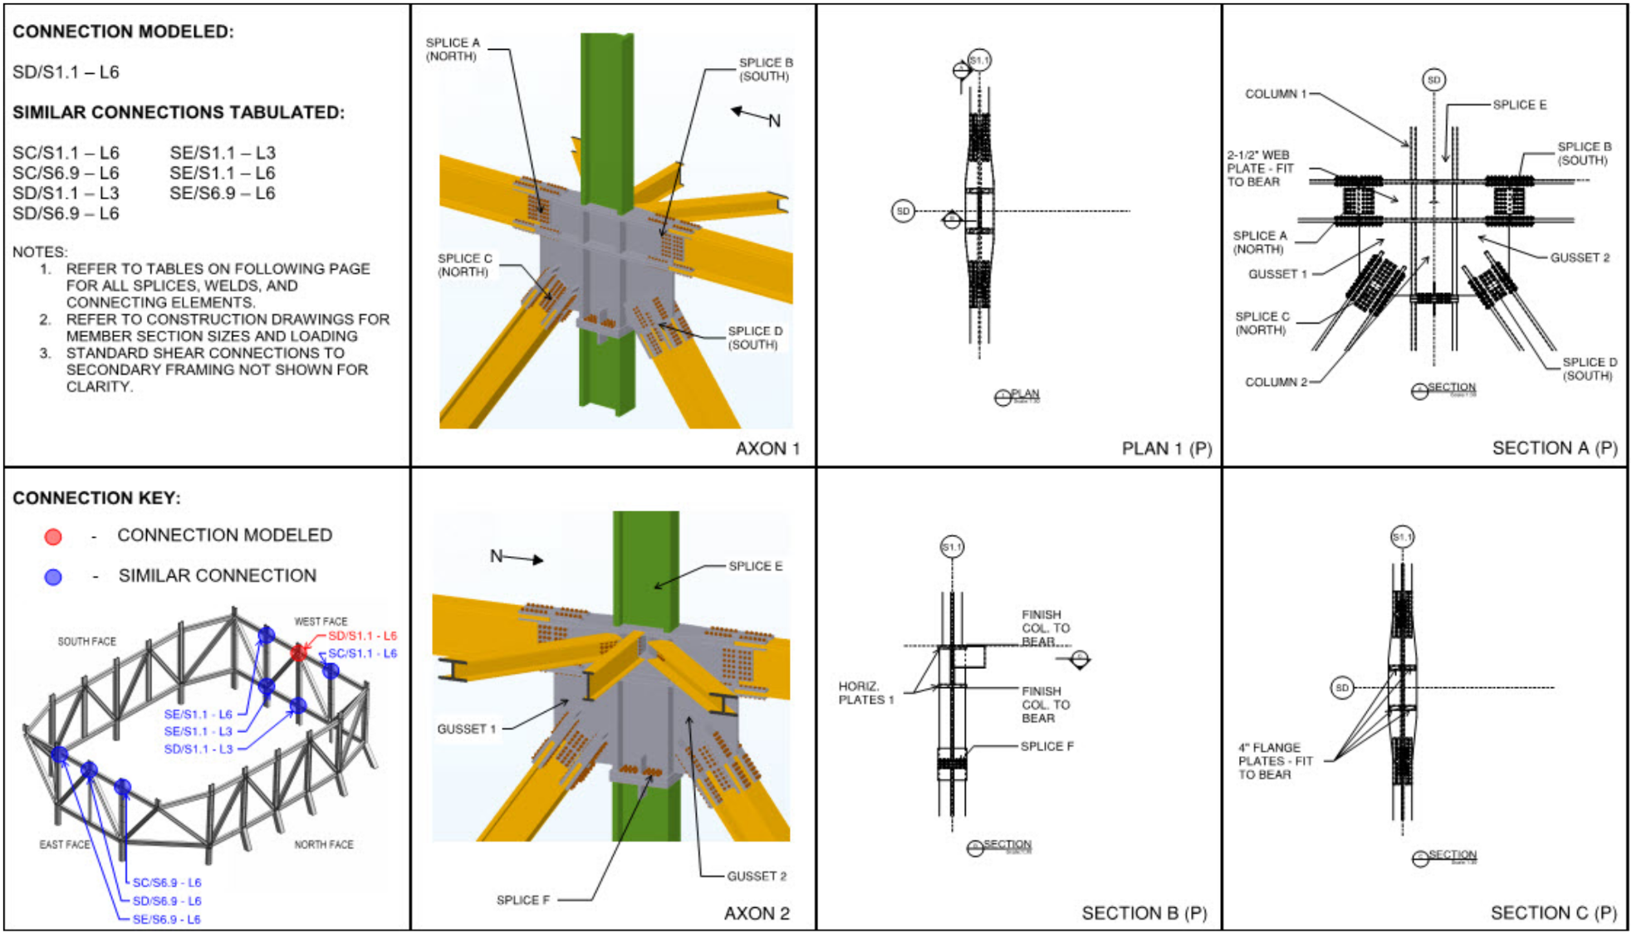
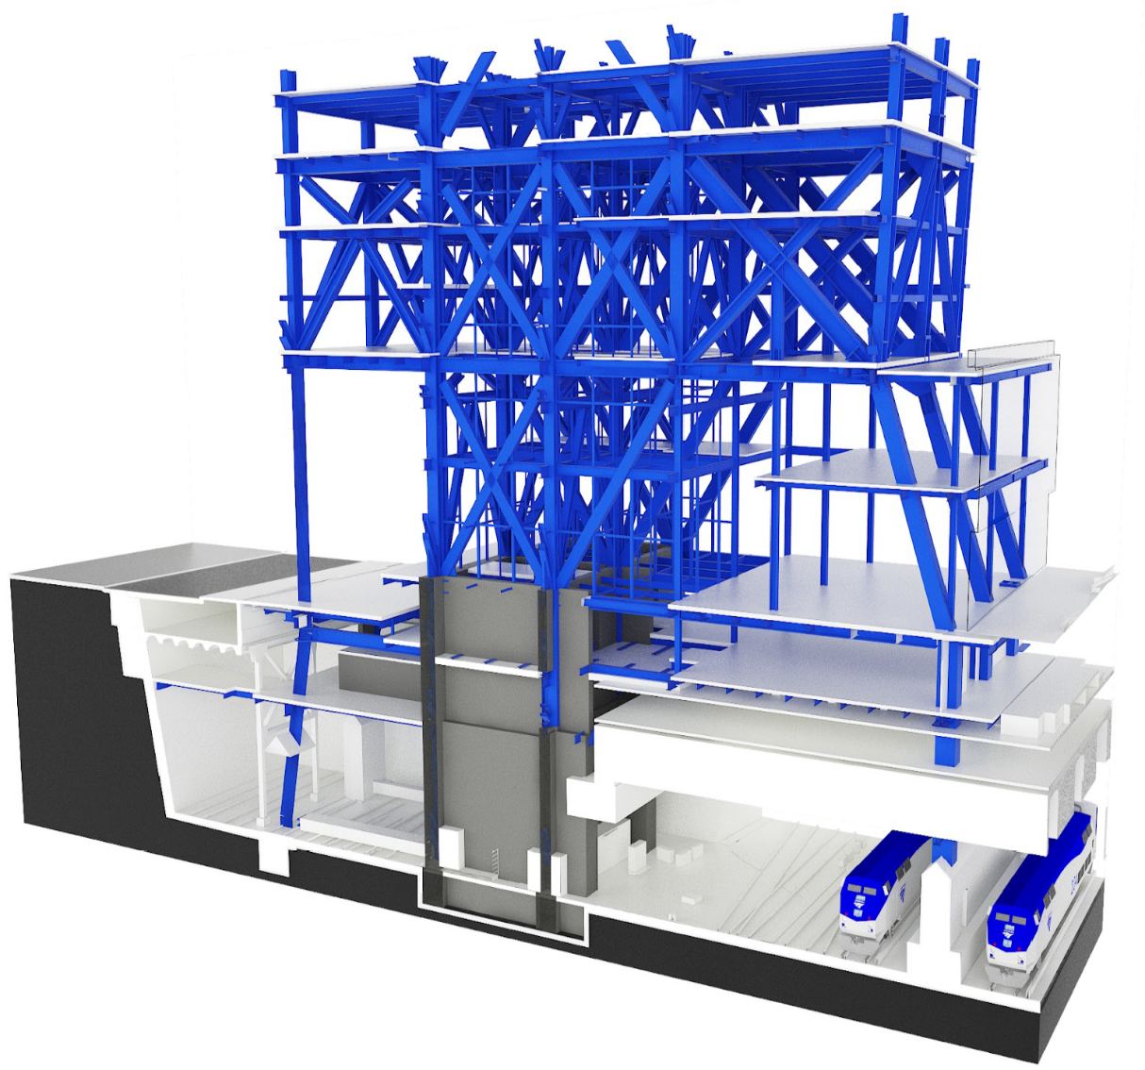
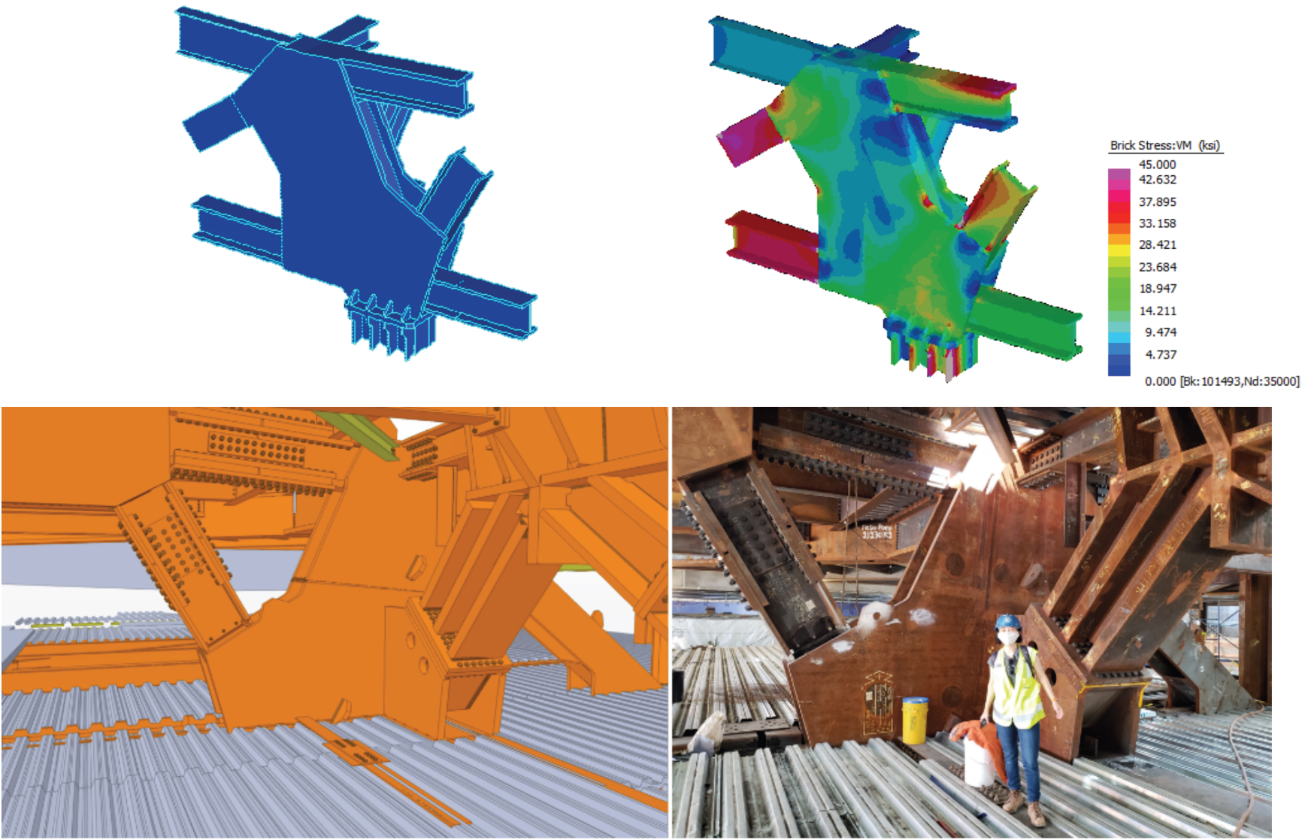

Design workflow
Architectural design
Structural model
Drawings
Fabrication
Biswas et al. Cross-platform integration for realizing efficient steel connections

Slide 7
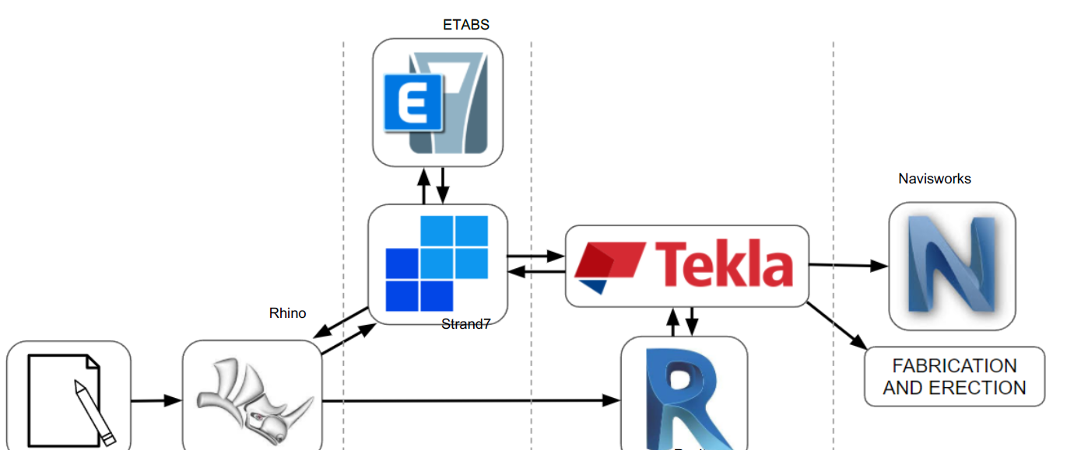
Cross-platform design
Biswas et al. Cross-platform integration for realizing efficient steel connections

Slide 8
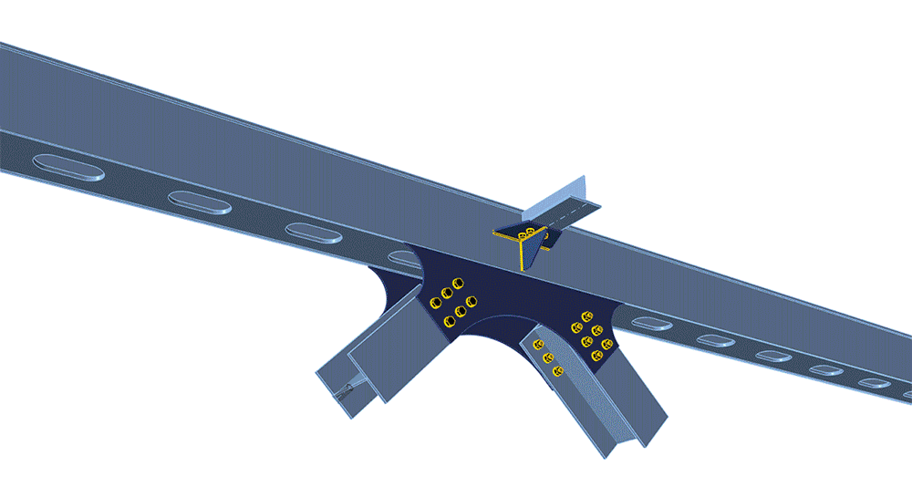
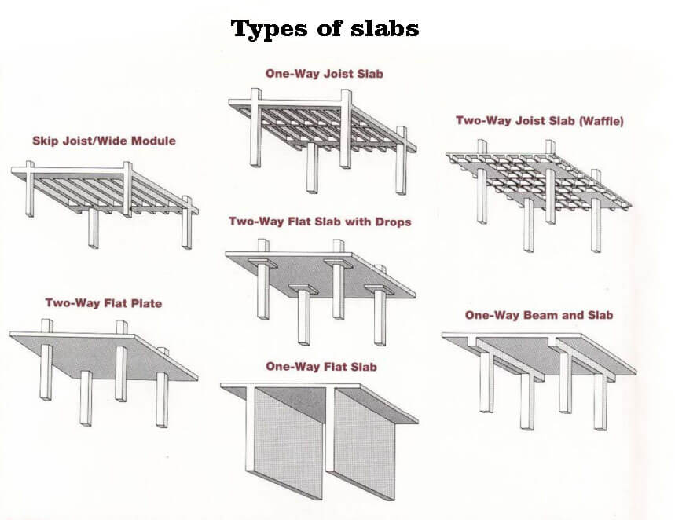
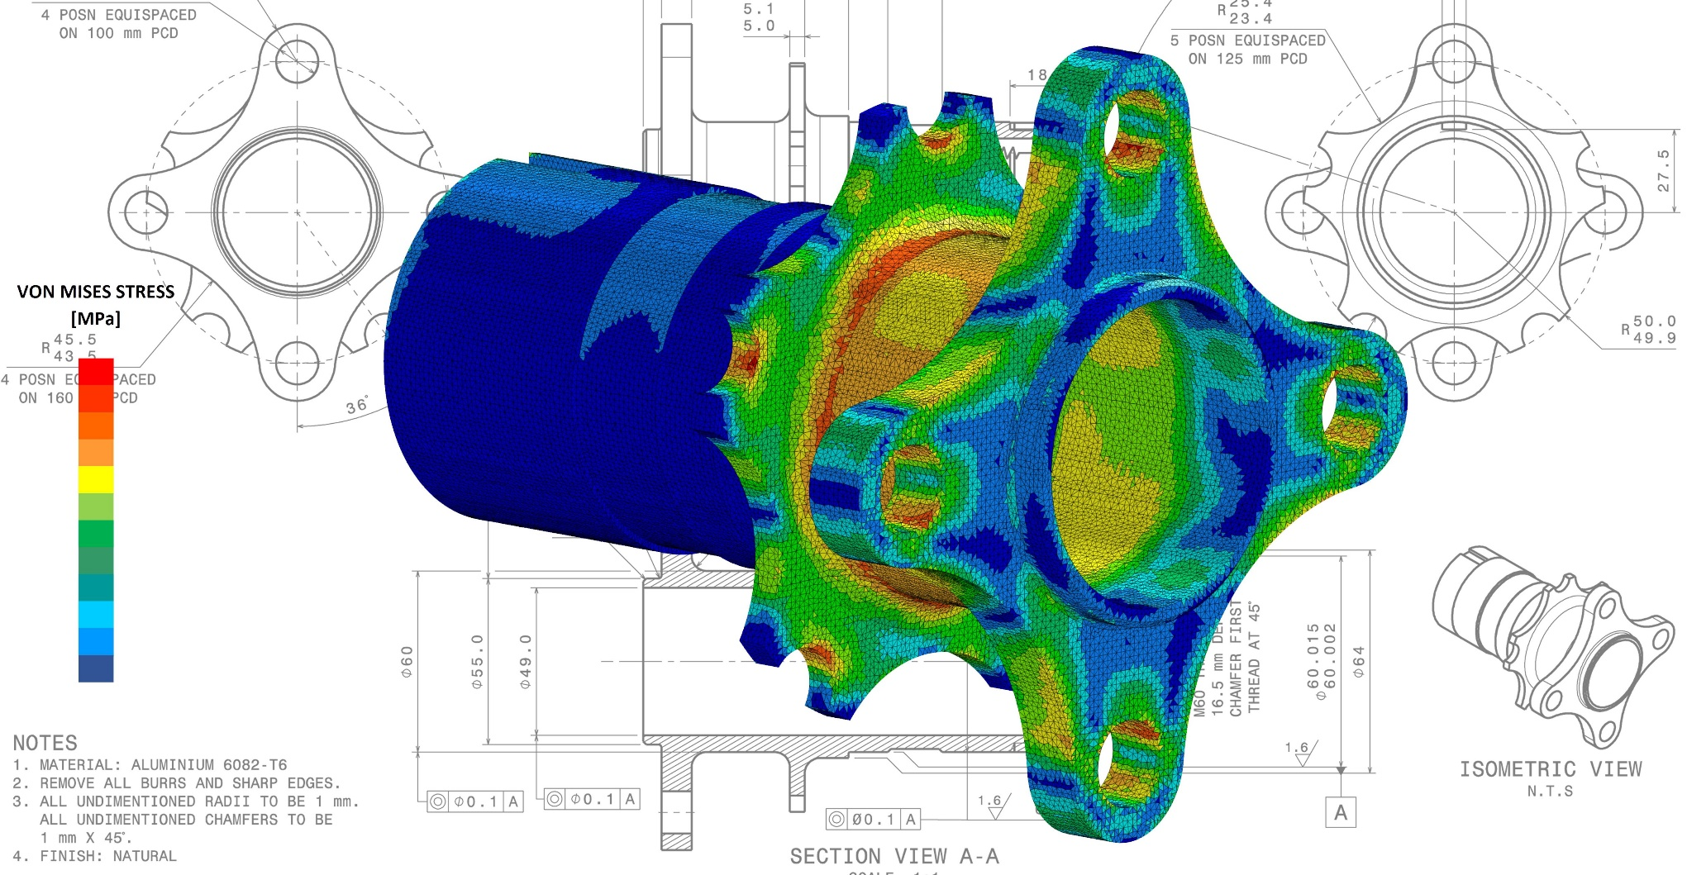
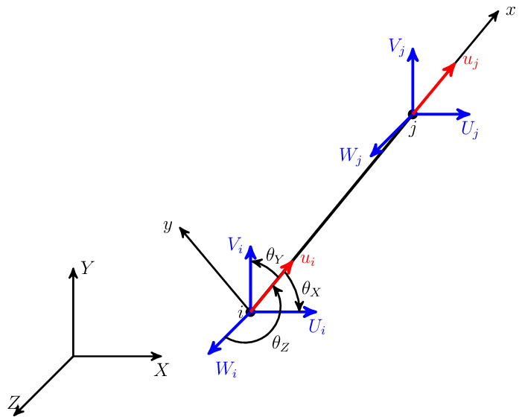
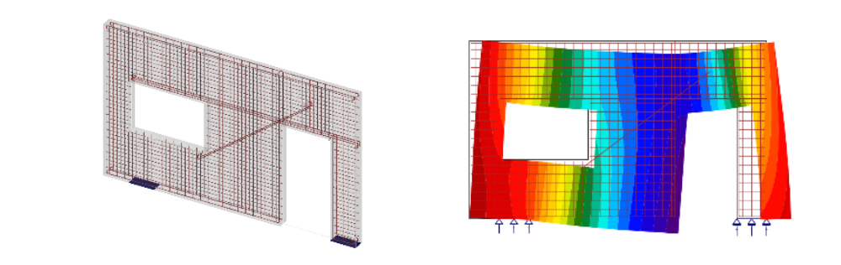
Structural elements
Bar
Wall
Slab
Shell
3D
https://blog.spatial.com/finite-element-modeling

Slide 9
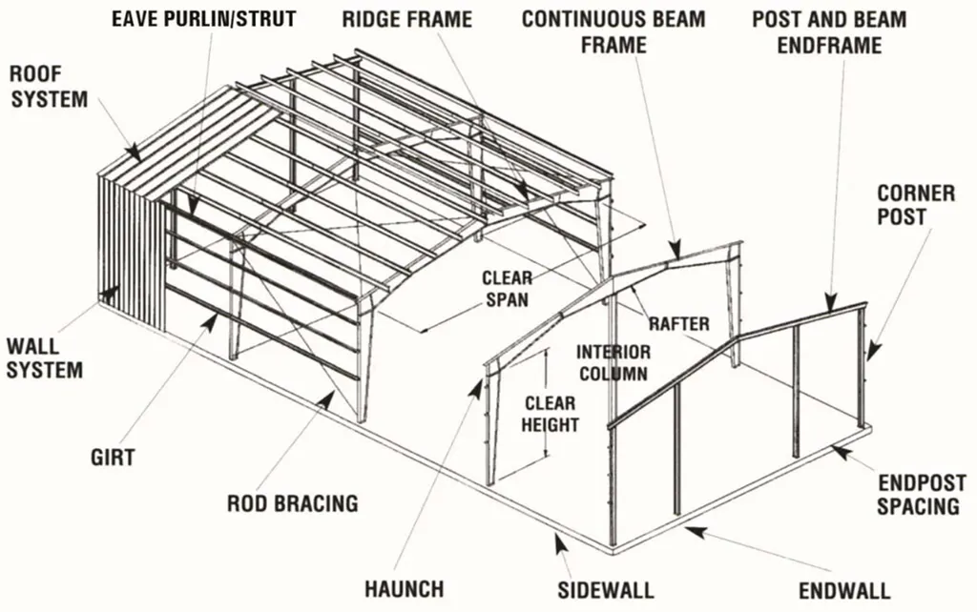
Structural system
Wind load
Frame action
Wind load
Photo from NorSteel Buildings

Slide 10
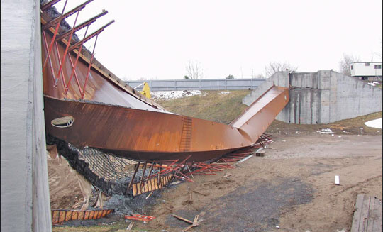
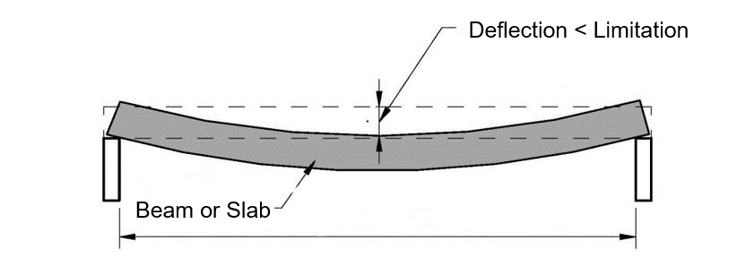
Limit state design
Serviceability limit state (1.)
Ultimate limit state (2.)
Deformations
Deflections
Vibrations
Cracks
EQU – loss of equilibrium
STR – mechanism, rupture, loss of stability
GEO – supports and foundations
FAT – fatigue, creep
https://civildigital.com/lateral-torsional-buckling-beams-lateral-deflection-torsion/

Slide 11
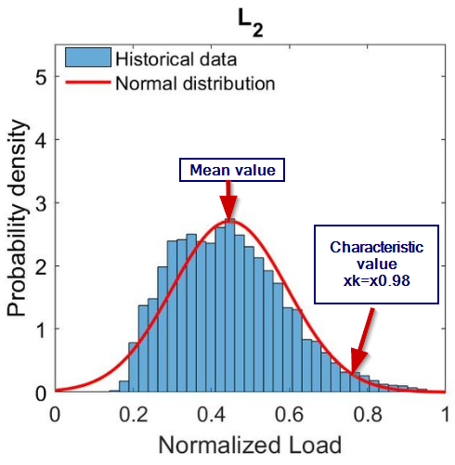
Loading
Anton V. Vykhodtsev et al.: The Cumulant Tensor Framework for the Probabilistic Power Flow

Slide 12
Loading – Safety factors
$$γ_{F}$$
Load effects
𝛾_𝐹
Load effects
Load modelling
Load effects values
$$γ_{M}$$
Load resistance
𝛾_𝑀
Load resistance
Computational model
Material, tolerances
Partial safety factors
Uncertainties

Slide 13
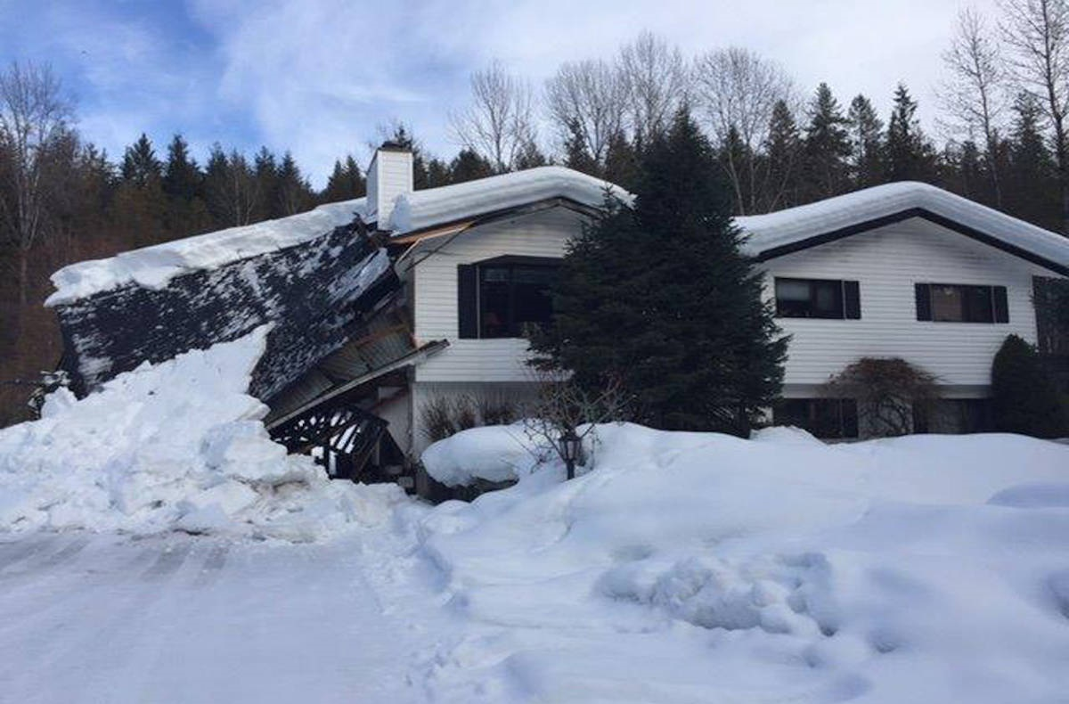
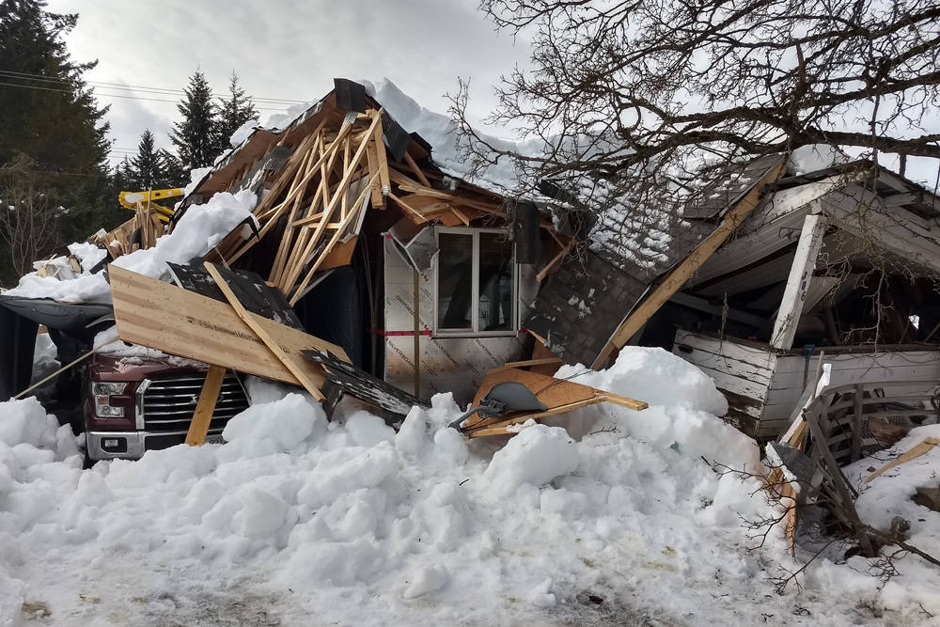
Snow load
https://www.westerlynews.ca/news/another-nakusp-roof-collapses-under-weight-of-snow/
https://www.theprogress.com/news/two-houses-in-nakusp-collapse-under-snow-load/

Slide 14

Snow load (EN 1991-1-3)
$$S=μ_{i}⋅C_{e}⋅C_{t}⋅s_{k}$$
Snow load shape coefficient
[-]
Exposure coefficient
[-]
Thermal coefficient
[-]
Characteristic value of snow on the ground [kN/m²]

Slide 15
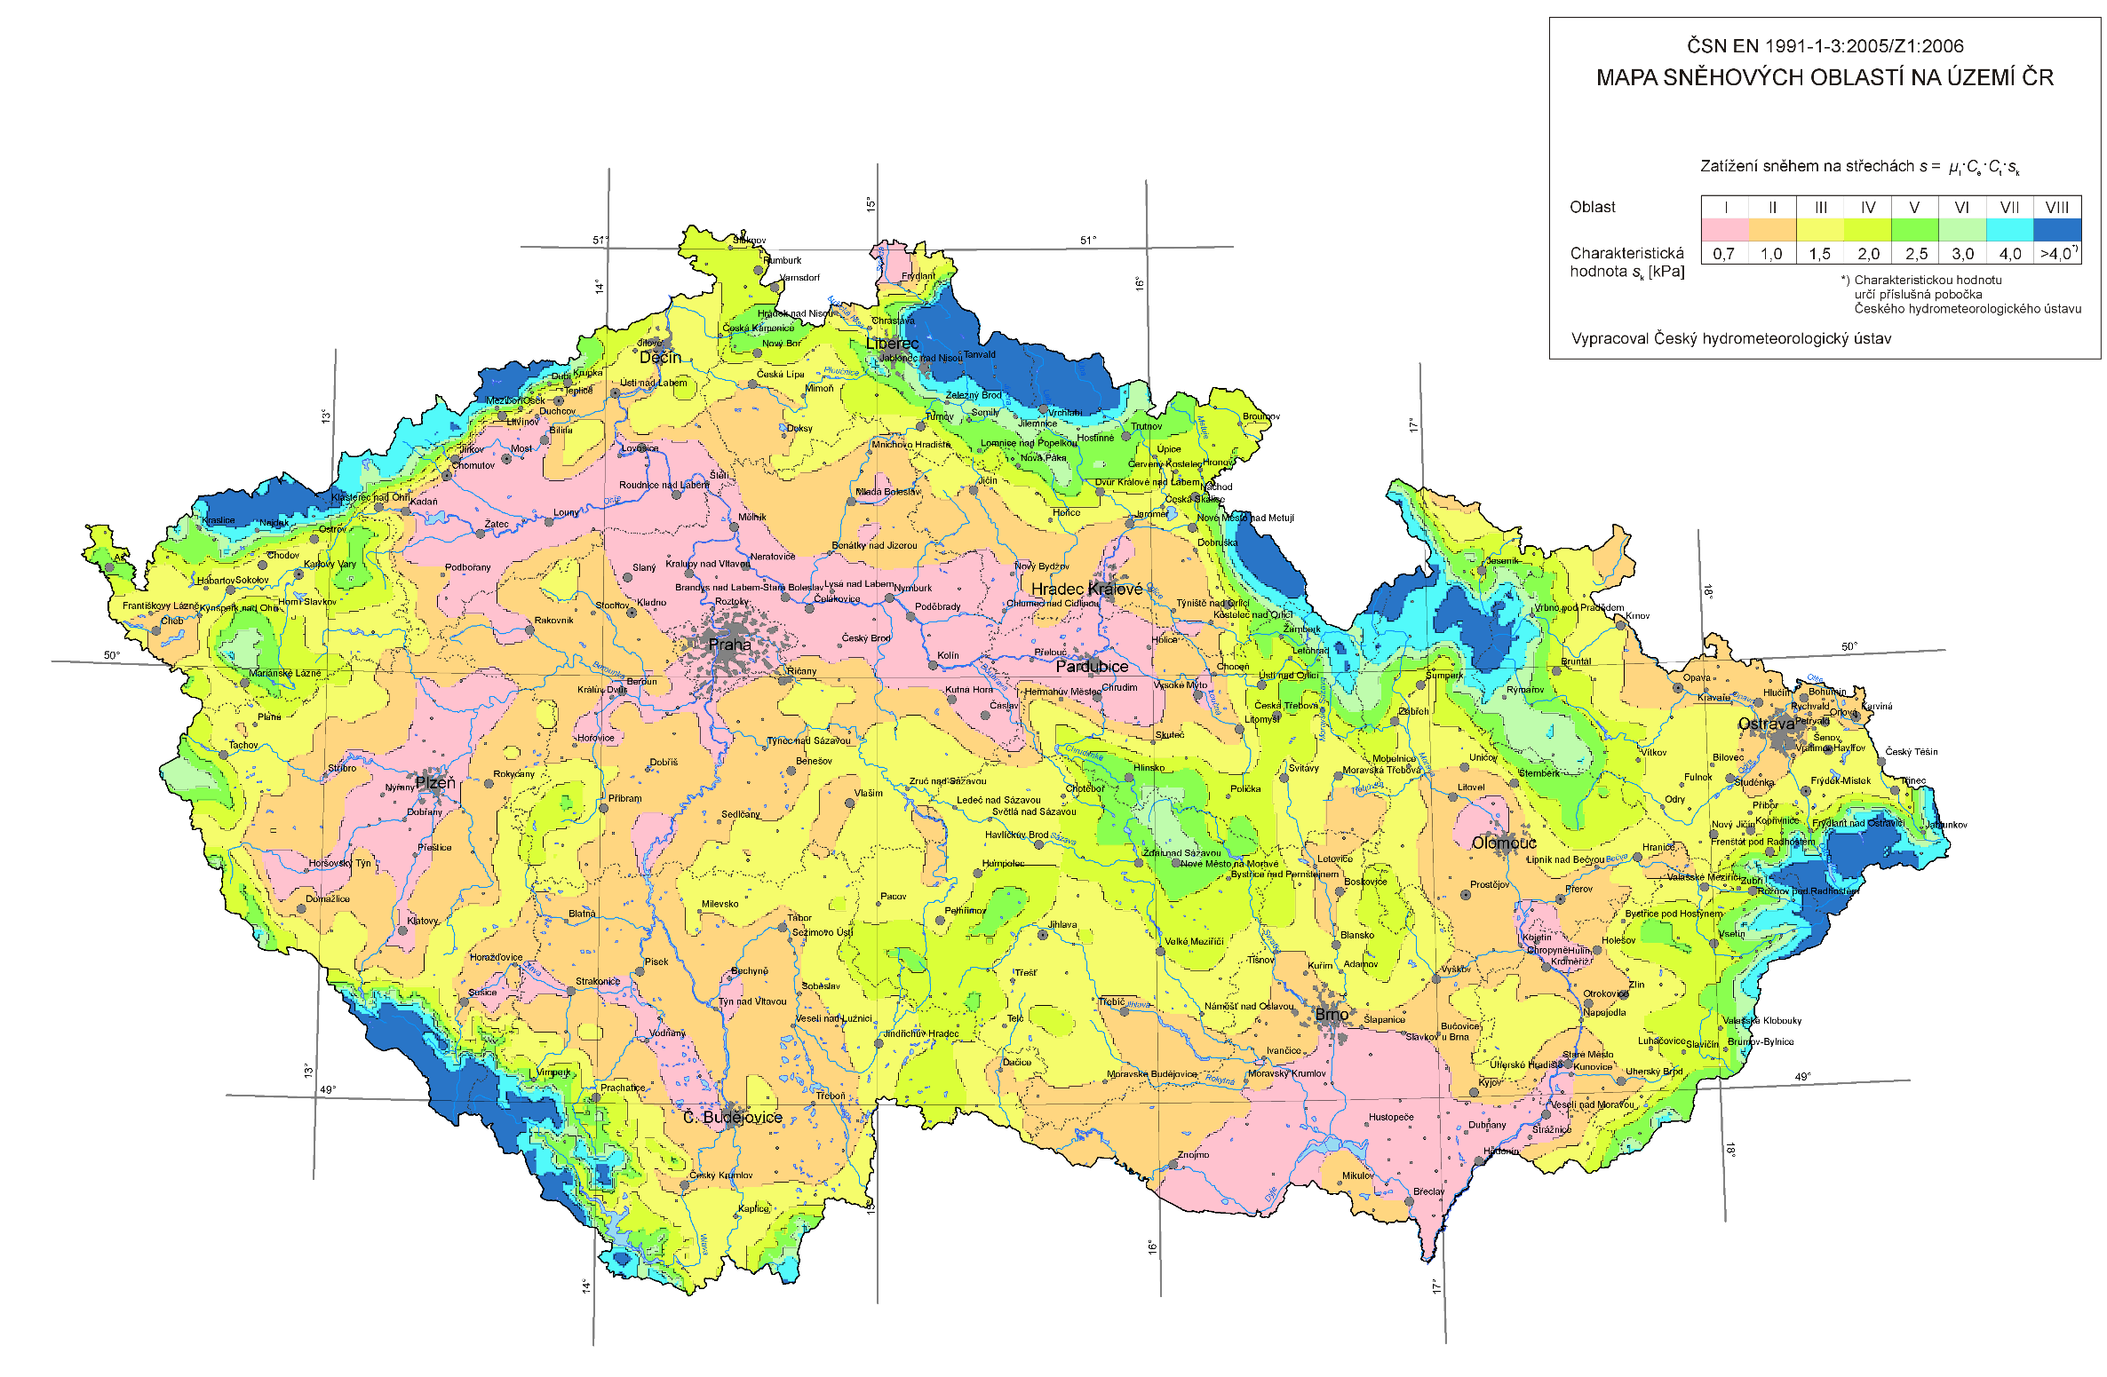
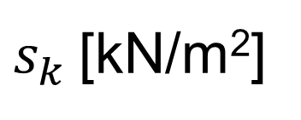
$s_{k}$[kN/m²]
https://clima-maps.info/snehovamapa/

Slide 16
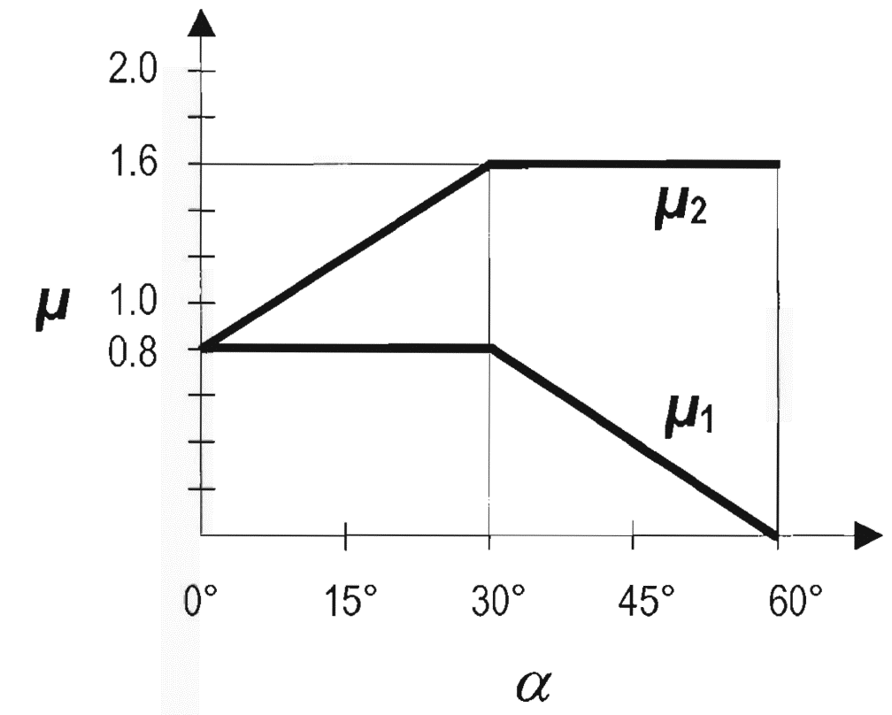
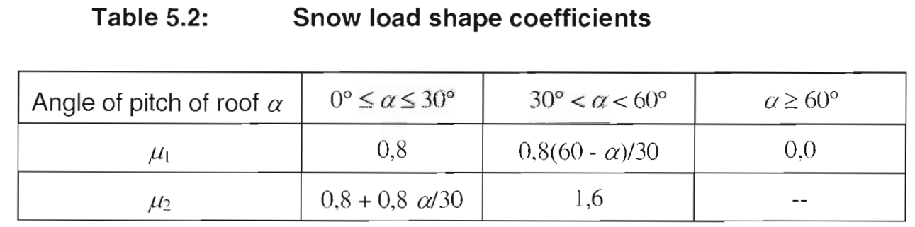
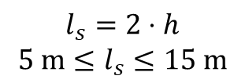




Snow load shape coefficient
Drifted
$$μ_{1}$$
$$μ_{2}$$
$$α$$
Undrifted
$$l_{s}=2⋅h$$
$$5 m≤l_{s}≤15 m$$
$$l_{s}$$
EN 1991-1-3

Slide 17
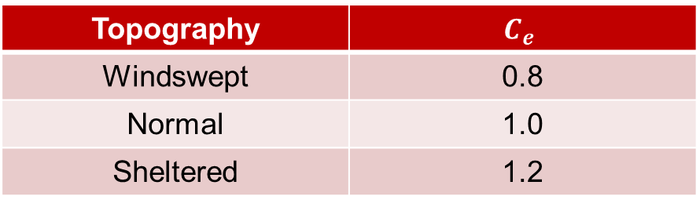
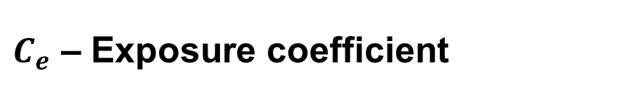

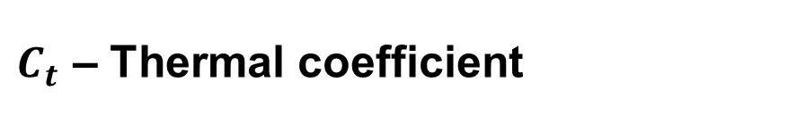
Exposure and thermal coefficients
$C_{e}$ – Exposure coefficient
$C_{t}$ – Thermal coefficient
Topography | $$C_{e}$$
Windswept | 0.8
Normal | 1.0
Sheltered | 1.2
For thermal transmittance > 1 W/m²K
Snow melts
$C_{t}<1.0$
Otherwise → $C_{t}=1.0$

Slide 18
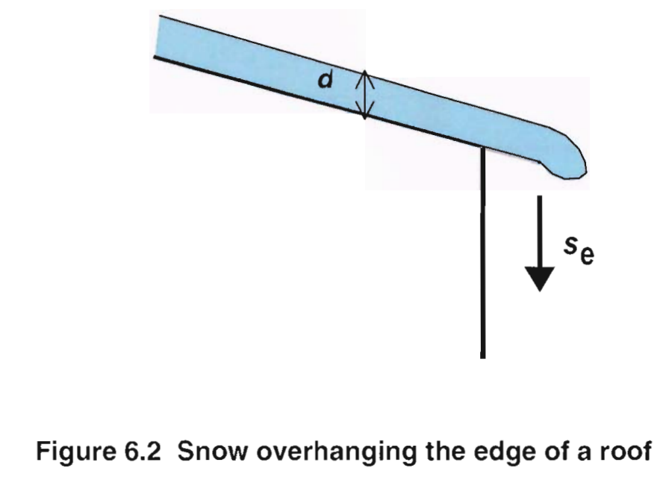
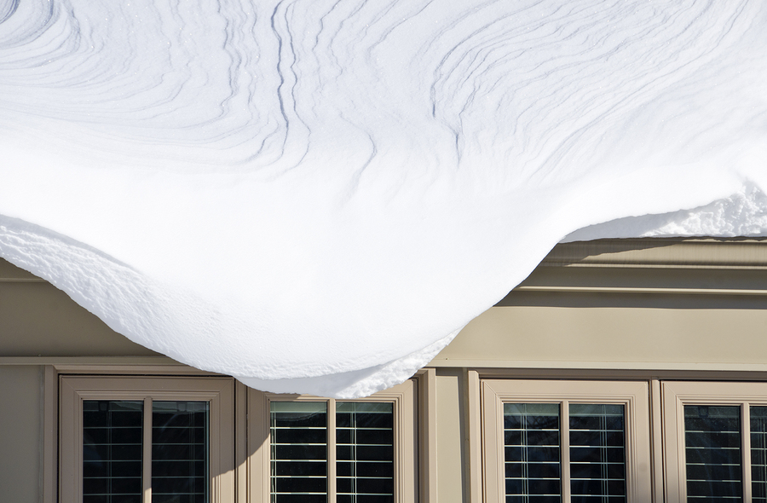
Local effects
EN 1991-1-3
https://www.claimsjournal.com/news/national/2014/10/20/256504.htm

Slide 19
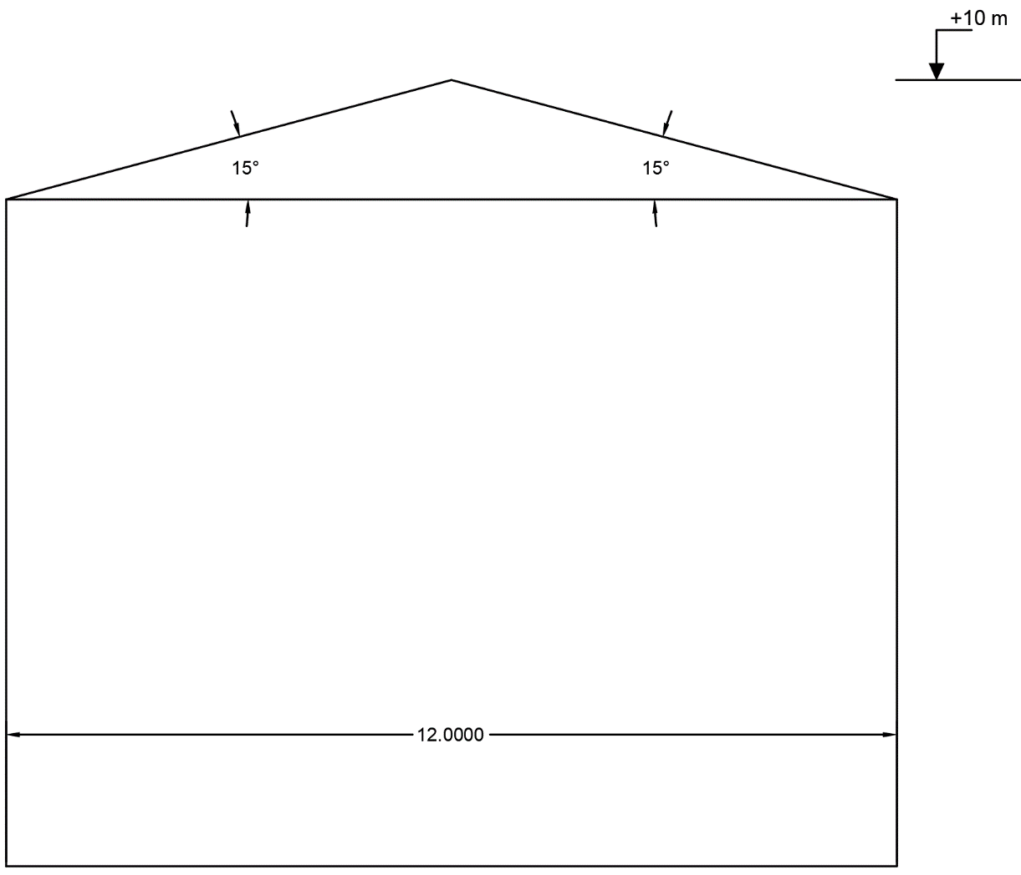

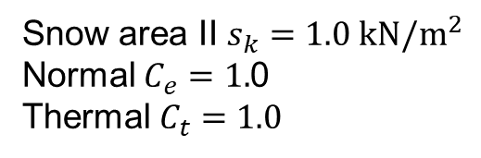
Example
$$S=μ_{i}⋅C_{e}⋅C_{t}⋅s_{k}$$
Solution:
$$S=0.8⋅1.0⋅1.0⋅1.0=0.8 kN/m^{2}$$
Snow area II $s_{k}=1.0 kN/m^{2}$
Normal $C_{e}=1.$0
Thermal $C_{t}=1.0$
EN 1991-1-3

Slide 20
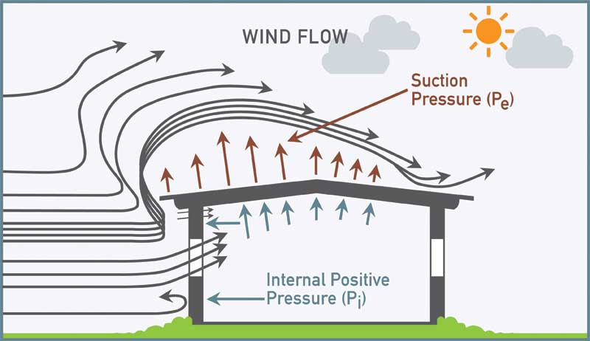
Wind load (EN 1991-1-4)
https://structville.com/2022/03/how-to-apply-wind-load-on-roofs-of-buildings.html

Slide 21

Wind load (EN 1991-1-4)

Slide 22
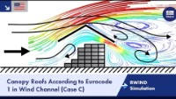
Wind load (EN 1991-1-4)

Slide 23
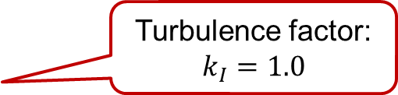
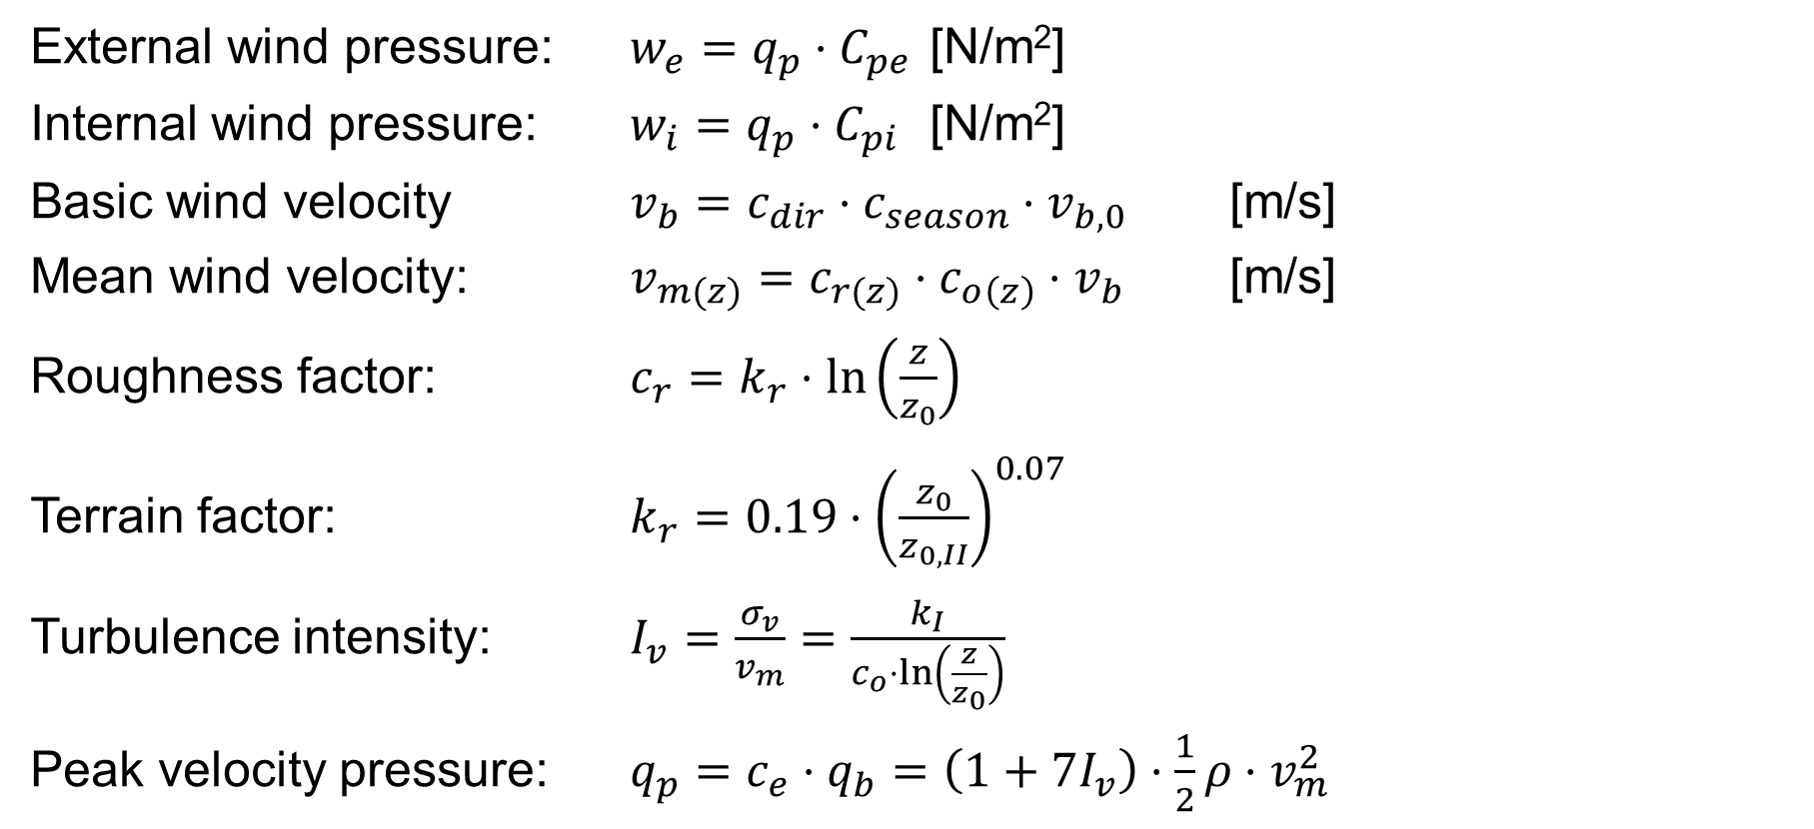
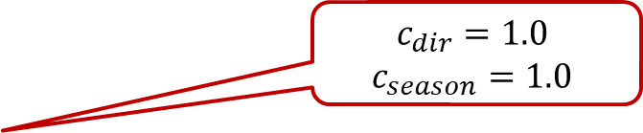
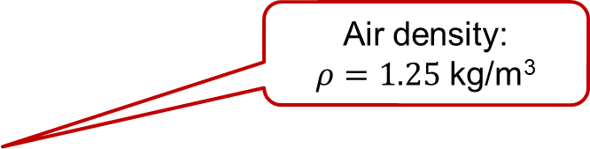
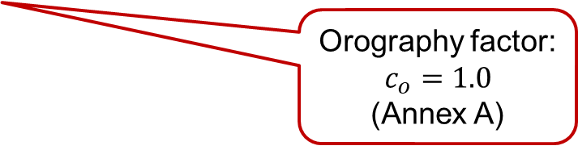
Wind load (EN 1991-1-4)
External wind pressure: $w_{e}=q_{p}⋅C_{pe}$ [N/m²]
Internal wind pressure: $w_{i}=q_{p}⋅C_{pi}$ [N/m²]
Basic wind velocity $v_{b}=c_{dir}⋅c_{season}⋅v_{b,0}$ [m/s]
Mean wind velocity: $v_{m(z)}=c_{r(z)}⋅c_{o\left(z\right)}⋅v_{b}$ [m/s]
Roughness factor: $c_{r}=k_{r}⋅\ln\left(\frac{z}{z_{0}}\right)$
Terrain factor: $k_{r}=0.19⋅{\left(\frac{z_{0}}{z_{0,II}}\right)}^{0.07}$
Turbulence intensity: $I_{v}=\frac{σ_{v}}{v_{m}}=\frac{k_{I}}{c_{o}⋅\ln\left(\frac{z}{z_{0}}\right)}$
Peak velocity pressure: $q_{p}=c_{e}⋅q_{b}=\left(1+7I_{v}\right)⋅\frac{1}{2}ρ⋅v_{m}^{2}$
$$c_{dir}=1.0$$
$$c_{season}=1.0$$
Orography factor:
$$c_{o}=1.0$$
(Annex A)
Turbulence factor:
$$k_{I}=1.0$$
Air density:
$ρ=1.25$ kg/m³

Slide 24
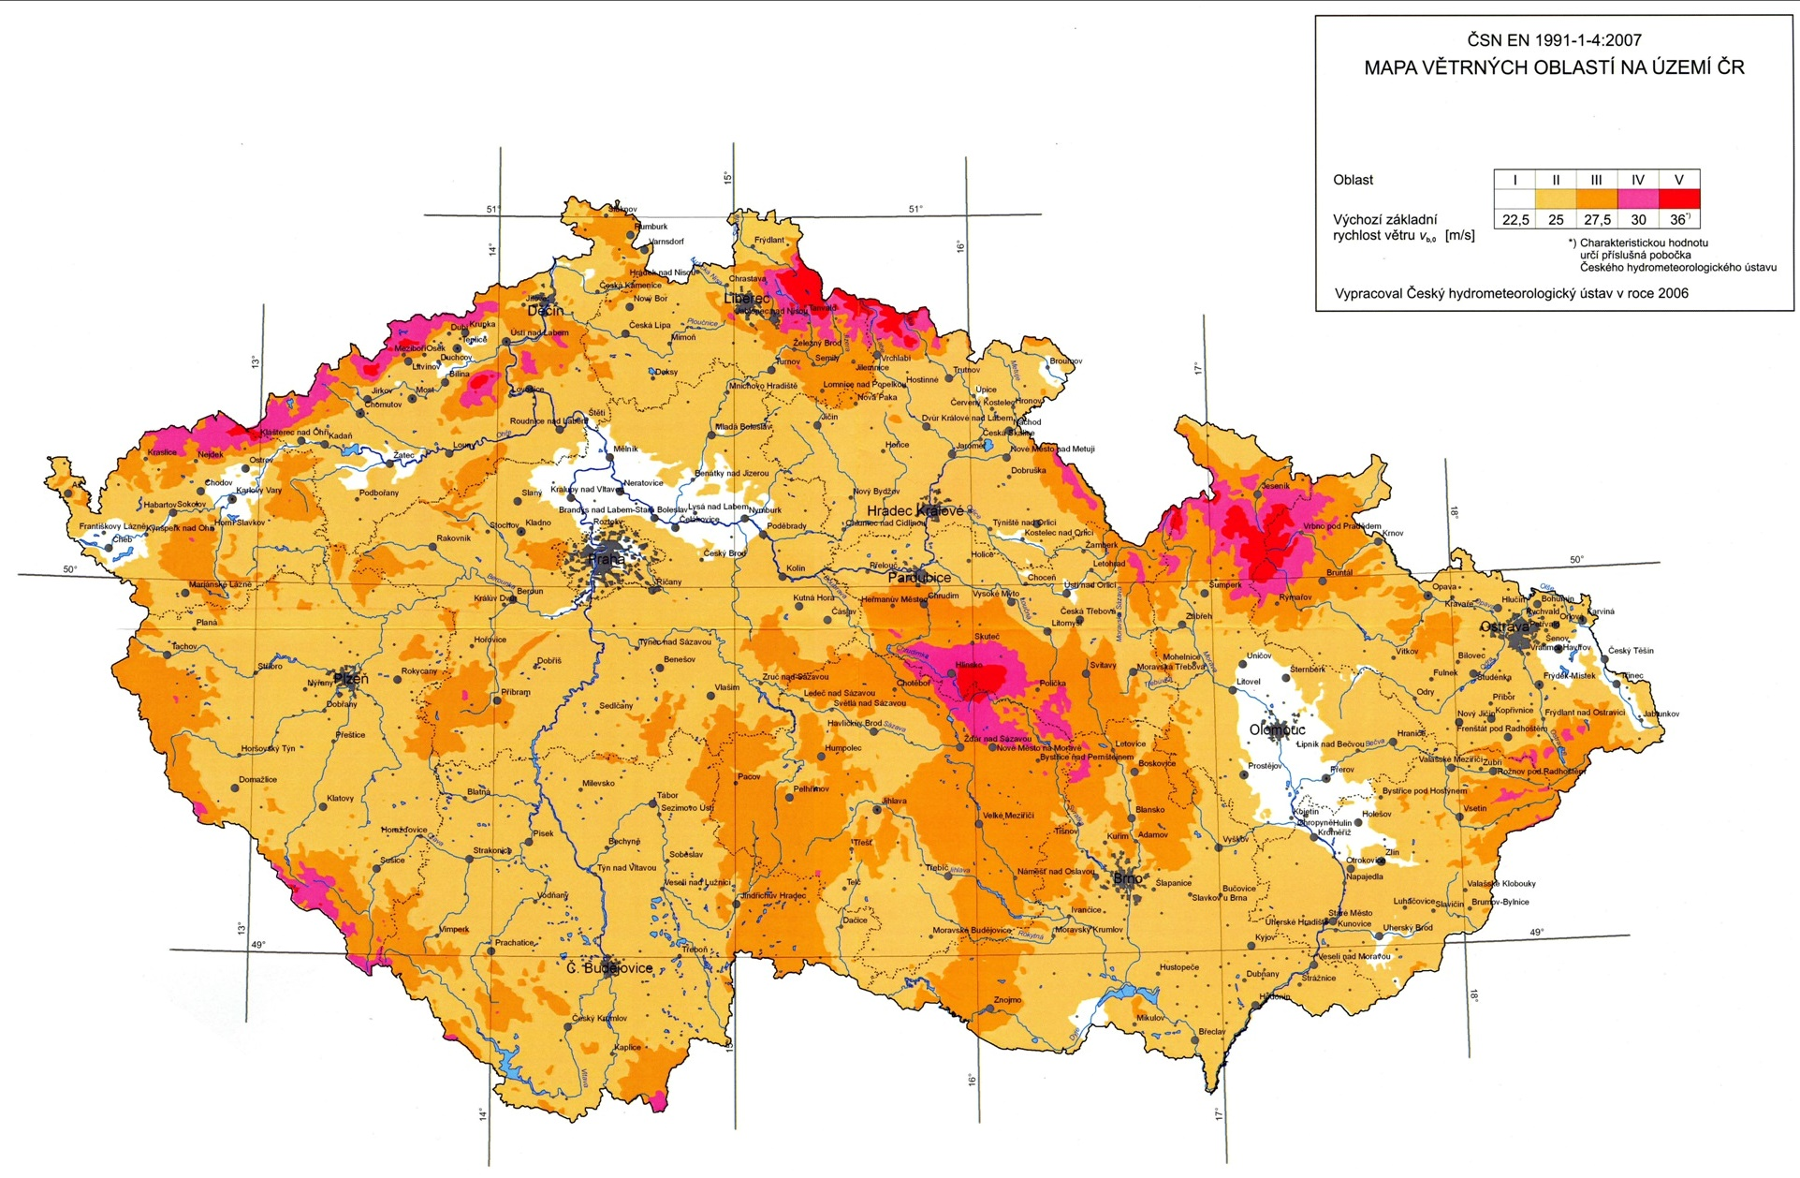
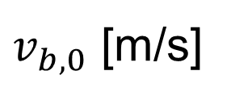
$v_{b,0}$ [m/s]
https://www.dlubal.com/cs/reseni/online-sluzby/oblasti-zatizeni-snehem-vetrem-a-zemetresenim

Slide 25
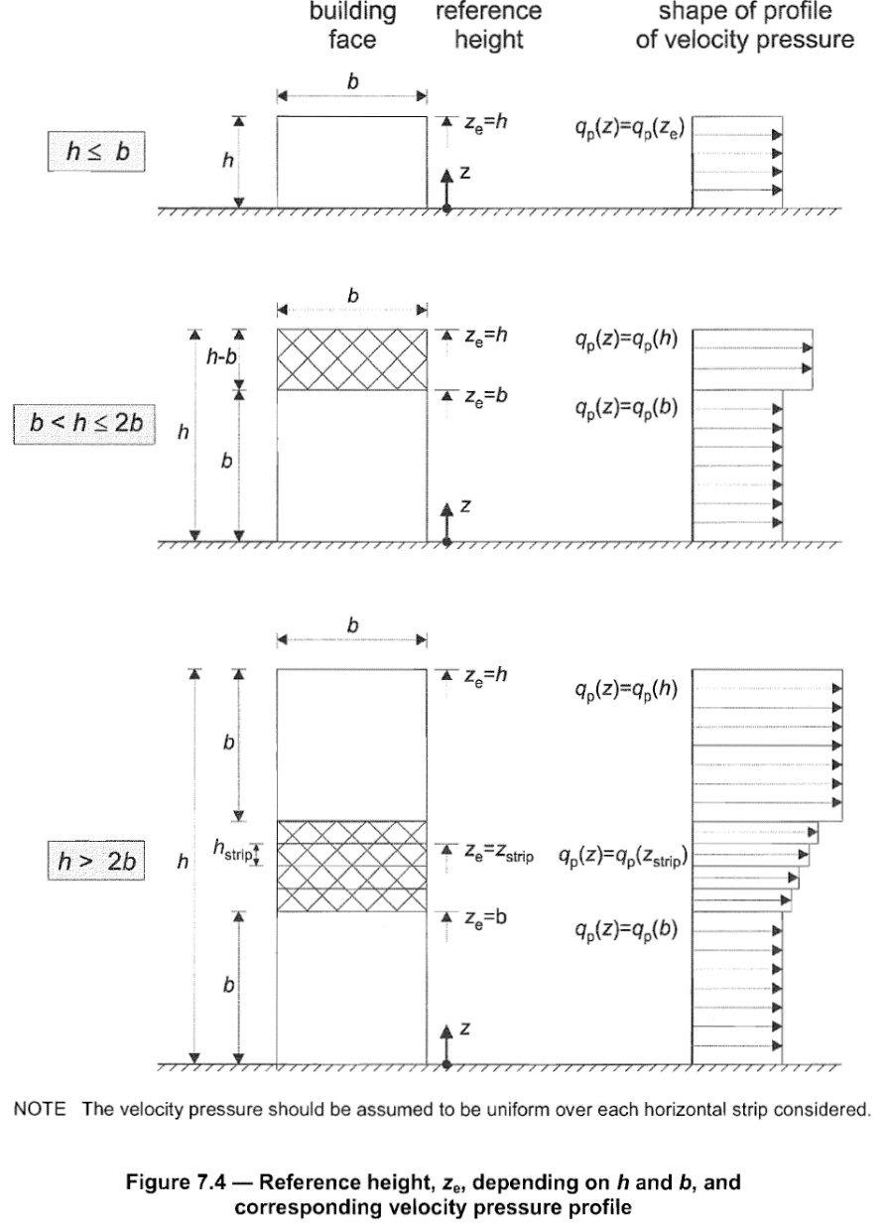
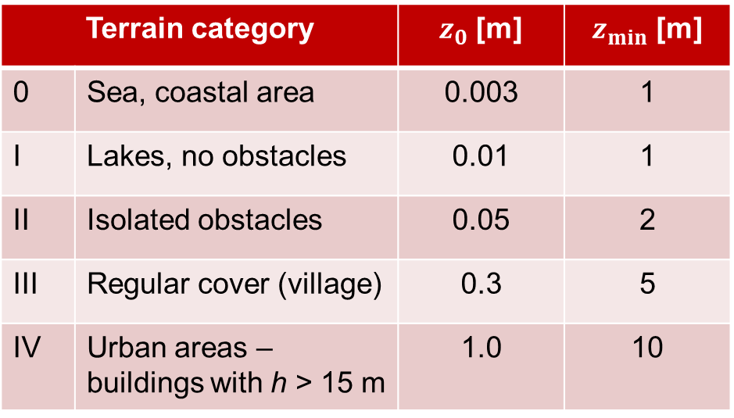

Wind load (EN 1991-1-4)
Terrain category |  | $z_{0}$ [m] | $z_{min}$ [m]
0 | Sea, coastal area | 0.003 | 1
I | Lakes, no obstacles | 0.01 | 1
II | Isolated obstacles | 0.05 | 2
III | Regular cover (village) | 0.3 | 5
IV | Urban areas – buildings with h > 15 m | 1.0 | 10
Reference height $z=\max\left\{z;z_{min}\right\}$
EN 1991-1-4

Slide 26
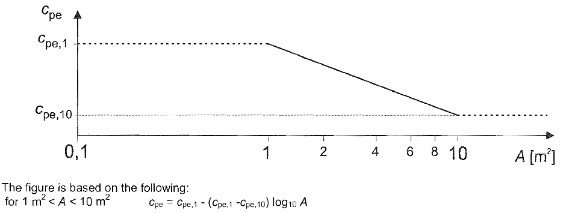
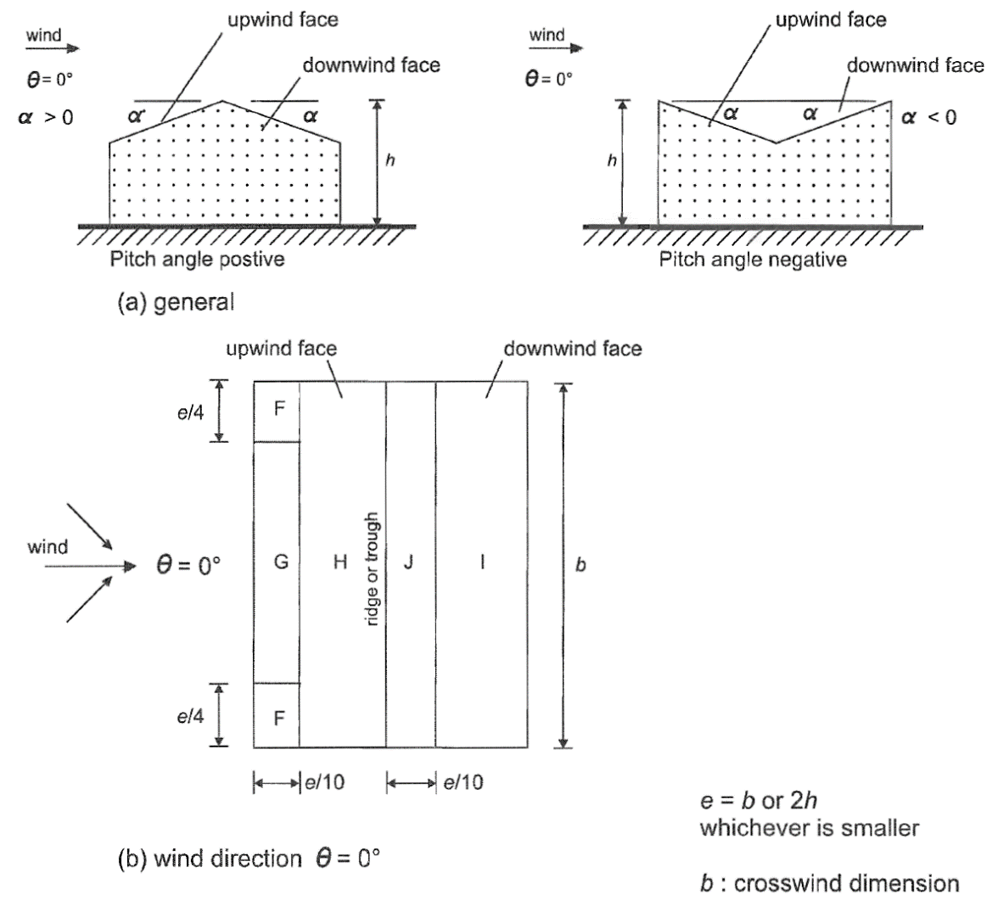
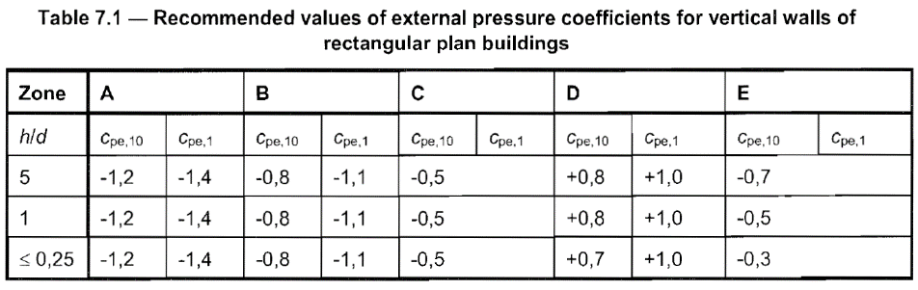
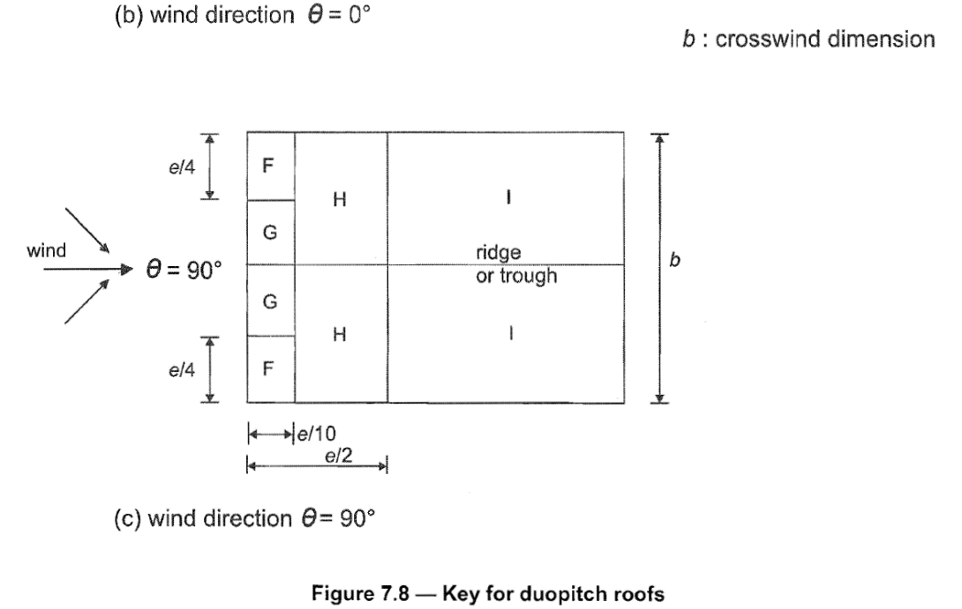
External pressure coefficient $c_{pe}$
EN 1991-1-4

Slide 27


Slide 28
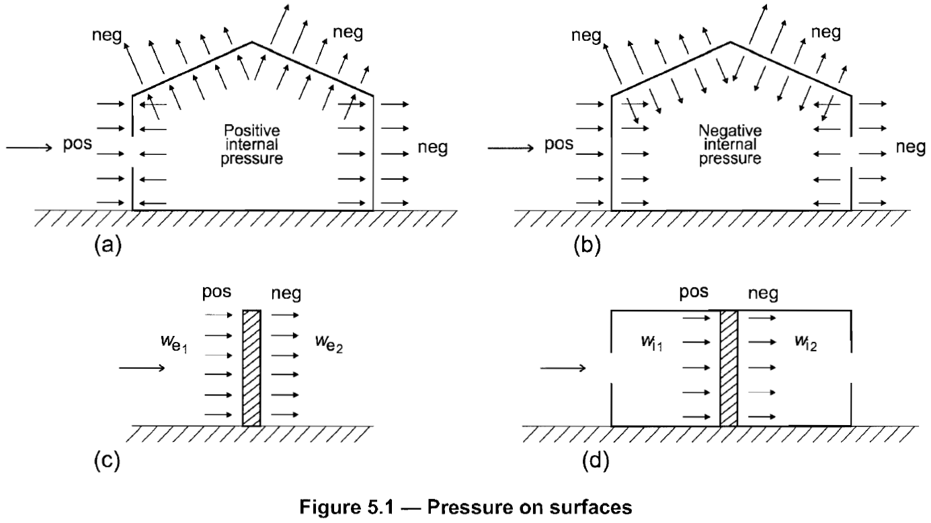
Wind – External & Internal
EN 1991-1-4

Slide 29
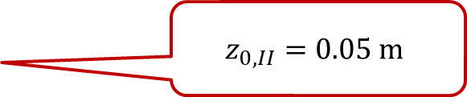







Example
$w_{suction}=q_{p}⋅C_{p,suction}$ [N/m²]
$w_{pressure}=q_{p}⋅C_{p,pressure}$ [N/m²]
$v_{b}=c_{dir}⋅c_{season}⋅v_{b,0}$ [m/s]
$v_{m}=c_{r}⋅c_{o}⋅v_{b}$ [m/s]
$c_{r}=k_{r}⋅\ln\left(\frac{z}{z_{0}}\right)$
$k_{r}=0.19⋅{\left(\frac{z_{0}}{z_{0,II}}\right)}^{0.07}$
$I_{v}=\frac{σ_{v}}{v_{m}}=\frac{k_{I}}{c_{o}⋅\ln\left(\frac{z}{z_{0}}\right)}$
$q_{p}=c_{e}⋅q_{b}=\left(1+7I_{v}\right)⋅\frac{1}{2}ρ⋅v_{m}^{2}$ [N/m²]
Reference height
$$z=\max\left\{z;z_{min}\right\}$$
Building height
$$c_{dir}=1.0$$
$$c_{season}=1.0$$
Orography factor:
$$c_{o}=1.0$$
(Annex A)
Wind area IV $v_{b,0}=30$ m/s
Terrain category III $z_{0}=0.3 m;z_{min}=5 m$
Orography factor $c_{o}=1.0$
Pressure coefficients
$c_{pe1}=−0.9$ (suction)
$c_{pe2}=+0.2$ (pressure)
$c_{pi1}=+0.$6 (internal positive)
$c_{pi2}=−$0.375 (internal negative)
$c_{p,suction}=c_{pe1}−c_{pi1}$
$c_{p,pressure}=c_{pe2}−c_{pi2}$
$$z_{0,II}=0.05 m$$
Turbulence factor:
$$k_{I}=1.0$$
Air density:
$ρ=1.25$ kg/m³
EN 1991-1-4

